Slide 1
Notes:
Good afternoon everyone, My name is Naeemah Ruffin and I am from the Icahn School of Medicine at Mount Sinai. My mentor is Dr. Cappy Collins and the title of my project is closing Health Disparities through a Multilevel Approach. The setting for my project is East Harlem, a community in New York City, Manhattan where the populations is just over126k and where significant health disparities among children exist. This is an ariel picture of the Jefferson Housing projects in East Harlem where the intervention I will discuss later has been implemented.

Slide 2
Situation
Notes:
Children 17 and under make up a bout 28% of the population in East Harlem and this group represents a higher proportion than the same group in overall Manhattan which is 17% , and overall NYC which is 24%. Therefore, this population group is a significant.

Slide 3
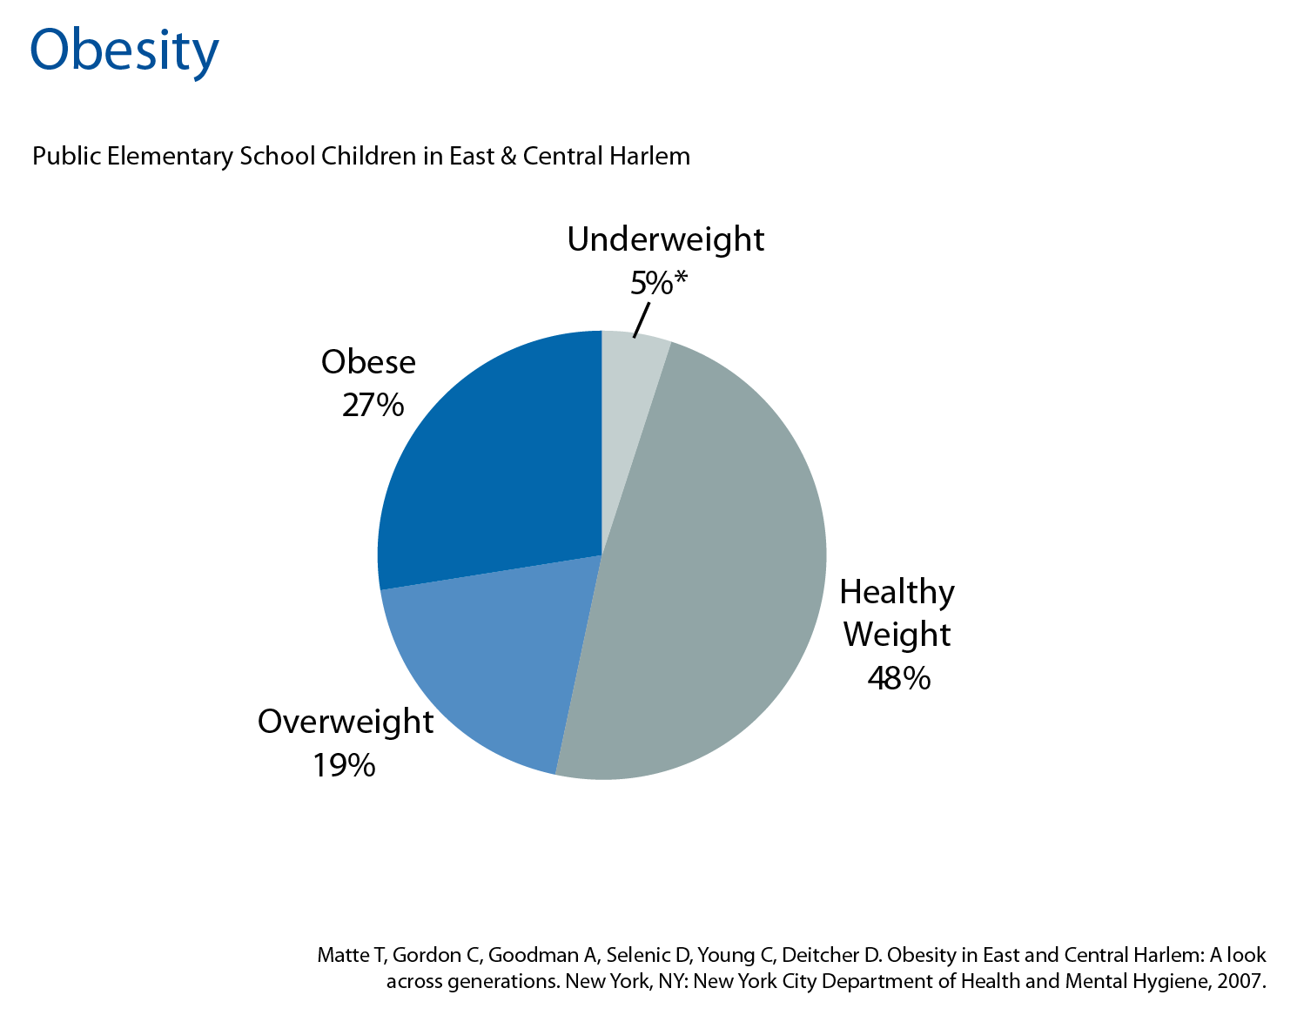
Notes:
A closer look at the health of these children reveals that almost 50% of them are Overweight and Obese. This is a chart that shows the weight categories of public Elementary school children in East & Central Harlem. This is not surprising since it has been reported that compared with children nationwide, NYC children are more likely to be obese (21% vs. 17%) and overweight (18% vs. 14%).

Slide 4
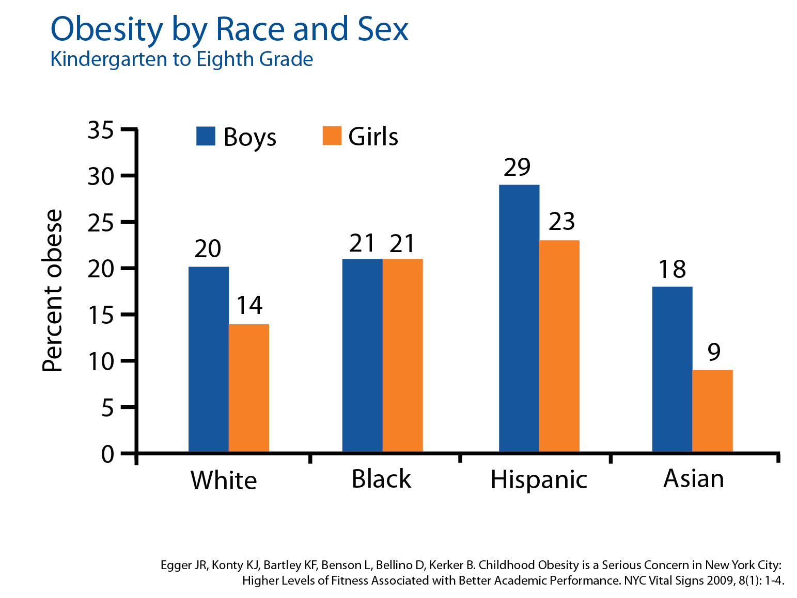
Notes:
Another look at obesity by race and sex from kindergarten to 8th grade in NYC.
This graph shows that in general, boys are more likely to be obese than girls (24% vs. 19%). This difference is seen across racial and ethnic groups, except among black students for whom there is no difference between boys and girls.
But while obesity is common among all racial and ethnic groups in kindergarten through eighth grade, Hispanic students are the most affected 29% of Hispanic boys are obese.
And as you all know, the eating and activity habits developed in childhood are crucial to lifelong health.

Slide 5
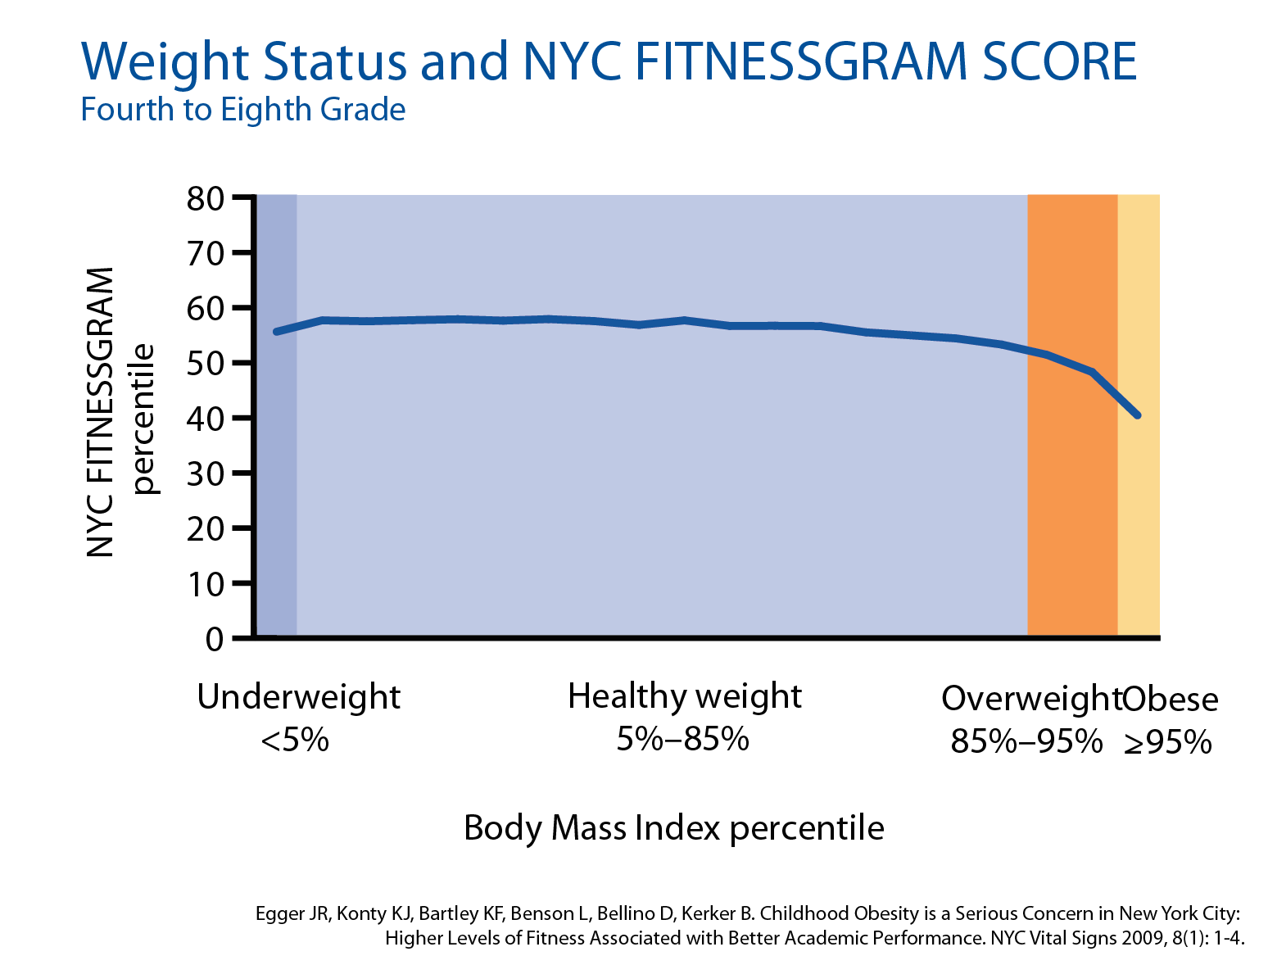
Notes:
A key tool used to measure a student’s fitness, called FITNESSGRAM, is currently used in New York City Public Schools.
The NYC FITNESSGRAM report summarizes each student's performance on fitness assessments and suggests ways to help them to optimal performance for better health based on their age and sex. NYC FITNESSGRAM supports teachers and students in effectively setting and managing personal and collective fitness goals.
The NYC FITNESSGRAM assessment for students in grades K—12 (and all parents (K-12) receive results in a personalized report) is one tool to support students as they develop personal goals for lifelong fitness. It does not compare one student to another
NYC FITNESSGRAM ia a great tool to used to to provide students, families, teachers, and health care providers another tool to create healthy futures for all our children.
On average,
Healthy weight students score in the 56th percentile on NYC FITNESSGRAM;
Overweight students score in the 49th percentile and
Obese students score in the 40th percentile.

Slide 6
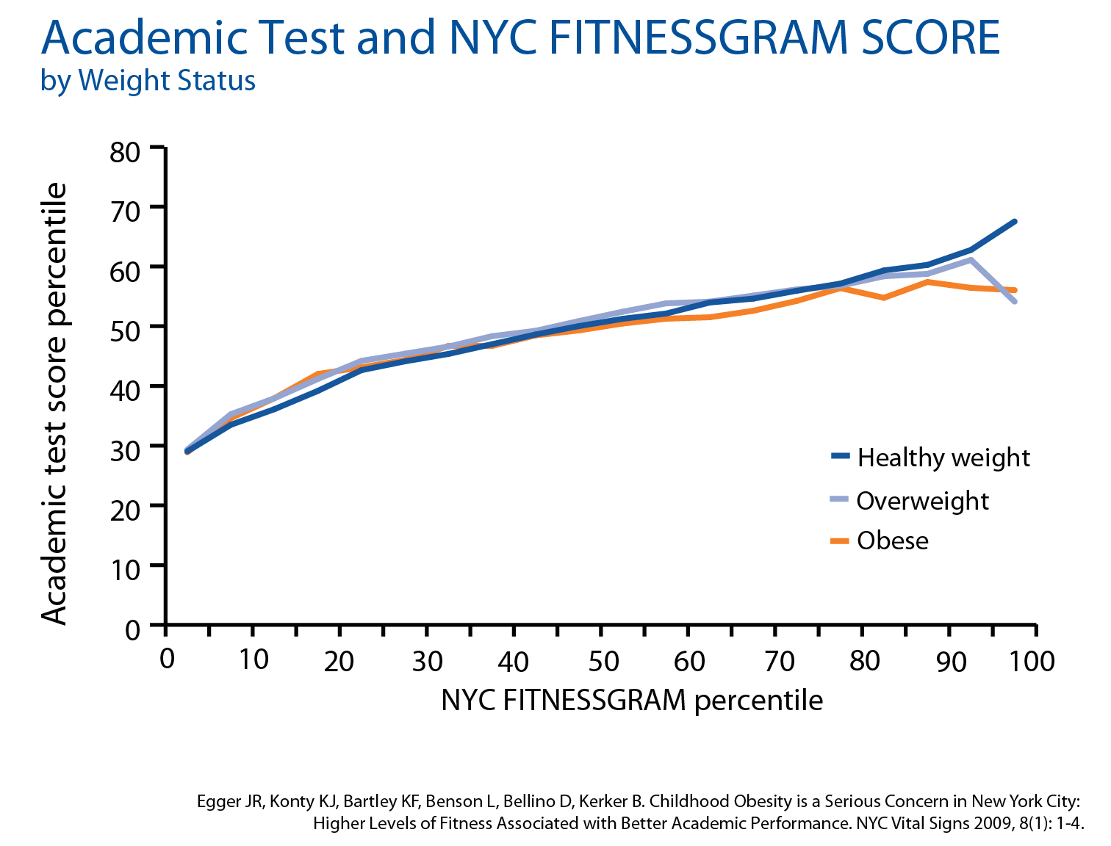
Notes:
And as you can see his in this graph, Students’ academic test scores increase with physical fitness scores across all weight categories
Standardized test score performance increases consistently with increasing NYC FITNESSGRAM score across all weight groups.

Slide 7
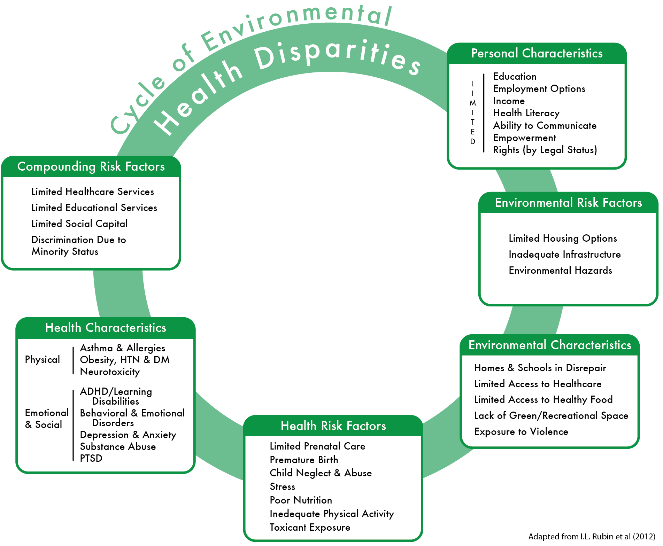
Breaking the Cycle
Notes:
Give these child health disparities, it is important to take a closer look at the broader context in which the children are living to determine which intervention would be most effective in addressing the issues.
As demonstrated on the Cycle of Environment Health Disparities, there are various aspects of a child’s environment in which they live, both in the home and outside the home, that can significantly hamper their ability to make decisions that will positively impact their life. For example….read off some.
So… a quick look at the environment in which the children are living in East Harlem is….

Slide 8
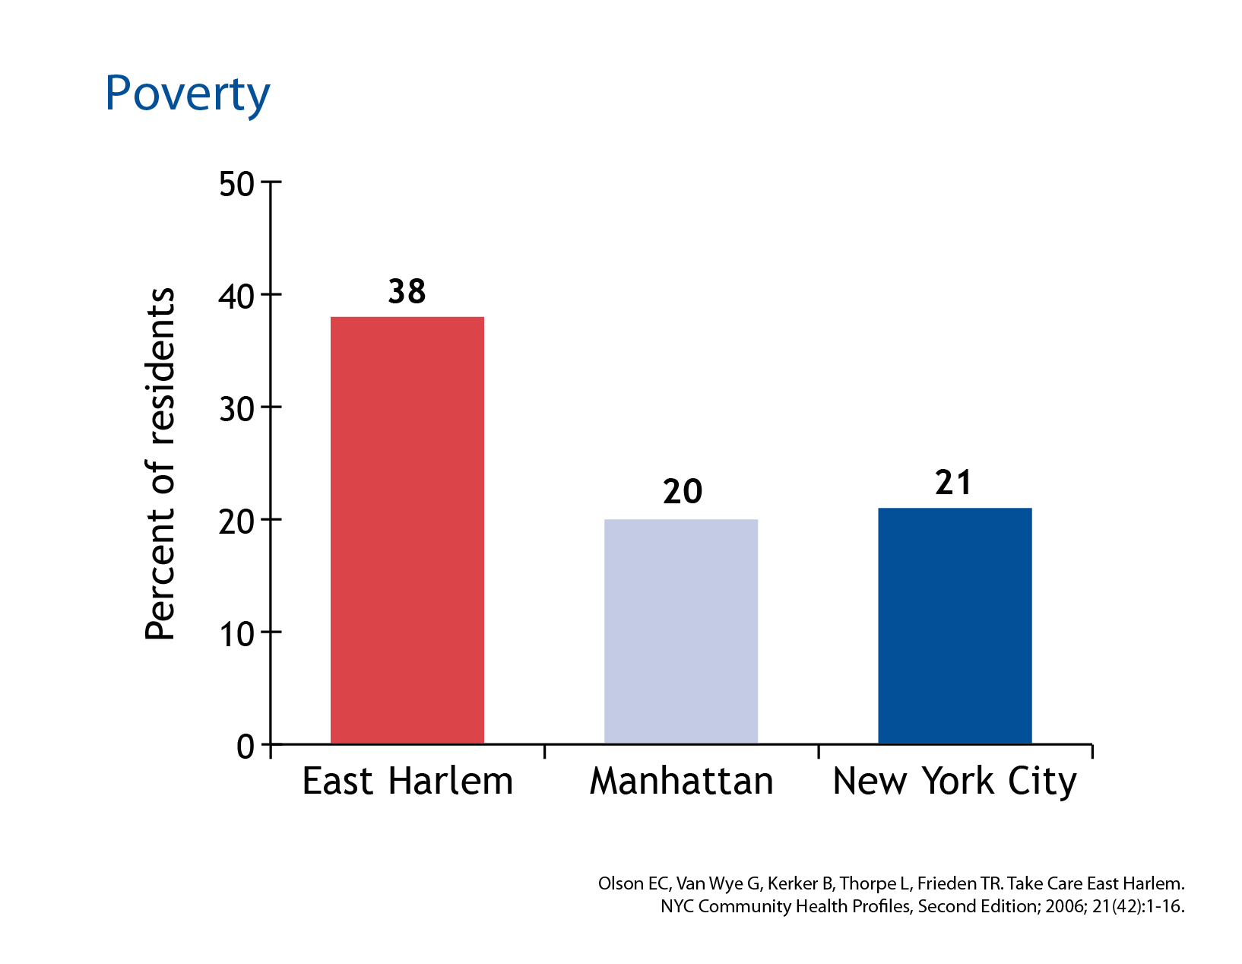
Notes:
38 % of residents in East Harlem are living in poverty vs. 20% in Manhattan overall and 21% in New York City.

Slide 9
Notes:
Hispanic and Black Residents make up about 88% of the East Harlem population vs. 42% in Manhattan and 51% in NYC.

Slide 10
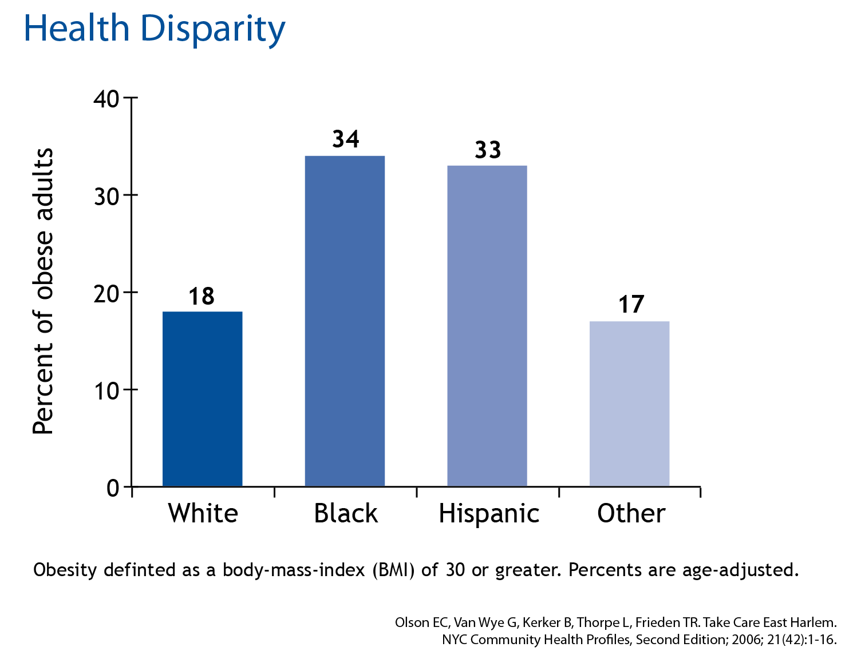
Notes:
A look at the parents of these children show that over 30% tend to be obese themselves

Slide 11
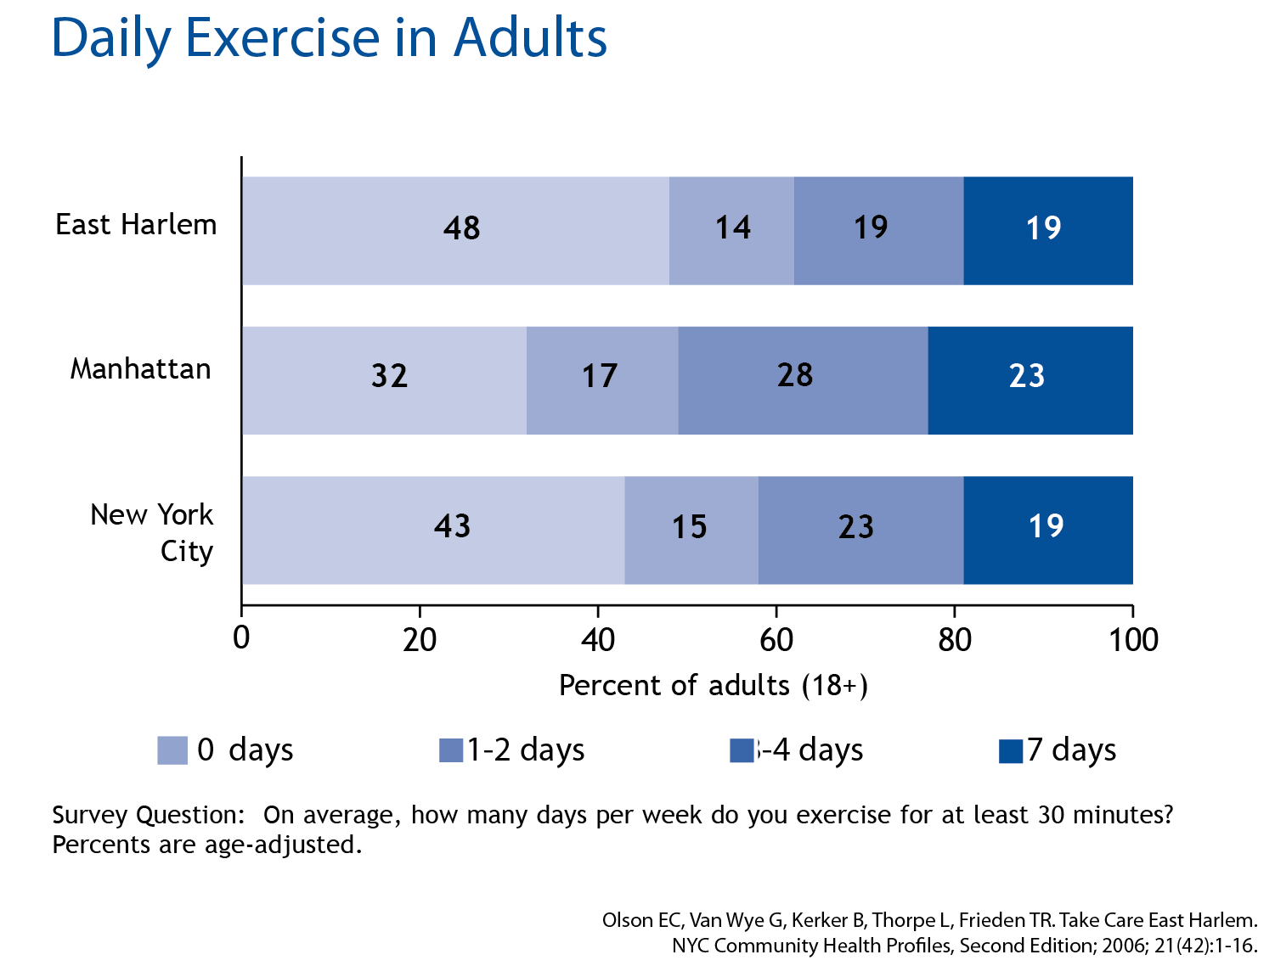
Notes:
Primarily driven by the fact that many of these adults spend little to no time exercising.

Slide 12
Notes:
And the same goes for the children as documented in a study on the exercise levels of the children of East Harlem

Slide 13
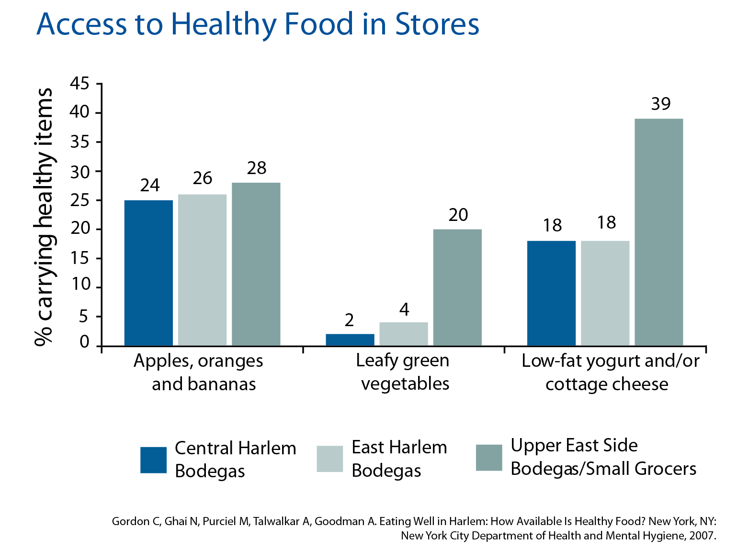
Notes:
And further exacerbating this picture is the East Harlem neighborhood is the food available in East Harlem. Access to affordable, nutritious foods such as fresh fruits and vegetables and foods low in fat and sodium, and rich in vitamins and fiber makes it easier to achieve and maintain a healthy weight but East Harlem has minimal access to these types of healthy grocery items versus what seems to be available in an Upper East Side neighbohood that is situated only blocks away from East Harlem.

Slide 14
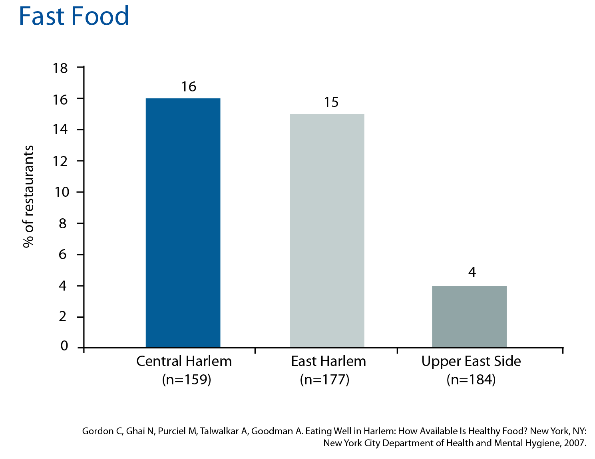
Notes:
And while restaurants are common in all 3 neighborhoods, fast-food establishments are more prevalent in East and Central Harlem than on the Upper East Side.
All of of these factors make for a very difficult environment for children to make healthy decisions.
Now, there are many interventions that can can be implemented to improve a children’s environment. For example,…next slide

Slide 15
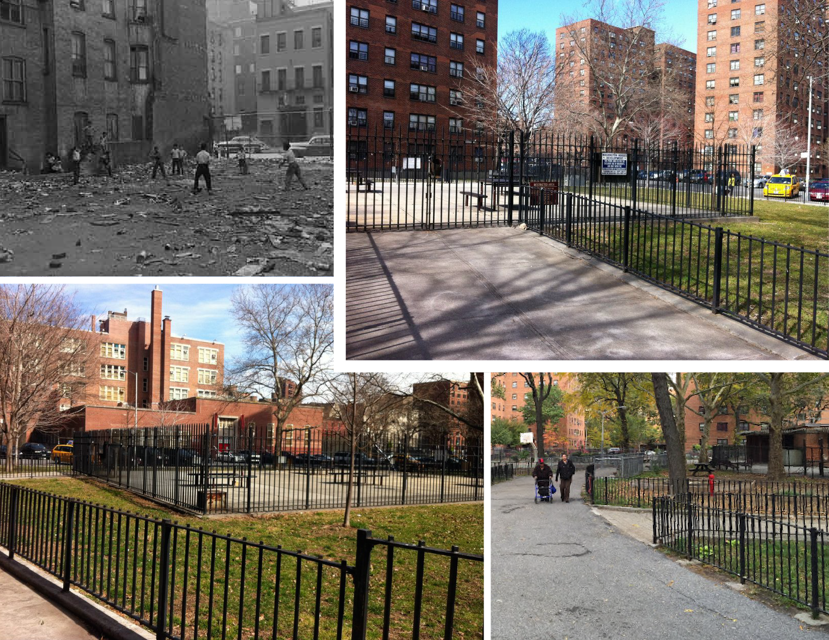
Notes:
A public housing intervention to improve the Jefferson housing projects was a great idea. Transforming the Jefferson Housing projects from the picture in the upper left hand corner to the color pictures looks amazing.
However, in the old picture, the children were seen playing stickball or what ever game, even in a dirty lot.
Today, the picture of a cleaner and orderly housing project looks great but the green grass is in a fenced off area and there are just a lot of gates and fences. And the children are clearly not using the space.

