Slide 1
A Community-Based Program to Decrease the Risk of Childhood Obesity
Student: Hope Bentley, OTS
Mentor: Jannett Lewis-Clark, MOT, OTD, OTR/L, CLT
Tuskegee University

Slide 2
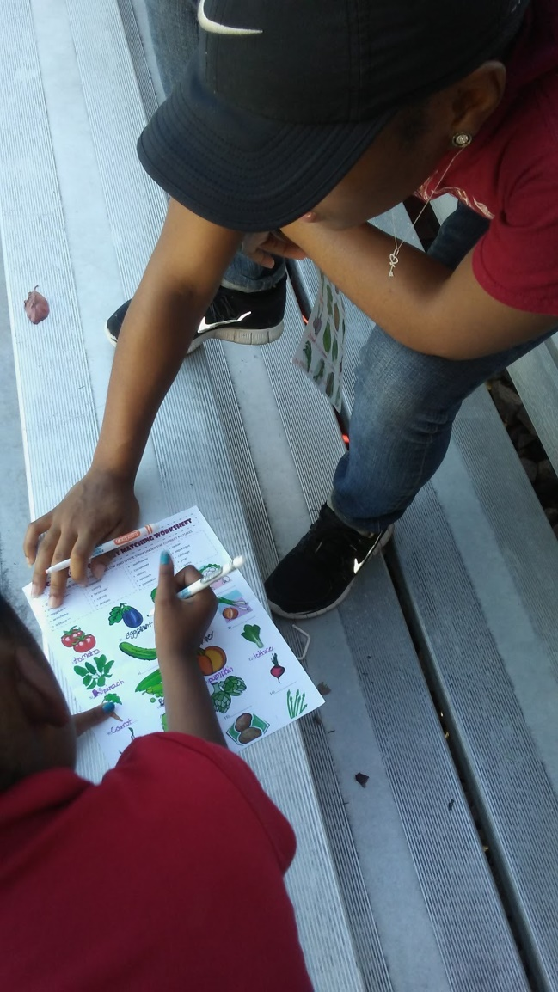
Research Question
Will a program of nutrition education and physical activity change the attitudes and behaviors related to a healthy lifestyle among children age 6-14 living in a rural setting?

Slide 3
Purpose
Purpose:
combine health education and physical activity to children age 6-14 in rural Macon County.
Goals:
Promote healthier lifestyles
Build close knit communities
To develop a sustainable pattern of healthy behaviors among the study participants

Slide 4
Significance
Why is it important to pursue this type of investigation?
rural areas children have less access to healthy foods
lifestyles in this environment will create a pattern of poor diet and physical activity.
contribute to an existing body of knowledge about prevention of obesity and long term morbidity among rural youth from disadvantage backgrounds.

Slide 5
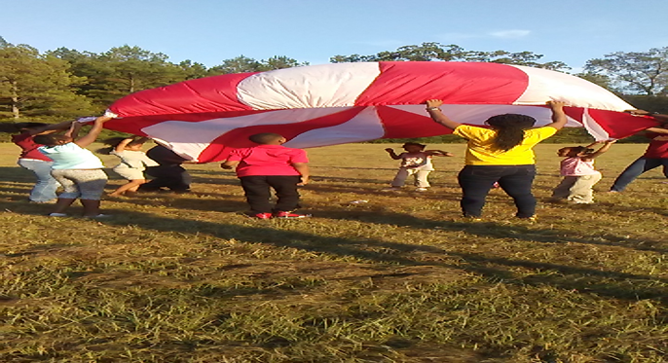
Background
Physical Activity
Most physical activity interventions target obesity (Roberts,2000)
Bicycle riding a day for a few hours can reduce a person's risk of heart disease and stroke by 50%. (Roberts,2000)
Notes:
More citations and information from articles

Slide 6
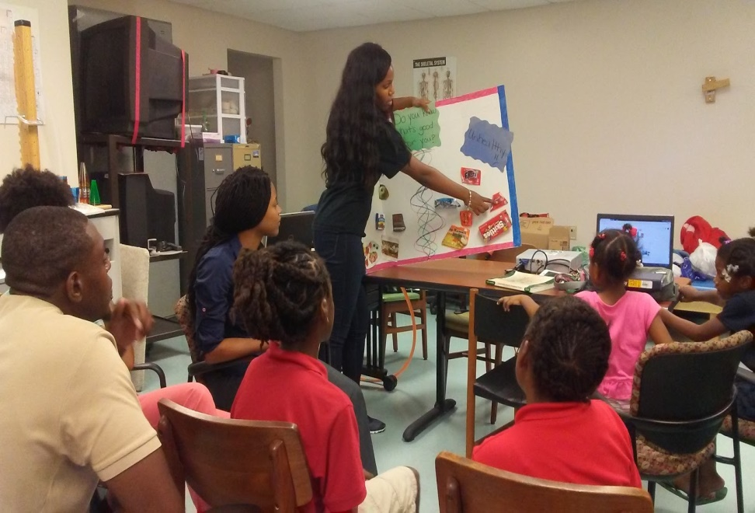
Background
Health Education
Visual aids emphasizes the importance nutrition education. (Holub & Muscher-Elzenman; Story & French, 2004;Shariff, 2008)
Identiyfing healthy foods as important for growth and health, but considerably less ability to reject unhealthy food items. (Mimi Tatlow-Golden et al, 2013)
Health education builds student’s knowledge, skills, and positive attitudes about health. (Mimi Tatlow-Golden et al, 2013)
Notes:
More information from main articles that support study

Slide 7
How are we breaking the Cycle?

Slide 8
Methodology
Population: Low income, African American males and females ages K-12 who live in Tuskegee, AL and participate in the Tuskegee Youth Safe Haven program.
Sample: 11 participants (6 girls and 5 boys) between the ages of 6-14 selected from the Tuskegee Youth Safe Haven program.
Measurement instrument:
Questionnaire adapted from the IRCM lifestyle questionnaire
Administered before and after the intervention phase
Intervention: A program of physical activity and health education for two hours a week over a period of 18 weeks.

Slide 9
Data Collection Instrument
Lifestyle Questionnaire-Behaviors and attitudes of Healthy Eating
Questions | A | B | C
How many meals do you eat a day? | 1-2 | 3 | 4 or more
How many vegetables do you eat? | <1 | 2-3 | > 4
How many fruits do you eat? | < 1 a day | 2-3 a day | More than 4 a day
How often do you eat sweet foods? (candies, chocolate, table sugar, honey, jam) | 3 times a week or less | 4-5 times a week | Every day
Do you enjoy exercising? | A lot | A little | Not at all
Do you find different ways of staying active when the weather is bad and you don’t want to go outside to exercise | Never | Sometimes | Always
Do you drink enough during and/or after a training session? | Never | Sometimes | Always
I am in school for long hours and when I get the chance to relax, I just want to sit in front of the TV | Never | Sometimes | Always

Slide 10
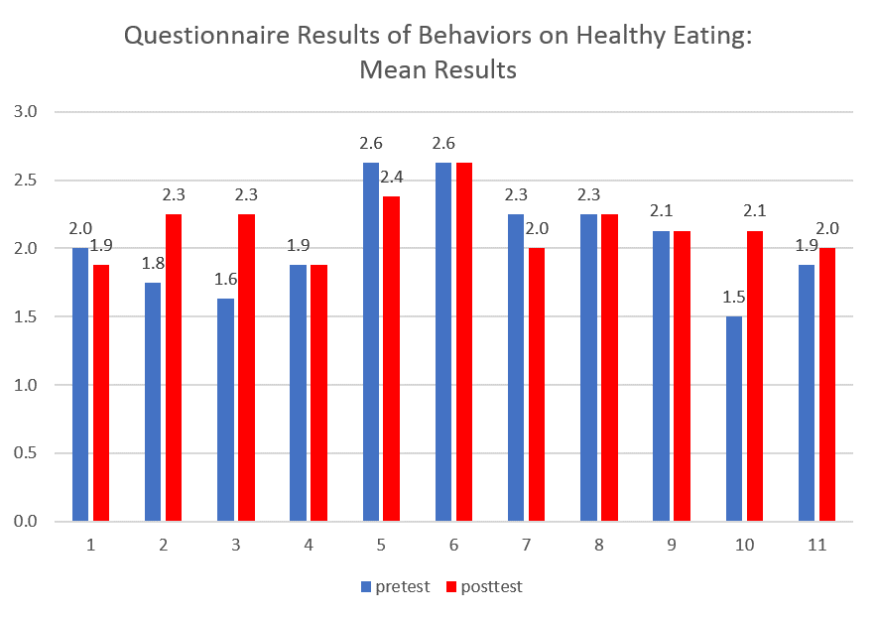
Results and Analysis
Three - slight decrease in behaviors of healthy eating.
Four - increase in their behaviors.
Four - no change

Slide 11
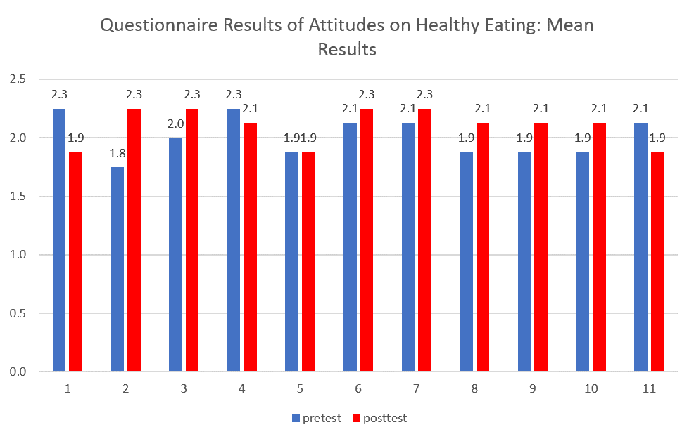
Results and Analysis
Three - slight decrease in attitudes of healthy eating.
Seven - very small increase
One – no change

Slide 12
Discussion
Strengths
Able to gain knowledge regarding healthy living and healthy eating.
Increase in healthy behaviors during the study.
Children were highly motivated to engage in activities
Children demonstrated improved social interaction skills during the course of the investigation.

Slide 13
Discussion
Limitations
Adversity of the sample challenged presenting different styles of health education.
Transportation to and from the intervention site.
Because of various age groups, challenges with selecting appropriate activities.
External and internal validity was poor because of problems with instrument and sampling type and size.

Slide 14
Conclusion
A family’s attitudes and resources
A gap between a child’s knowing healthy food choices and choosing the healthier option.
Healthy lifestyle program long term will lead to a positive impact on lifestyles.

Slide 15
Video

