Slide 1
BREAK THE CYCLE 10 CONFERENCE
Title:
A Cross-sectional Study to Assess the Relationship between Environmental Risk Factors and Malnutrition in Under Fives Born from Teenage Mothers in Chipata Compound , Lusaka, Zambia.
Student: CHALWE B. CHANDA
Supervisor: MRS. MUNYINDA N S

Slide 2
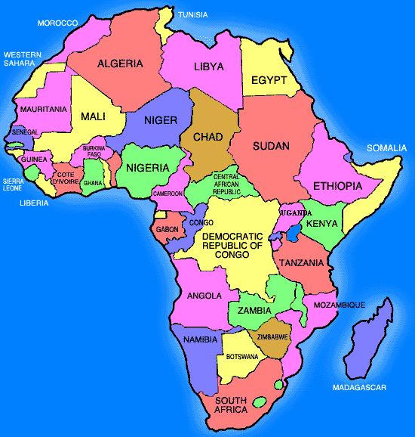

Slide 3
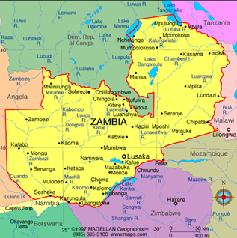
Zambia
Total population (thousands) 2012 | 14,075.1
Annual no. of births (thousands) 2012 | 608
Annual no. of under-5 deaths (thousands) 2012 | 50
GNI per capita (US$) 2012 | 1,350
Life expectancy at birth (years) 2012 | 57
Total adult literacy rate (%) 2008-2012* | 61.4
Primary school net enrolment ratio (%) 2008-2011* | 97.2
Infant mortality rate (under 1), 2012 56

Slide 4
Introduction and background
According to UNICEF-Zambia (2013) Zambia is one of 22 African countries with the highest burden of under nutrition in children under five
Thousands of children and women suffer from one or more forms of malnutrition, including micronutrient deficiencies such as vitamin A, iron, zinc, and iodine deficiencies
WHO (2013) has concluded that infection is more common when there is a shortage of adequate sanitation and hygiene and safe water for drinking, cooking and cleaning.

Slide 5
General objective
To assess the relationship between environmental risk factors and under nutrition in children born from teenage mothers of Chipata compound of Lusaka District, Zambia

Slide 6
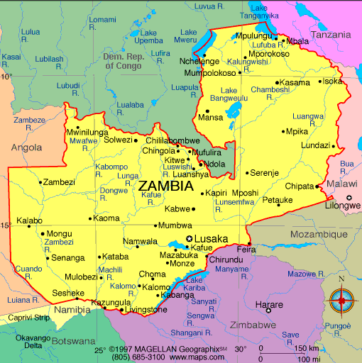


Slide 7
Objectives
To establish the sanitation status of the environment the under-five children of Chipata compound live in
To assess the housing status and its effect on the nutrition status of mothers and their under-five children
To determine the association between environmental risk factors (that is, water supply and sanitation) and nutrition status in under five children
To assess the association between teenage motherhood and nutrition status in the child

Slide 8
Research methods
Source population:
  All mothers with children aged 6months – 59 months
Sample size:
  88 mothers, calculated using Epi Info v7.1.4 of 2014
Target population:
  approximately 835 mothers

Slide 9
Study variables:
  Income
  Age of the mother,
  Family monthly marital status,
  sanitation status,
  water supply,
  housing status,
  family/father support,
  immunization status,
  mother’s level of education

Slide 10
Results: Age of Mothers & Anthropometric measures
Variable | Frequency | Percentage (%)
Age of mother 13 – 19years 20 years and over Weight for Age Z-Score (Acute Malnutrition) Adequate nutrition (-2 ≥Z-Score < +3) Moderate to severe malnutrition (-3 ≤Z score< -2) Mid-upper Arm circumference (MUAC) <12.5 Cm 12.5 Cm and above Total | 19 69 60 28 16 72 88 | 21.6 78.4 68.2 31.8 18.2 81.8 100.0

Slide 11
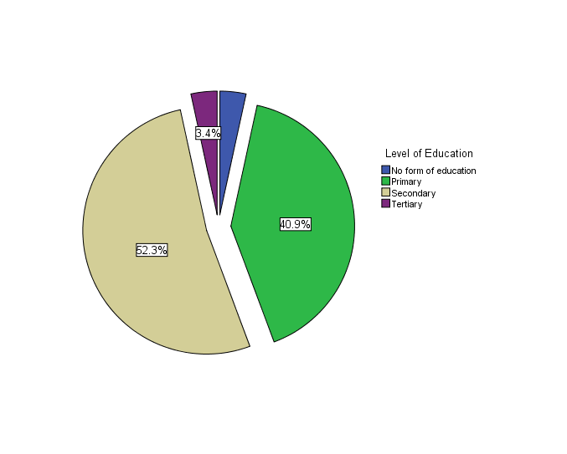
Results cont’d:
Level of Education Attained
3.4
40.9
52.3

Slide 12
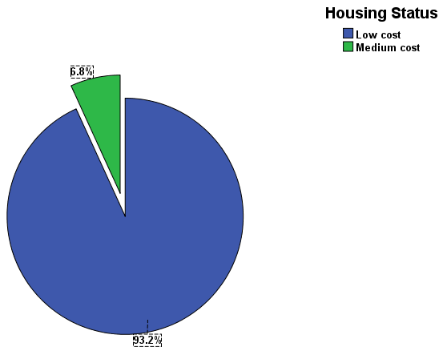
Results cont’d:
Housing Status
6.8%
93.2%

Slide 13
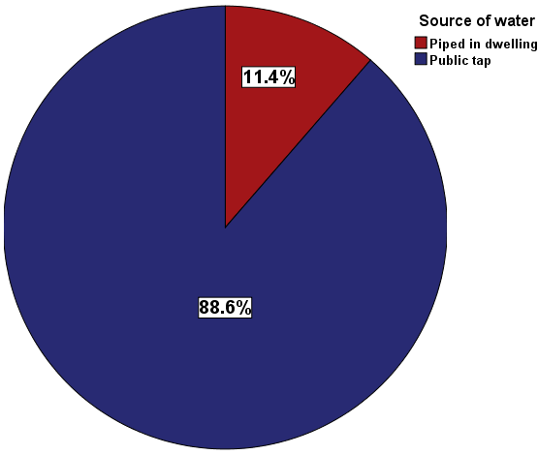
Results cont’d:
Water Source

Slide 14
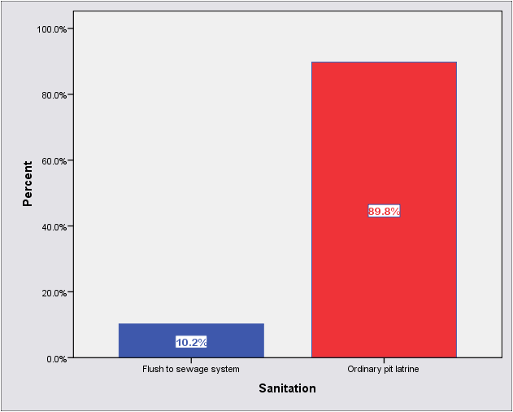
Results cont’d:
Sanitation Facility
89.8%
10.2%

Slide 15
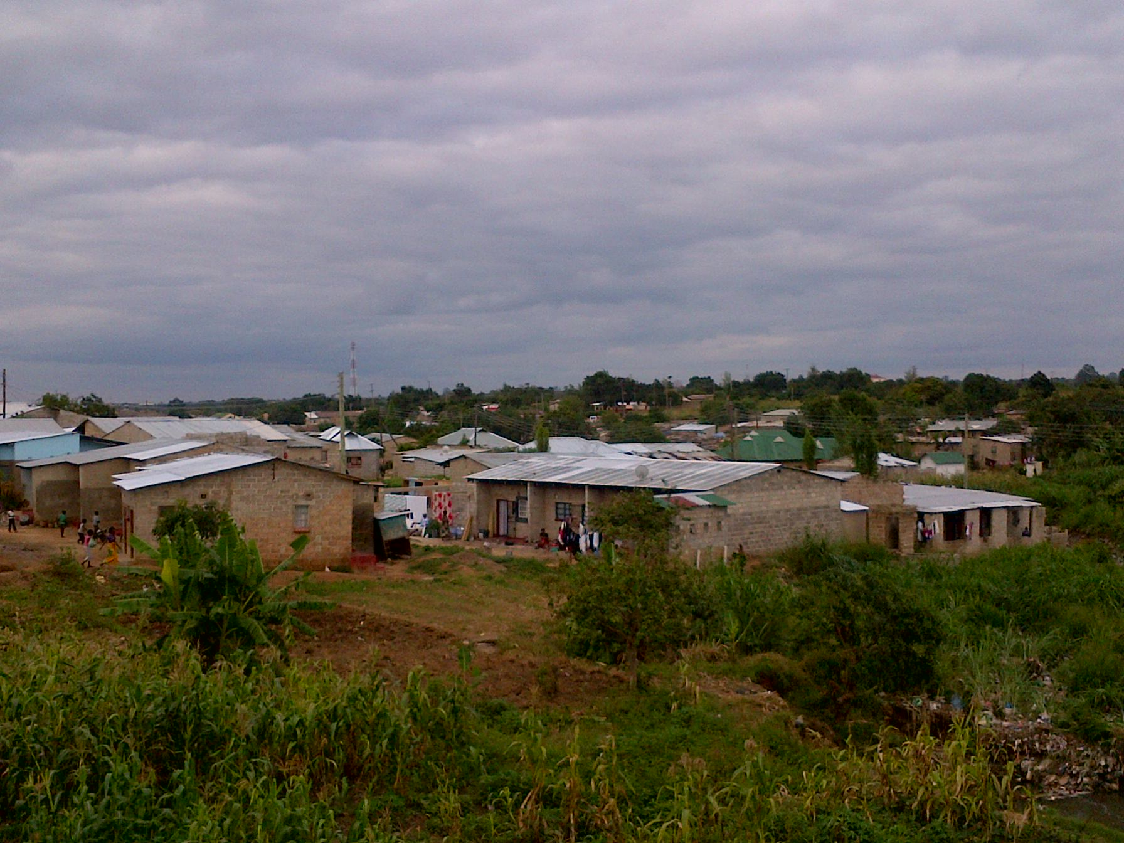

Slide 16
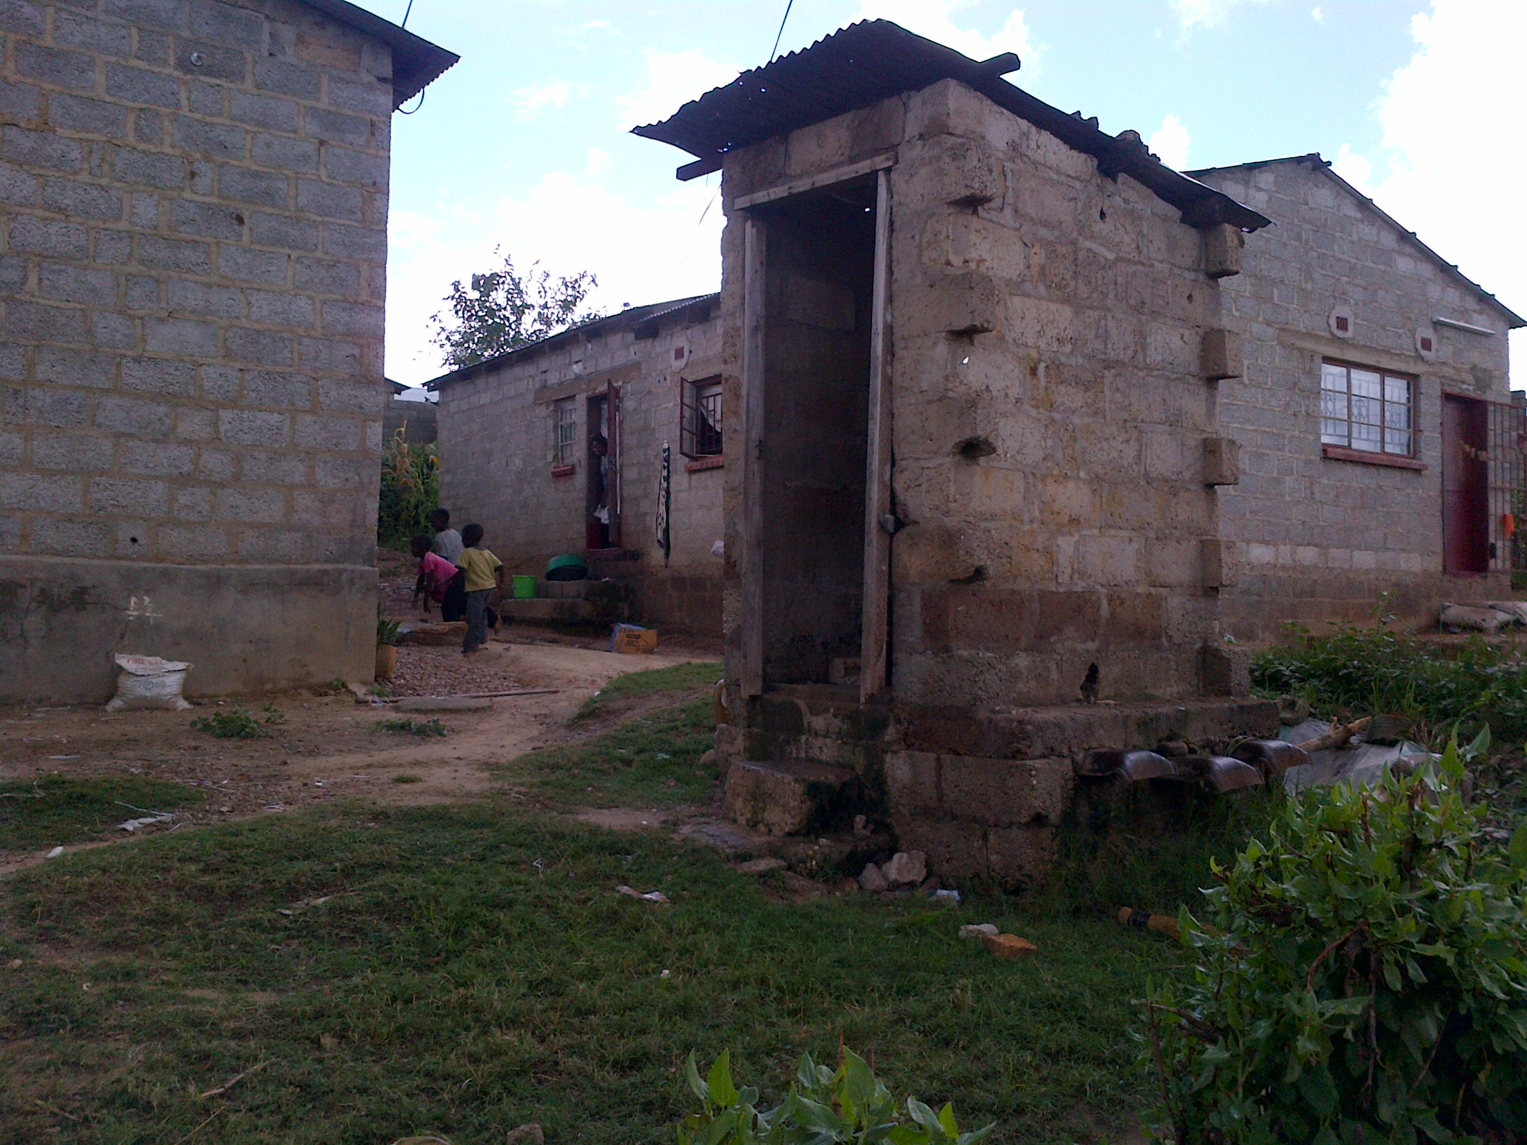

Slide 17
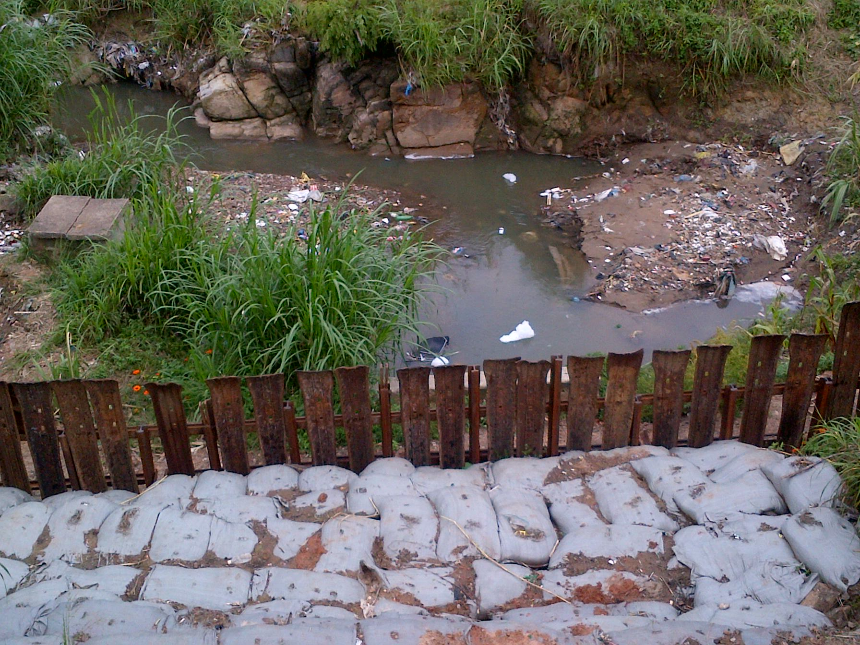

Slide 18
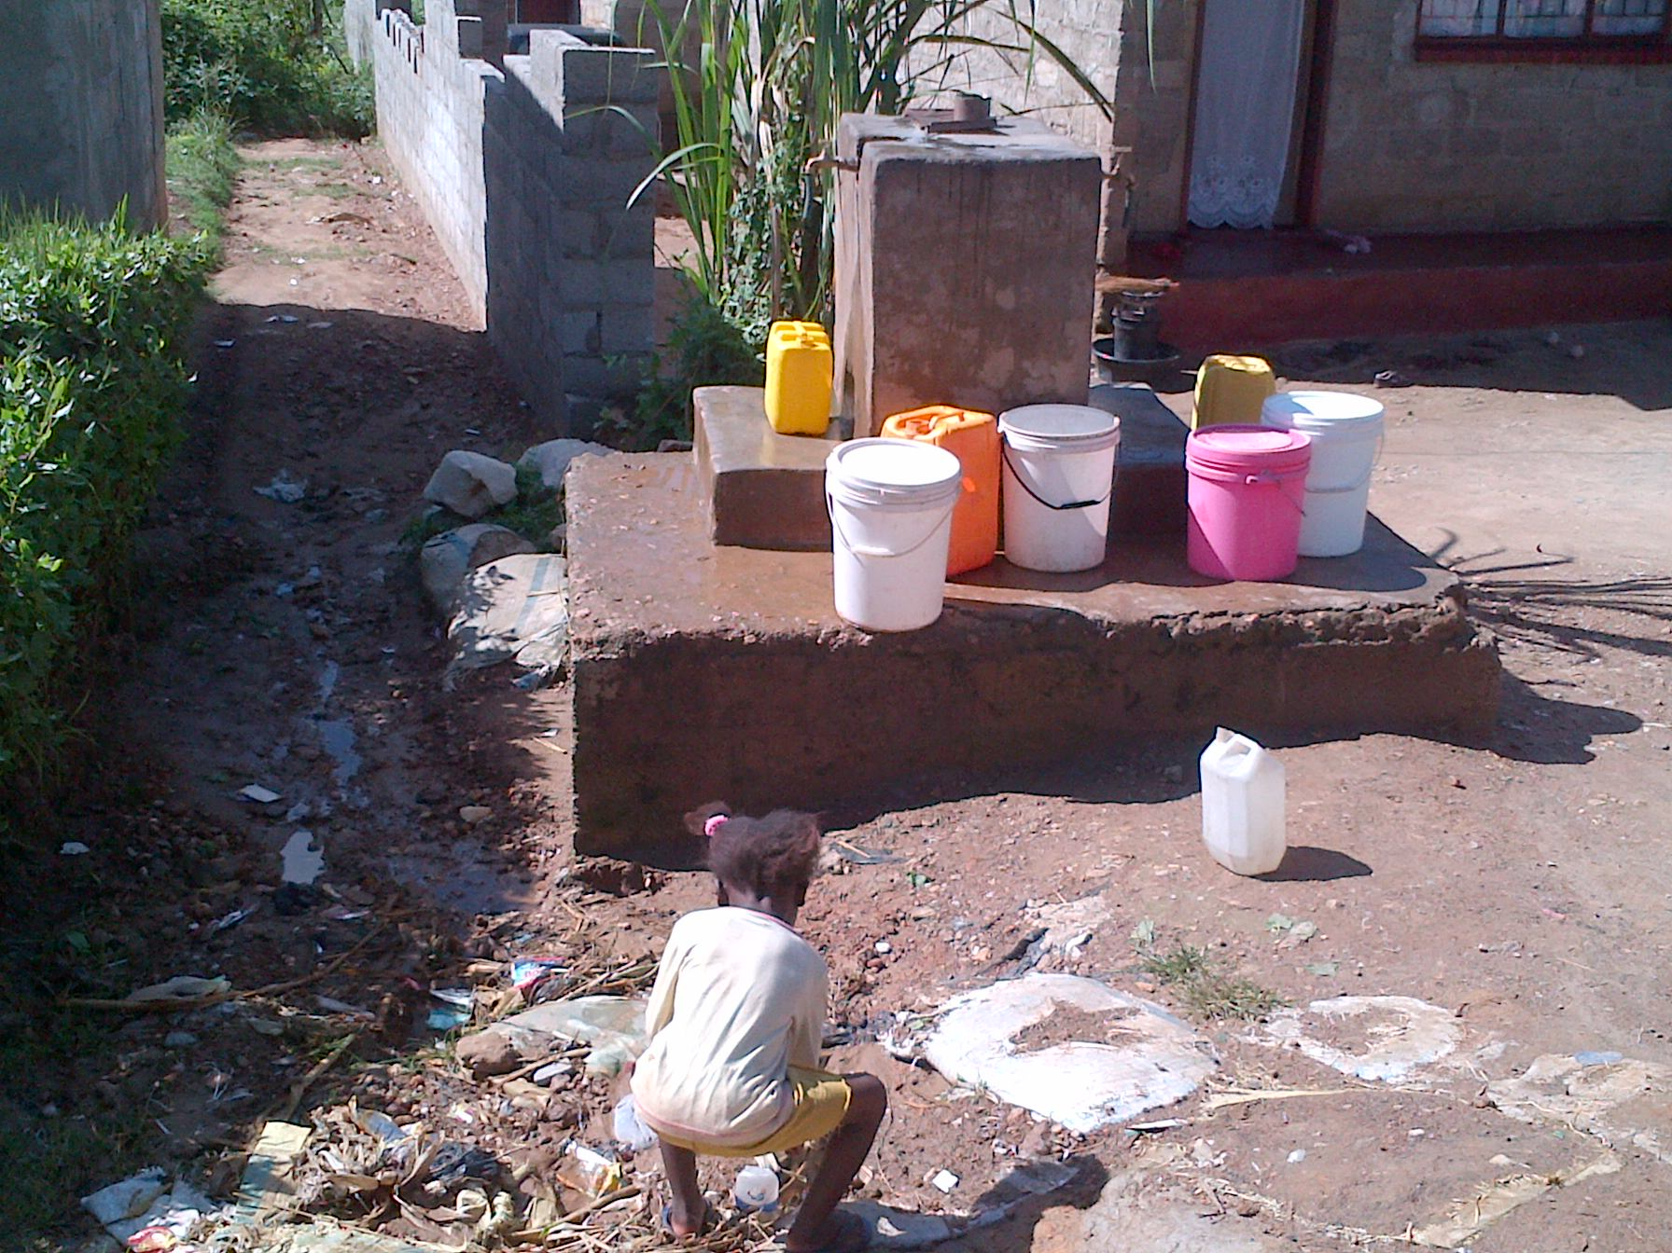

Slide 19
Results: Summary
Of the 88 mothers 21.6% were teenagers
  45.0 % of the were single mothers living in their parents’ houses
A majority (58%) of families did not access waste collection services, and of these
  51.1% dug refuse pits while
  48.9% resorted to dumping household waste into a nearby stream.

Slide 20
Discussion
A strong association was observed between housing status and nutrition of the child (p value = 0.01)
This agrees with katepa-Bwalya (2008) who found that causes of malnutrition were multi-factorial and included biological, social, and environmental factors
This, and other literature support a strong association between child nutrition and key independent variables such as age of the mother, and environmental factors such as source of drinking water, and sanitation.

Slide 21
Conclusion
Housing status, which encompasses various environmental aspects vital to the the wellbeing of the under five child, showed a strong association when cross tabulated with the nutrition status of the child.
The strong association evidenced in this study is strong enough a cue for the nation (and the world at large) to act, through multi-sectoral partnership, and address the health disparities.
This unity is a vital tool in the quest to break the cycle of environment-related health challenges affecting the under five child and its mother.

Slide 22
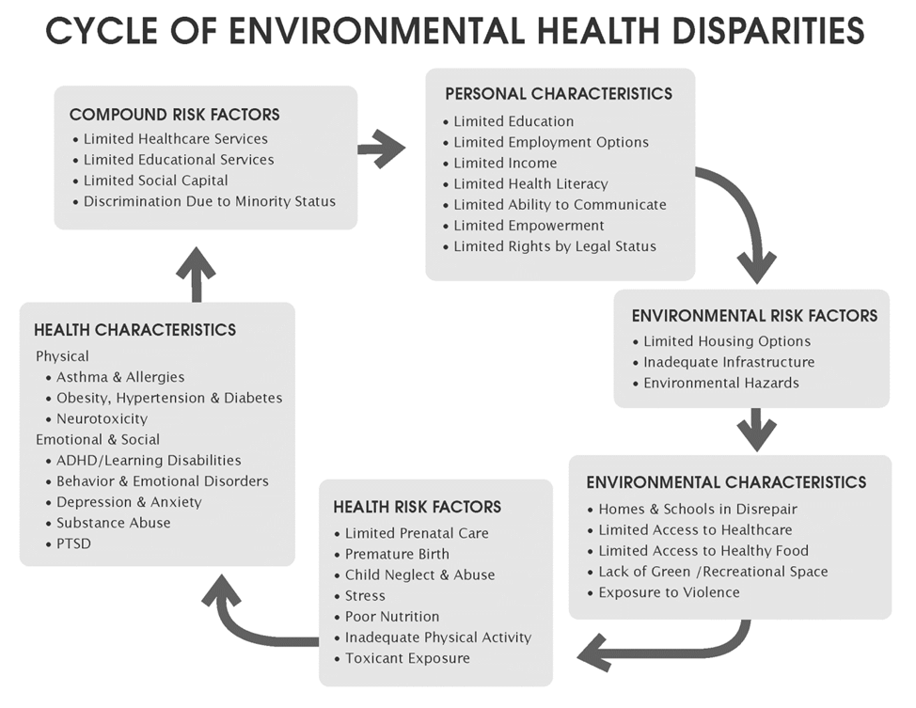


Slide 24
Thank You.

