Slide 1
Predictors of Completed Childhood Vaccination in Bolivia
Brianna Osetinsky
Laura Gaydos PhD – Mentor
Emory University
Rollins School of Public Health
Health Policy and Management

Slide 2
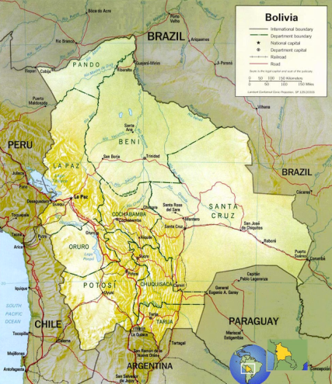
Introduction
Low middle income country
66% live in urban areas
Large indigenous population
Varied geography
9 Departments

Slide 3
Study Significance
Global Immunization Vision and Strategy (GIVS) goal is to have 90% of children over 2 years completed vaccination
Vaccination is a public health priority in Bolivia since it is cost saving and has substantial health benefits
Bolivia falls short of the goal but no studies have been done to understand what may predict incomplete vaccination

Slide 4
Breaking the Cycle
Compound Risk Factors:
Limited Healthcare Services
Limited Educational Services
Limited Social Capital
Discrimination Due to Minority Status
Personal Characteristics:
Limited Education
Limited Employment Options
Limited Income
Limited Health Literacy
Limited Ability to Communicate
Limited Empowerment
Limited Rights by Legal Status
Health Characteristics:
Physical:
Asthma & Allergies
Obesity, Hypertension & Diabetes
Neurotoxicity
Emotional and Social
ADHD/Learning Disabilities
Behavior & Emotional Disorders
Depression & Anxiety
Substance Abuse
PTSD
Environmental Risk Factors:
Limited Housing Options
Inadequate Infrastructure
Environmental Hazards
Health Risk Factors:
Limited Prenatal Care
Premature Birth
Child Neglect and Abuse
Stress
Poor Nutrition
Inadequate Physical Activity
Toxicant Exposure
Environmental Characteristics:
Homes and Schools in Disrepair
Limited Access to Healthcare
Limited Access to Healthy Food
Lack of Green/Recreational Space
Exposure to violence

Slide 5
Study Questions
Q₁: Do physical access barriers predict completed vaccination among children in Bolivia?
Q₂: Does geographic location predict complete vaccination?
Q₃: Does ethnicity predict complete vaccination?
Q₄: Does ethnicity predict difference in physical access barriers?

Slide 6
Methods
Data:
Monitoring and Evaluation to Assess and Use Results Demographic and Health Surveys (MEASURE DHS)
2008
Nationally representative data
Analysis
Binomial logistic regression
Adjusted for survey weights clustered at the village or neighborhood level

Slide 7
Methods
Model 1:
Outcome: Competed vaccination
Key Independent Variables:
Distance to health center is a problem
Public/Private healthcare provider
Ethnicity
Department
Urbanicity
Covariates
SES
Familial Characteristics

Slide 8
Methods
Model 2:
Outcome: Distance to health center is a problem in obtaining healthcare
Key Independent Variables:
Ethnicity
Department
Urbanicity
Covariates
SES
Familial Characteristics

Slide 9
Results: Descriptive Statistics

Slide 10
Results Table 2: Logistic Regression for Completed Vaccination
Variable | Odds Ratio | P>|t|
Distance Is A Problem | 0.751 | 0.009**
Public Health Center | 1.181 | 0.308
Ethnicity (Omitted Variable Spanish)
Quechua | 1.090 | 0.609
Aimara | 0.732 | 0.116
Other Ethnicity | 1.181 | 0.381
Department (Omitted Variable: Chuquisaca)
La Paz | 0.199 | >0.0001 ***
Chochabamba | 0.203 | >0.0001 ***
Oruro | 0.274 | >0.0001 ***
Potosi | 0.423 | >0.0 001 ***
Tarija | 0.773 | 0.444
Santa Cruz | 0.305 | >0.0001 ***
Beni | 0.397 | 0.009**
Pando | 0.332 | 0.002**
Urban | 0.507 | 0.005**

Slide 11
Results Table 3: Logistic Regression of Distance is a Problem
Variable | Odds Ratio | P>|t|
Omitted Culture Variable: Spanish
Quechua | 1.25 | 0.06*
Aimara | 1.01 | 0.95
Other | 0.95 | 0.743
Omitted Departmental Variable: Chuquisaca
La Paz | 2.48 | >0.0001***
Chochabamba | 1.96 | >0.0001***
Oruro | 1.23 | 0.359
Potosi | 1.14 | 0.557
Tarija | 1.79 | 0.009
Santa Cruz | 1.79 | 0.003
Beni | 1.09 | 0.731
Pando | 1.47 | 0.1
Wealth Index Omitted variable: Variable: Poorest
Poor | 0.452 | >0.0001***
Middle | 0.397 | >0.0001***
Richer | 0.278 | >0.0001***
Richest | 0.188 | >0.0001***

Slide 12
Key Findings
If “Distance is a big problem” less likely to have completed vaccinations
Departments had statistically significant variation in odds of completing vaccination
There was no direct effect of ethnicity on completed vaccination
Quecha more likely that “distance is a big problem” in obtaining healthcare
Rural environment showed a protective effect for completed vaccination

Slide 13
Discussion
Departmental could be associated with the decentralized health system
Ethnicity is not significant by itself but Quechua people are more likely to have trouble accessing healthcare due to distance
Urban/rural differences may be due to different health services available

Slide 14
Limitations
Immunization report is from maternal reports or health cards
Sample limited to children over 2 years
Subjective nature of variable “Distance is a problem in accessing healthcare.”
Patient reported survey data limits what can be learned about the health system

Slide 15
Where do we go from here?
Departmental differences should be addressed to achieve national immunization goals
Study how decentralization policies may result in differences in vaccination completion
Study health services available in rural and urban settings to understand if this is associated with difference in vaccination completion
GIS mapping of health centers to more precisely why distance is a problem

