Slide 1
COMMUNITY ENGAGEMENT ADDS VALUE TO ENVIRONMENTAL HEALTH SCIENCE AT EMORY
Melanie Pearson, PhD
Notes:
Yesterday, Dean McCauley did a wonderful job introducing community engagement principles and someone in the audience asked “How do you get the community knowledge into the science?” Today, will describe two examples of community engagement in environmental health at Emory and describe how community knowledge has influenced the science conducted.

Slide 2
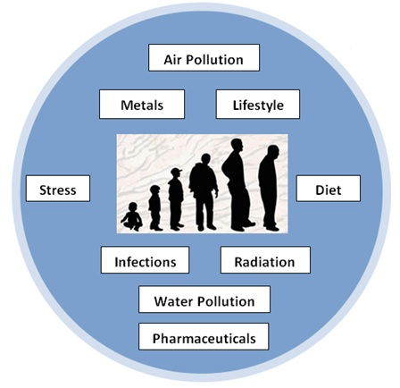
Emory Example # 1
emoryhercules.com
HERCULES Exposome Research Center
Infrastructure center
  No long-term research projects
Exposome: Lifetime of cumulative exposures
Notes:
the environmental equivalent the genome. All things not genetic that can predict someone’s health – research yesterday is a good example, lead exposure, living in the south with poor access to services, exposure to viruses. All of these aspects influence health. This center is trying to develop a comprehensive approach to quantify all (many) of the stressors to predict health outcomes (and hopefully to find ways to intervene).
What is community engagement to look like? What should our goals be??

Slide 3
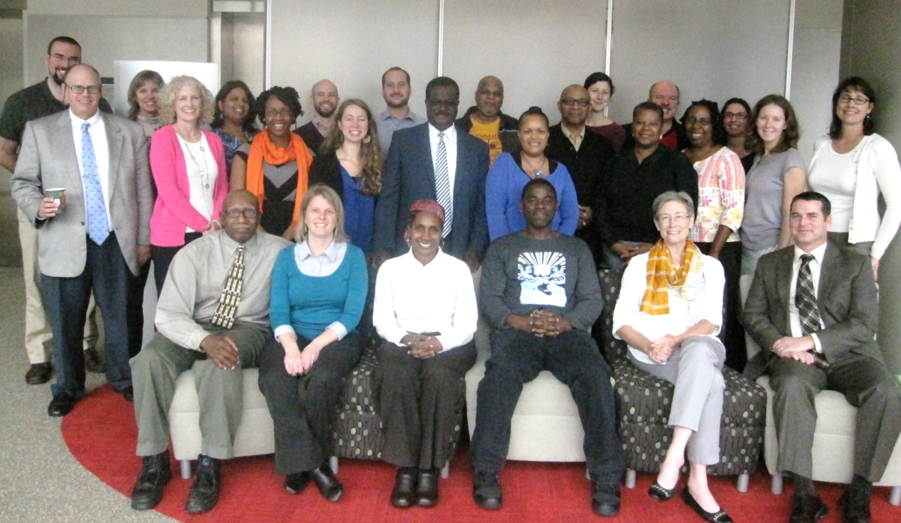
Stakeholder Advisory Board
emoryhercules.com
30+ members—community members, non-profit organizations, government agencies, academic partners
Notes:
We asked the community and stakeholders. We explained the exposome concept and that the center would promote exposome science. We didn’t know what to expect. They were thrilled. Finally, they said, science that matches our experiences!!! But, how can we engage the community while the science develops?
Answer: build capacity in the community by sharing the current EH knowledge, sharing the resources, and building research partnerships that answer our questions!

Slide 4
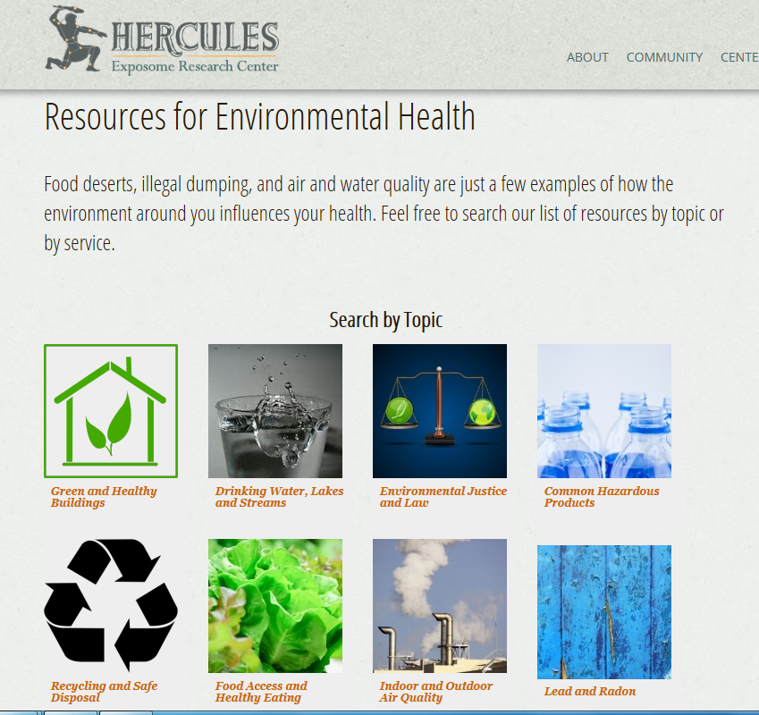
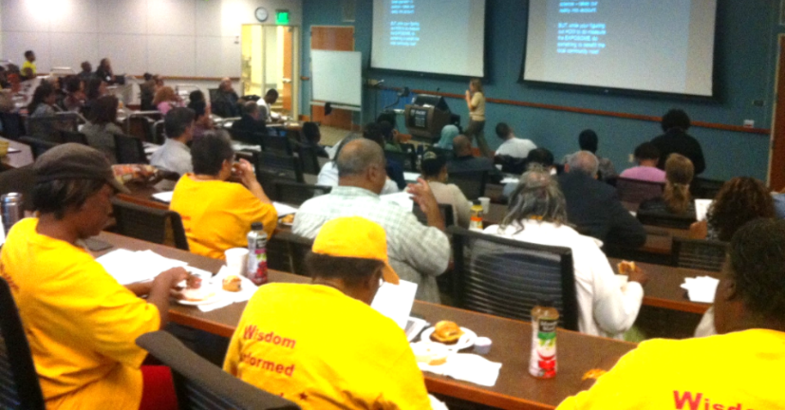
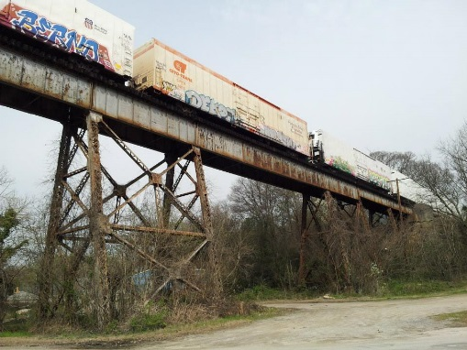
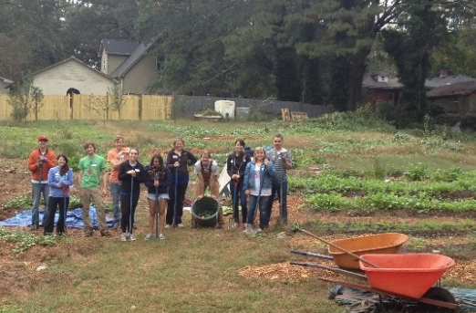
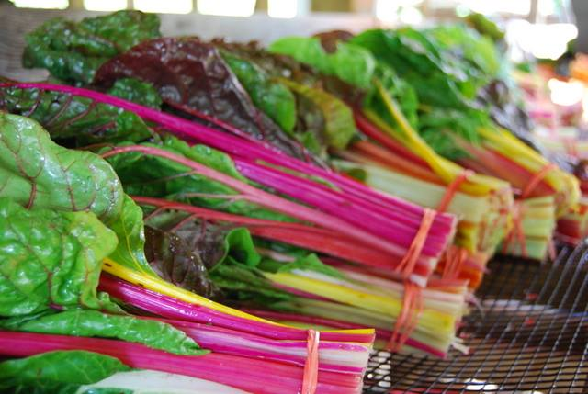
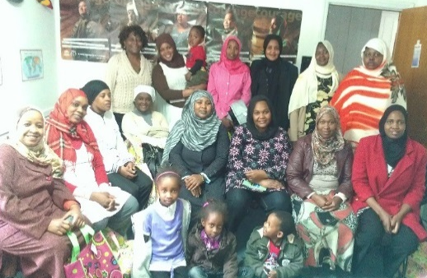
The Clarence “Shaheed” DuBois Community Grant Program* ($2500 for one-year project)
emoryhercules.com
Community Forum:
Environment, Health, & Action
*Community partners helped develop the RFA and review/score the applications
Notes:
Forum: Small-group discussions - scientists at each table
Community collaborative problem solving models - Led by EPA partners

Slide 5
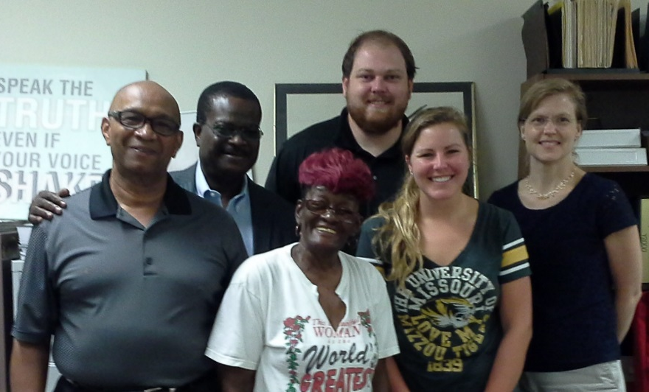
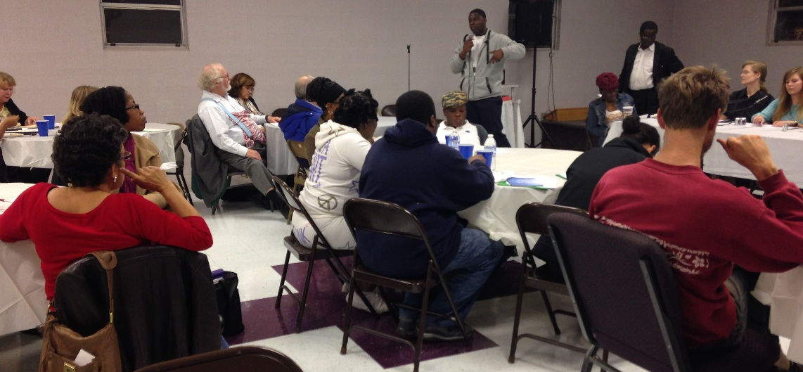

Proctor Creek Community Collaborative Health Survey: Community-based Participatory Research
emoryhercules.com
Results:
High prevalence of observed mold
High asthma prevalence
Community-based Participatory Research Elements:
Problem identified by community,
Community partner co-leader & received part of funding
Survey teams: 1 student & 1 community resident
Results shared with community & City of Atlanta
Notes:
Partnership between community organization and scientist! This was a long-term goal, but it started. Funded as a pilot grant through the center. Well-designed survey and measures documented conditions and garnered attention of city.

Slide 6


Emory Example # 2
pbbregistry.emory.edu
Michigan PBB Research Registry
MgO
PBB
Nutrimaster
Firemaster

Slide 7
Emory Example # 2
pbbregistry.emory.edu
Michigan PBB Research Registry
PBB
Nutrimaster
Firemaster

Slide 8
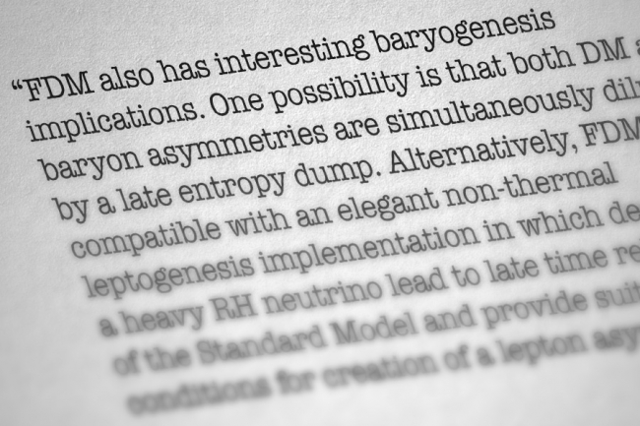
Emory Example # 2
pbbregistry.emory.edu
Michigan PBB Research Registry
Long-term Research
First 30 years, all contact via state
  Dense, jargon-laden newsletters periodically sent to participants
In 2012, state no longer had resources to maintain Registry.
Emory agreed to take over the Registry.

Slide 9
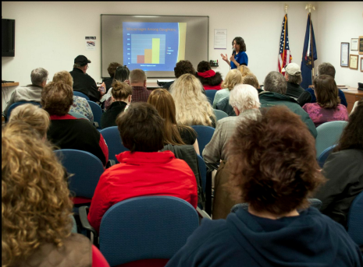
Community Outreach & Consultation
pbbregistry.emory.edu

Slide 10
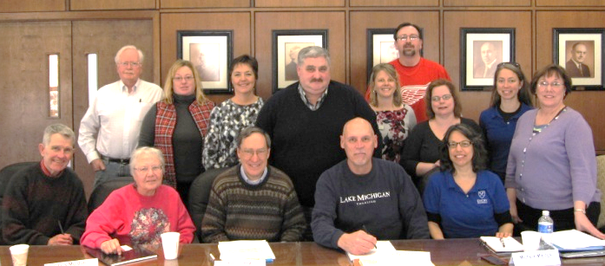
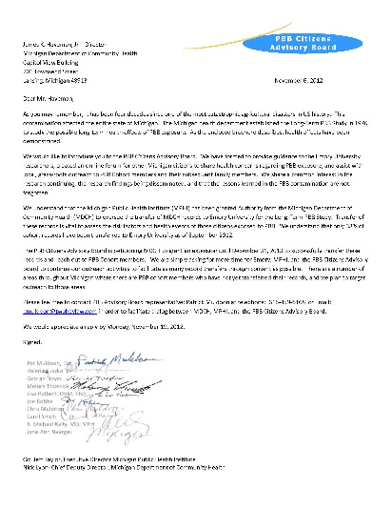
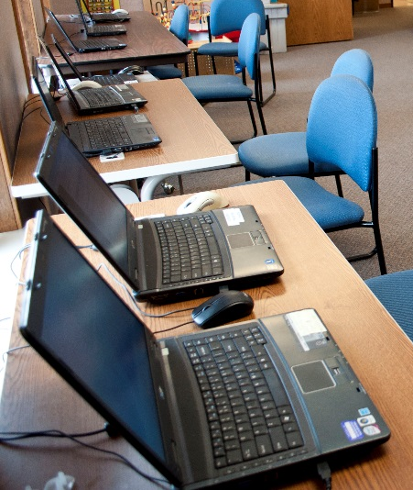
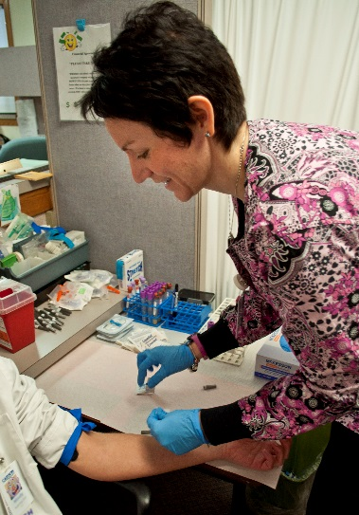
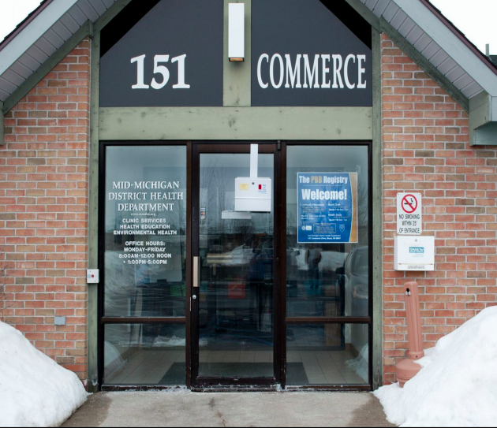
PBB Citizens Advisory Board
pbbregistry.emory.edu

Slide 11


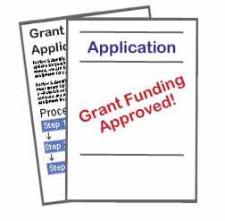

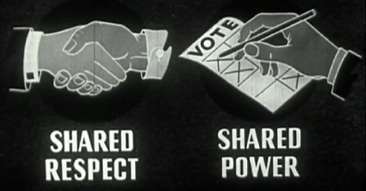
Research Partners
pbbregistry.emory.edu
Conference
Calls

Slide 12
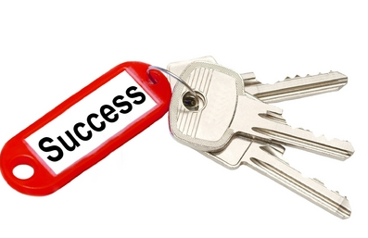
Keys to success
Recognizing and valuing the community’s knowledge!
  Implementing suggestions from community members
Partners share in decision-making
  Decide activities, process, budget priorities
  Sharing $$ and expertise

