Slide 1
Lead Toxicity and Children
Robert J. Geller MD
Professor, Emory Univ. Dept. of Pediatrics
Emory SE Pediatric Environmental Health Specialty Unit
Medical Director, Georgia Poison Center

Slide 2
What happened in Flint, MI
To save money, the state and city switched the water supply from Detroit municipal system to the Flint River in April 2014
Stopped adding orthophosphates (which reduce leaching of lead from pipes)
Multiple community concerns about water quality ensued – including bacterial counts, minerals, etc

Slide 3
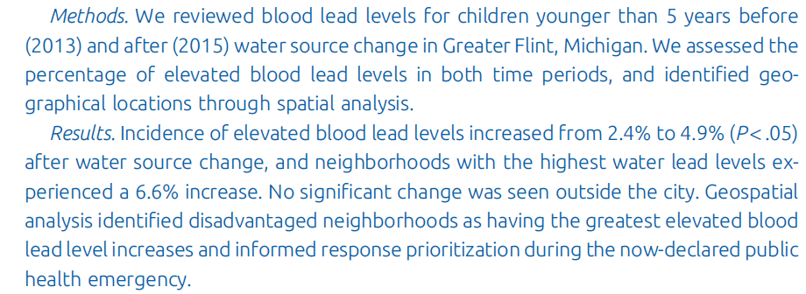
New data from Flint MI
Hanna-Attisha M, LaChance J, Sadler RC, Schnepp AC. Am J Publ Hlth 2016; 106_283-290.

Slide 4
Lead Sources in the Environment
Leaded gasoline
  Initial concern raised in 1920’s about lead addition to gasoline, but lead only removed in late 1970’s in US
Lead paint – limited use in US since 1973
Crafts
Automotive
Lead in water (Plumbing etc)
  Further restricted since 2001

Slide 5
Heavy Metals as Childhood Toxins
Lead
  Encephalopathy at high levels
  Anemia at blood lead (BLL) > 40 μg/dL
  Intellectual impact at low levels
  No clearly defined safe level
  Recent recommendation from US Advisory Committee on Childhood Lead Poisoning Prevention to intervene at BLL >5 μg/dL

Slide 6
Lead effects
Lead effects are observed on an average, population basis
Lead effects difficult to ascertain or attribute at the individual level

Slide 7
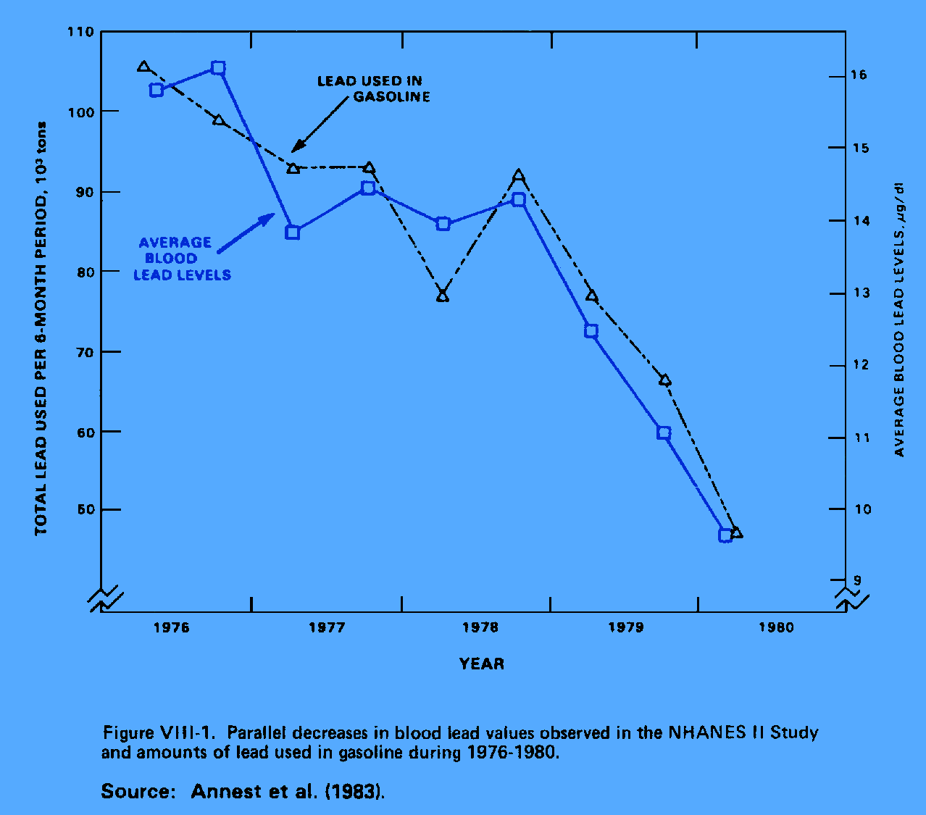
Lead

Slide 8
Lead Poisoning – Making the Diagnosis
Venous lead level – the current gold standard
“Fingerstick” capillary lead level – prone to false positives due to skin contamination
Free erythrocyte protoporphyrin, zinc protoporphyrin
  FEP only elevated if BLL > 20 μg/dL or so
  Not valid as a screening method for lower BLL, therefore no longer useful for this purpose

Slide 9
Lead and IQ
No clearly established threshold for lead toxicity
Extent of mean IQ reduction:
  ≈ 0.25 IQ points per μg/dL BLL at BLL <5 μg/dL
(Landrigan P et al. Environ Health Perspect 2002; 110:721-728)
  3.9 IQ points more from BLL increasing 5-> 20 μg/dL
  3.5 IQ points more from BLL > 20 μg/dL
    (Fewtrell LJ et al. Environ Res 2004; 94: 120–133)
“Normal” BLL calculated to be <0.1 μg/dL

Slide 10
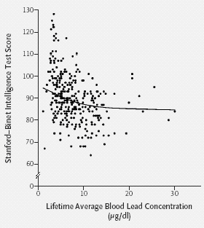
Lead Impact on IQ
Canfield et al
NEJM 2003; 248: 1517-1526

Slide 11
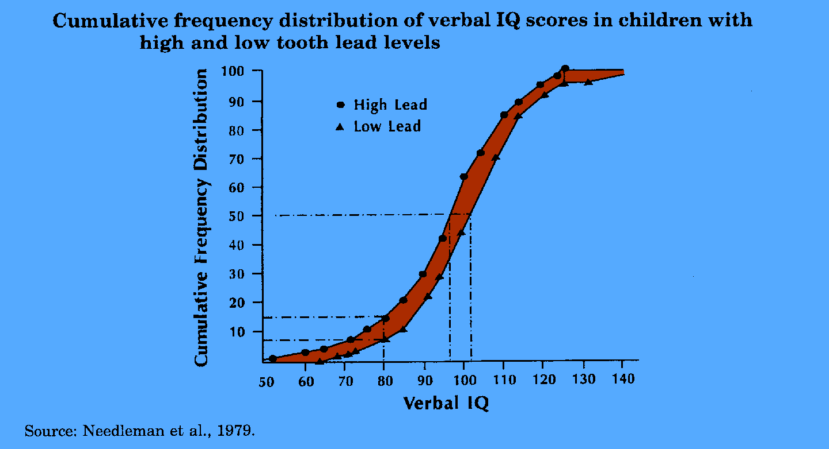
Lead’s impact on verbal IQ

Slide 12
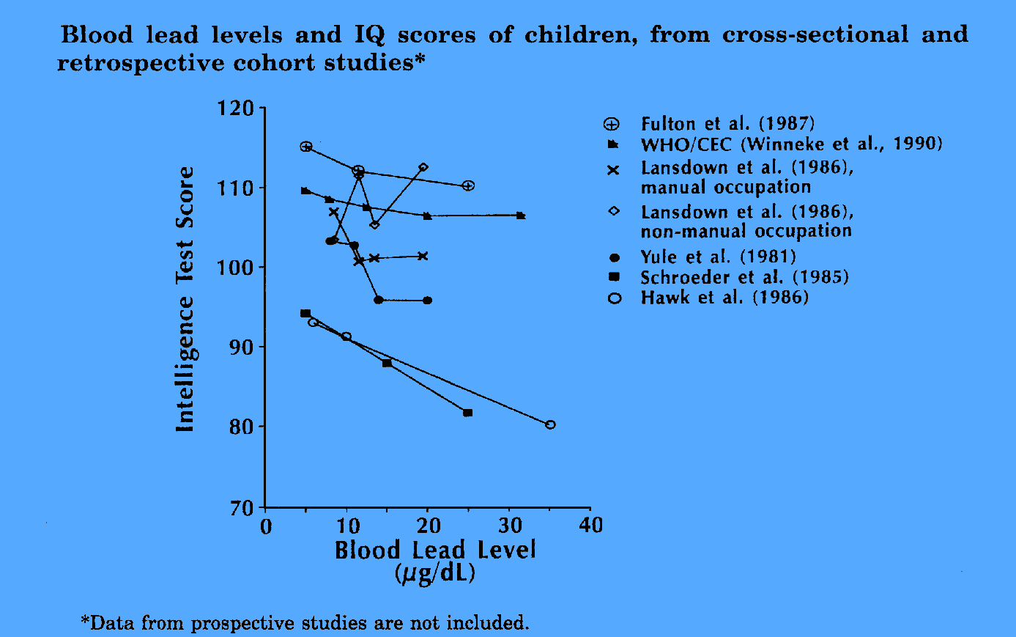
Lead blood levels vs. IQ

Slide 13
Lead and Behavior
ADHD
Disruptive behavior

Slide 14
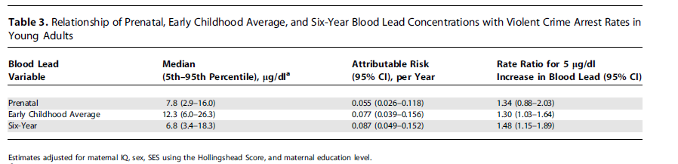
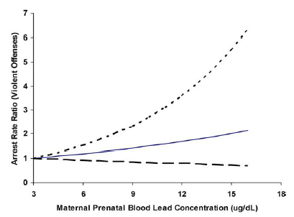
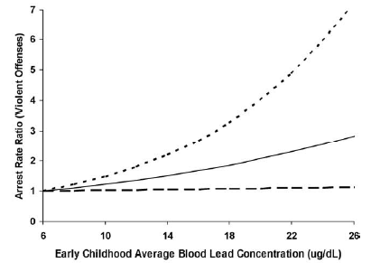
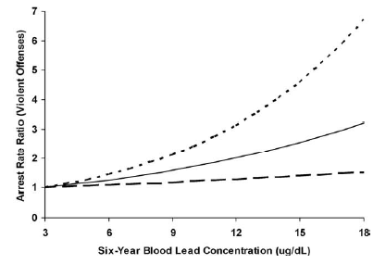
Lead Effect on Violent Crime
Wright JP et al. PLoS Medicine 2008; 5 (#5): 0732- 0740.

Slide 15
Lead Poisoning Prevention - US
Prevent exposure, particularly in early childhood
Reduce avoidable release into the environment and the workplace
Early detection at the mild stage

Slide 16


