Slide 1
The Role of Social Support on
Adolescent Mother’s Breastfeeding Practices in Western North Carolina
Colleen Clark, MPH
Mentor: Dr. Kimberly Price
Notes:
Figure 1: Anonymous (Unknown) The blue ridge parkway. Retrieved from: https://www.nps.gov/blri/index.htm

Slide 2
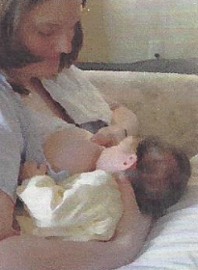
Breastfeeding Health Benefits
What does current research tell us?
Reduced Risk of:
Reduced Risk of:
Breast Cancer
Type 2 Diabetes
Heart Disease
Gastrointestinal Infection
Respiratory Infection
Ear Infections
Serious Colds
Allergies
STDs
Enhanced Benefits of:
Enhanced Benefits of:
Promotion of Postpartum Health
Financial Benefits
Bonding with Baby
Cognitive Benefits
Bonding with Mother
02

Slide 3
WHY ADOLESCENTS?
Adolescent Mothers
Mothers Aged ≥20 Years
VS
CDC Analyzed Data from 2009–2011 Pregnancy Risk Assessment Monitoring System (PRAMS)
3

Slide 4
Life Course Development Theory
How does health transcend generations?
Grandmother
Mother
Child
4

Slide 5
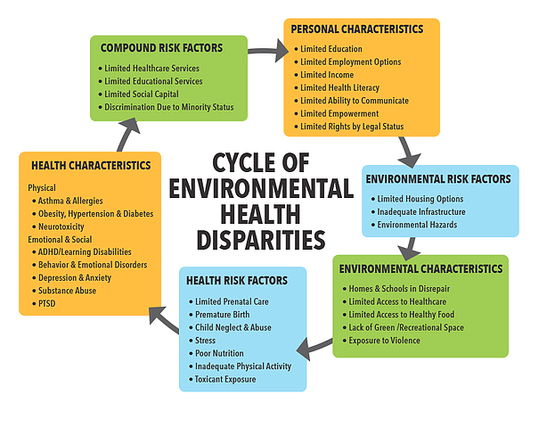
How can
improving an Adolescent Mother’s breastfeeding
practice
Break the Cycle?
5

Slide 6
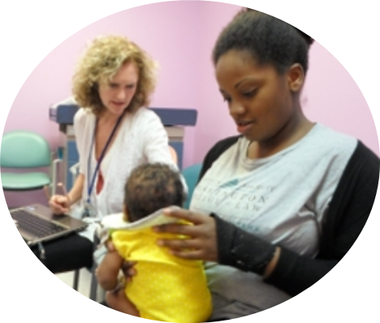
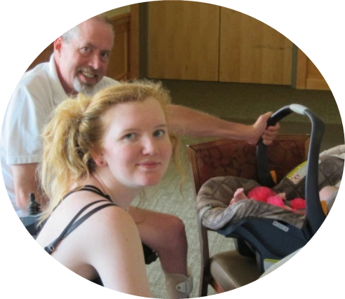
Social Support
Healthcare Providers
Family Members
Peers
6
Notes:
Figure 1: Coutlakis, J. (2014) Mother love graduation photo. Retrieved from: http://www.citizen-times.com/story/news/local/2014/05/24/ywcas-motherlove-program-helps-teen-parents-succeed/9549055/
Figure 2: Anon. (2015) A mother love participant and her father. Retrieved from: https://ywcaofasheville.wordpress.com/2015/06/02/another-transformational-year-of-motherlove/
Figure 3. Anon. Family Health and Birth Center (Unknown) Retrieved from: http://www.capitalcommunitynews.com/content/breast-best-babies

Slide 7
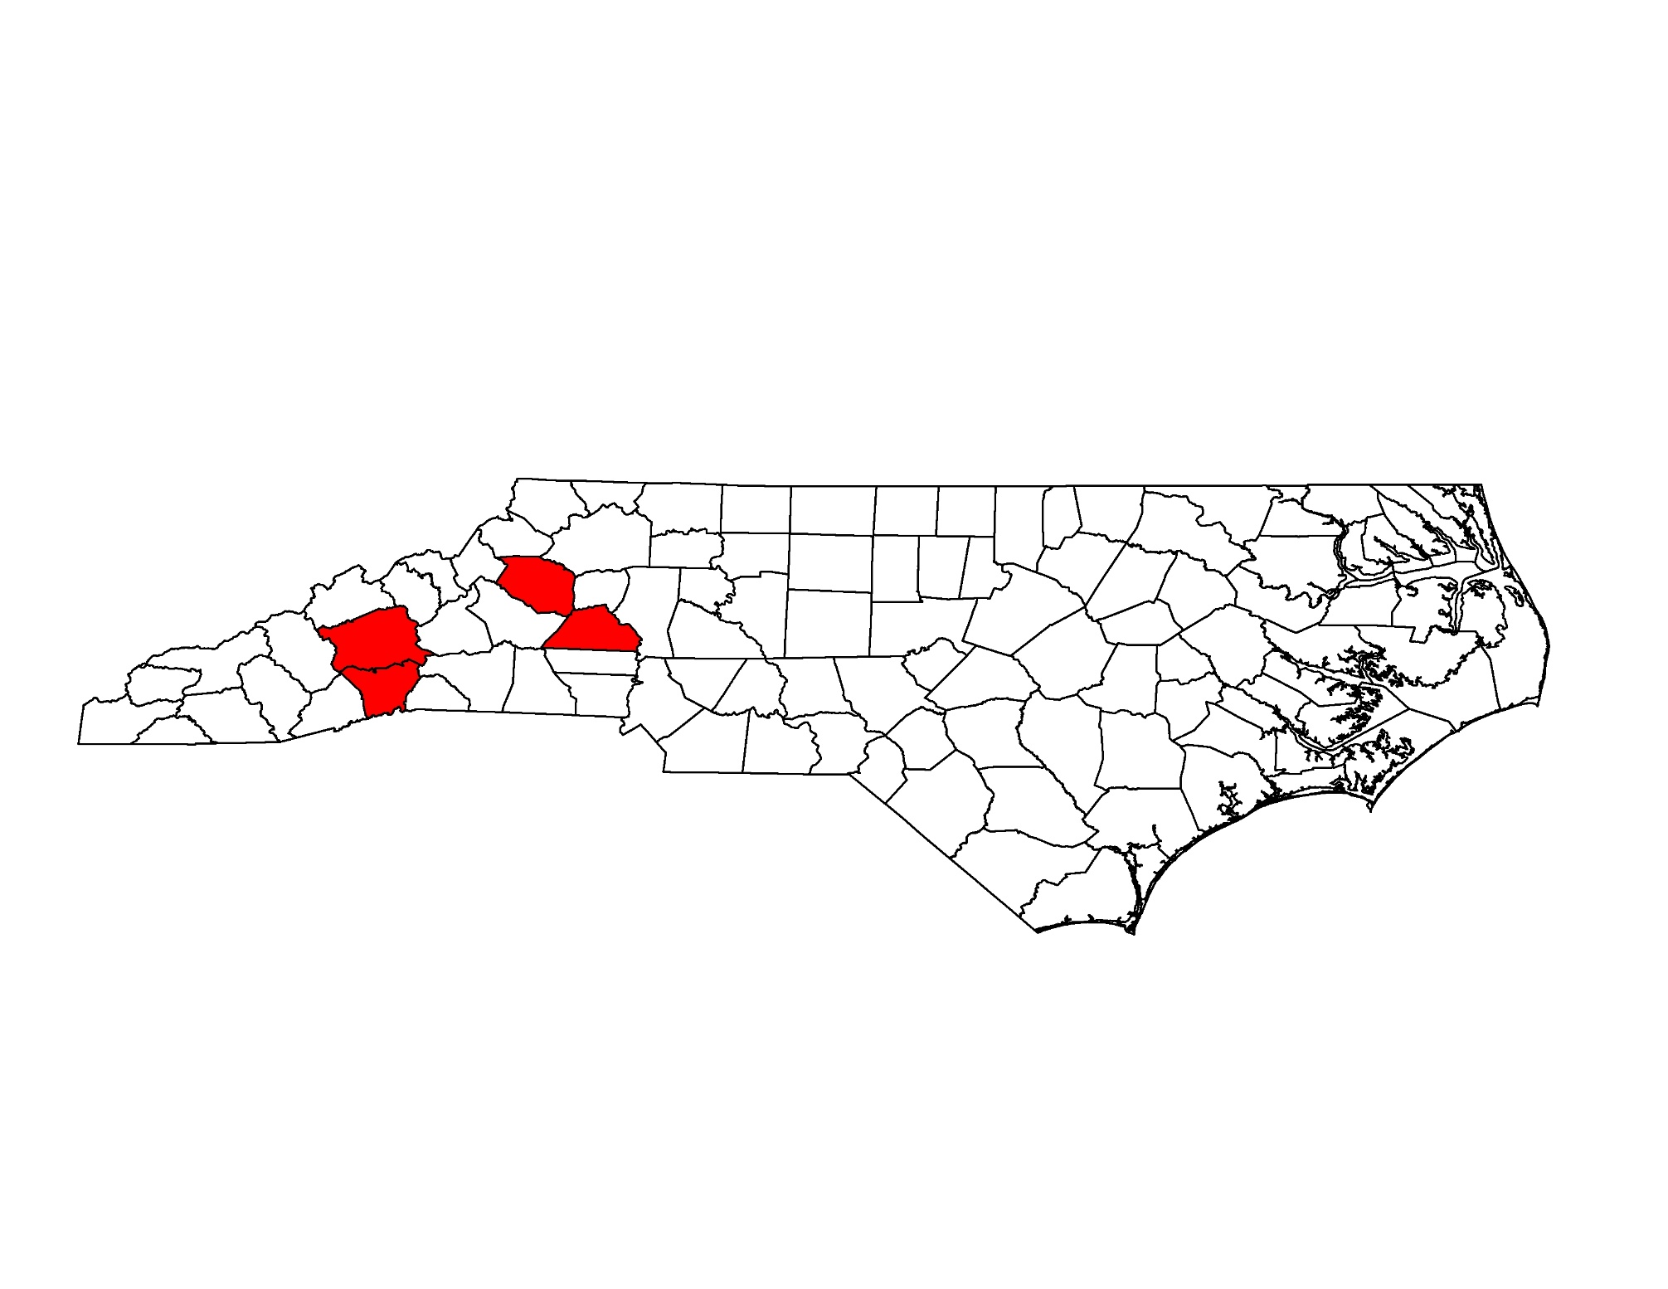
Population
1. Children Family Resource Center
Henderson County, NC
2. Caldwell Council on Adolescent Health
Caldwell County, NC
3. Council on Adolescents
Catawba County, NC
4. YWCA
Buncombe County, NC
7

Slide 8
Methods
Needs Assessment Through Cross Sectional Survey Distribution
Interviews with Health Providers and Clinic Directors
Categories of Intrigue
Environmental Support
Healthcare Social Support
Interpersonal Support
Use of Social Media
Obstacles at work? School? Comfort levels at these locations? Availability of pre-natal class? Intention?
Baby friendly facility? Media used? Benefits discussed? Length of conversation?
Do you feel in control of how you feed your baby? Do you feel encouraged by friends; family; peers?
Types of social media used? Length of time using? Use of social media for education? Interest in creating a website?
8

Slide 9
“You know, they are teenagers…”

Slide 10
Cultivate Resiliency
Ways to support an adolescent mother’s breastfeeding practice?
1
Do Not Assume
2
Language Matters
3
Encourage Breastfeeding
4
Connect Mother’s with Peers
10

Slide 11
# An Outlet to Support
Can we use social media to support adolescent mother’s intention to breastfeed?
EDUCATION AND OUTREACH
PEER-PEER CONVERSATION
DATA COLLECTION
EMPOWERMENT TO SHARE EXPERIENCES
REPRESENTATION
GENERATE A LARGER COMMUNITY
11
Notes:
Figure 1: Anon (2013). Young mother breastfeeding. Retrieved from: http://arch.yale.edu/news/most-adolescent-mothers-try-breastfeeding-do-not-continue-it

Slide 12
Limitations?

Slide 13
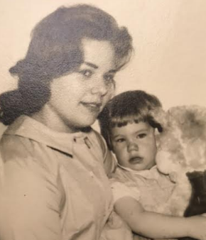
Thank You!
The Break the Cycle Team, especially Laura Wells
Dr. Kimberly Price
Dr. Jennifer Runkle
The coordinators at the site facilities: Amber, Tiffany, Amanda, Sarah and Emily
My Mother
Colleen.Clark@my.lr.edu
13

Slide 14
References:
American Academy of Pediatrics. (2012). Policy on breastfeeding and use of human milk. Pediatrics, 129(03), e827.
Retrieved from: http://pediatrics.aappublications.org/content/ pediatrics/129/3/e827.full.pdf
Angier, N. (1999). Woman: An intimate geography. New York, NY: Houghton Mifflin Company.
Bigelow, A. E., Power, M., Gillis, D. E., Maclellan-Peters, J., Alex, M., & McDonald, C. (2014). Breastfeeding, skin-to-skin contact, and mother-infant interaction over infants’ first three months. Infant Mental Health Journal, 35(1), 51-62. doi:10.1002/imhj.21424
Centers for Disease Control and Prevention. (2016). Maternity care practices and breastfeeding among adolescent mothers Aged 12–19 Years — United States, 2009–2011.
Retrieved from the CDC website: http://www.cdc.gov/mmwr/volumes/65/wr/mm6502a1.html
Godfrey, J. R., & Lawrence, R. A. (2010). Toward optimal health: The maternal benefits of breastfeeding. Journal Of Women's Health,19(9), 1597-1602. doi:10.1089/ jwh.2010.2290
La Leche League. (2016). What is colostrum? How does it benefit my baby?. Retrieved from: http://www.lalecheleague.org/faq/colostrum.html
Oddy, O., Kendall, G., Li, J., Jacoby, P., Robinson, M., Klerk, N., et al. (2010). The long-term effects of breastfeeding on child and adolescent mental health: A pregnancy cohort study followed for 14 years. The Journal of Pediatrics, 156 (4), 568-574. doi: http://dx.doi.org/10.1016/j.jpeds.2009.10.020
Mohrbacher, N., Stock, J. (2003). La leche league international: The breastfeeding answer book. Schaumburg, IL: La Leche League International.
Smith, P., Coley, S., Labbock, M., Cupito, S., Nwokah, E. (2012). Early breastfeeding experiences of adolescent mothers: a qualitative prospective study. International Breastfeeding Journal 7(13). doi: 10.1186/1746-4358-7-13
Tucker, C., Wilson, E., Samandari, G., (2011). Infant feeding experiences among teen mothers in North Carolina: Findings from a mixed-media stud. International Breastfeeding Journal,
6 (14). doi: 10.1186/1746-4358-6-14
U.S Department of Health and Human Services (2012). Healthy people 2020 topics: Infant care objectives. Retrieved from:
https://www.healthypeople.gov/2020/topics-objectives/topic/maternal-infant-and-child- health/objectives
U.S Department of Health and Human Services (2014a). Healthy people 2020 topics: Maternal, infant, and child health. Retrieved from:
https://www.healthypeople.gov/2020/topics-objectives/topic/maternal-infant-and-child- health
U.S Department of Health and Human Services (2014b). Trends in Teen Pregnancy and Childbearing. Retrieved from: http://www.hhs.gov/ash/oah/adolescent-health
topics/reproductive-health/teen-pregnancy/trends.html
Woods, N., Chesser, A., Wipperman, J. (2013). Describing adolescent breastfeeding environments through focus groups in an urban community. Journal of Primary & Community Care, 4(4)307-310. do: 10.117/2150131913487380

