Slide 1
Implementing Community Supports to Lessen Health Disparities at Kindergarten Entry for Very Preterm Survivors
Amelia Dmowska
Mentor: Dr. Michael E. Msall,
Chief of Developmental and Behavioral Pediatrics
University of Chicago Medicine Comer Children’s Hospital
JP Kennedy Research Center on Intellectual and Developmental Disabilities
Chicago IL 60637 mmsall@peds.bsd.uchicago.edu
Notes:
Over the past 3 decades, obstetrics and neonatology have dramatically increased the survival of children born preterm. Currently 95% of infants born late preterm(32-36 weeks gestation), 90% of infants born very preterm(28-31 weeks gestation) , and 80% of infants born at extreme prematurity(<28 weeks survive. We sought to examine accessing community supports prior to kindergarten entry for very preterm survivors.

Slide 2
Early Developmental Delay
Developmental delay=a gap between a child’s actual development and age-appropriate expectations
Factors associated with risk for developmental delay include both biological and environmental factors
Biological: premature birth or low birth weight, neonatal seizures/encephalopathies, malformations, and sepsis/meningitis
Environmental: low-quality home environments, harsh or neglectful parenting, Parental mental health or substance abuse disorder
Notes:
Children born very preterm are at high risk for developmental delays. These are defined as the gap between a child’s actual developmentand age appropriate expectations. There are multidimensional and incude physical,cognitive, communicative, social emotional and adaptive domains assessed using appropriately normed and culturally valid tools. A child is considered to have a developmental delay when he or she is diagnosed utilizing appropriately normed and culturally relevant assessments in the following areas of development:
Physical: includes motor, vision, hearing
Cognitive
Communication
Social-emotional
Adaptive
Developmental delays represent a complex interaction between biological and environmental risk factors. Biological risks include prematurity , low birth weight, neonatal seizures/encephalopathies, , malformations, and sepsis/meningitis.
Poverty, social disadvantage, and distressed neighborhoods has been repeatedly related to problematic development in communicative, cognitive, and socioemotional domains which are essential to entering kindergarten ready to learn.

Slide 3
Low-Income Risk Factor
Children in with prematurity and poverty are doubly vulnerable to risks for developmental problems
>50% of preterm children require special education supports .
<50% of children from low-income families are ready to learn at kindergarten entry
75% of children from families with moderate or high incomes are ready to learn at kindergarten entry
Preschool attendance is one of the strongest factors for school readiness in low income children.
Notes:
Attending a high-quality early childhood programs predicts higher levels of achievement at age 11, less grade repetition, and less need for special education services. Education readiness and early school success can mean the difference between a socially fulfilling, intellectually stimulating, and economically productive life.

Slide 4
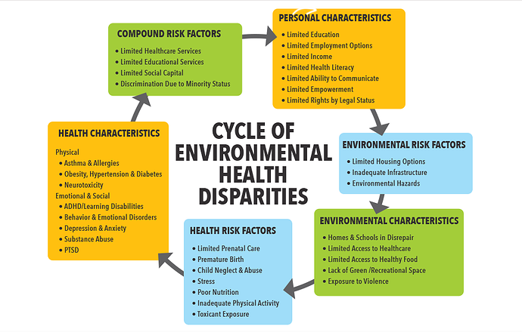
Notes:
We started with premature birth as a health risk factor and examined long term impact on learning behaviora and emotional competencies underlying school success. We examined the role of access to early intervention and preschool learning experiences and the role of missed opportunities in accessing these services on long term special education costs. We specifically examined what would be the cost of implementing comprehensive early intervention and preschool services on kindergarten readiness and long term special education costs.

Slide 5
Early Intervention Services
Early Intervention is based on the premise that identifying children’s needs and providing comprehensive quality interventions and family supports optimizes outcomes and decreases future special education services.
Early Intervention Services include: screening, assessment, referral, and treatment
Individuals with Disabilities Education Act (IDEA) in 1975
Notes:
These early intervention services include screening, assessment, referral, and treatment. The Individuals with Disabilities Education Act (IDEA), established the right of children with delays, disabilities, or high biological risk to receive comprehensive early intervention services from birth to 3 Y and preschool services from 3-5 Y and then throughout their schooling(6-21Y ). These services are designed to meet children’s needs free of charge, and, to the greatest extent possible, to receive instruction in regular education classrooms alongside nondisabled children and to receive the supports necessary to optimize educational, vocational and life skills outcomes.

Slide 6
Model Programs & Educational Costs
Early Intervention Model Programs include:
Perry Preschool Project
Head Start & Early Head Start (EHS)
Infant Health & Development Program (IHDP)
Chicago Child-Parent Centers (CPC)
Abecedarian Project
Evidence shows that high-quality early intervention at young ages can result in long-term cost savings
Focus on IHDP model
Notes:
Intensive mode quality early childhood programs from the 1960s and 1970s included the Perry Preschool, Head Start and Abecedarian projects These improved educational, health and life-course outcomes for children experiencing poverty, social disadvantage, and minority status. The IHDP implemented comprehensive home visiting , early intervention, and full day early child education in the first three years of life for children born prematurely. The Chicago CPC project involved preschool and early elementary services for children at high risk for poverty and educational failure. These model programs appear to generate benefits far in excess of program costs. However gaps in quality compromise large scale community implementation and the costs for implementing comprehensive model programs have been deemed too costly.

Slide 7
Cohort
121 preterm infants <30 weeks gestation were enrolled in a RCT of inhaled nitric oxide for respiratory distress syndrome
All received surfactant and ventilation for Respiratory Distress Syndrome.
All had neurodevelopmental assessment at the ages of 2 and 5.5 years old
Outcomes at ages 2 and 5.5 y were:
neurosensory disability (cerebral palsy, blindness, or bilateral hearing loss >40db)
delay (no neurosensory disability) but Baylely Scales of Infant Development <70 at 2y or Bracken SRA <70 at 5.5y
Notes:
Our cohort included 121 very preterm infants who survived respiratory distress syndrome and were comprehensively assess at ages 2 and 5.5 years.

Slide 8
Characteristics | n = 121
Birth Weight (grams) | 987 ± 374
Gestational age (weeks) | 27.3 ± 2.6
Male, n (%) | 57 (47%)
Median Apgar Scores
- 1 minute (IQR) | 5 (3-6)
- 5 minute | 7 (6-8)
Race/Ethnic Group (Self-Reported)
- African-American | 85 (70%)
- White | 21 (17%)
Hollingshead Index of Social Position
- Levels I-III | 51 (42%)
- Levels IV-V | 70 (58%)
Neonatal Morbidities
- Chronic Lung Disease | 56 (46%)
- Severe IVH/PVL | 20 (17%)

Slide 9
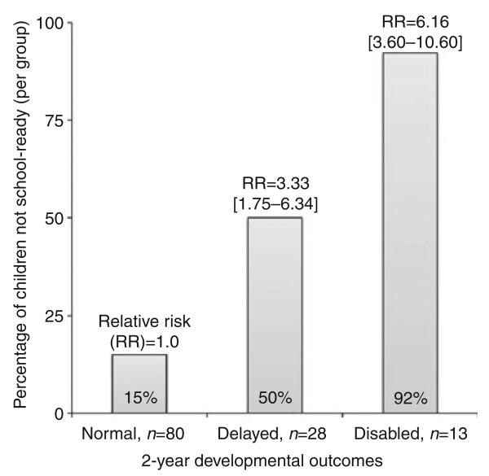
Relationship Between Neurodevelopmental Status: 2Y and 5.5 Y
Notes:
This slide demonstrates the relationship between neurodevelopmental status at age 2 years and lack of school readiness at age 5.5 years. Point to disabled column. 92% of children with disability at age 2 were not school ready at age 5.5, a relative risk of 6. with confidence intervals of 3.6 and 10.6) Point at delayed column. 50% of children with delay at age 2 were not school ready at age 5.5 years. A greater than threefold relative risk. The comparison group were the 80 children who were normal at age 2 Y, 15% were not ready for kindergarten.

Slide 10
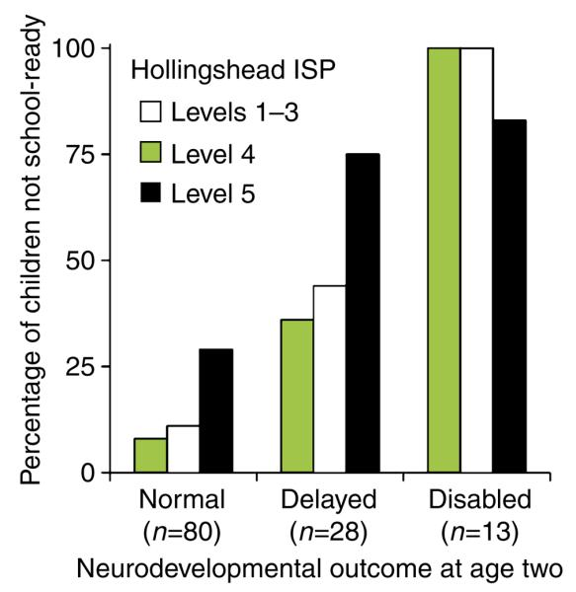
Neurodevelopmental Status at 2Y and 5.5Y by SES
Notes:
This graph shows the role of socioeconomic status as demonstrated by the Hollingshead Index of social position and neurodevelopmental status at ages 2 and 5.5 y. Of the 28 children delayed at age 2 75% of those with limited education and employment designated by Hollingshead level 5 were not school ready. Of the children with parents with some college and a middle income or higher wage, 7 % were not school ready if they had normal development at age 2. However more than 25% were not school ready if there parents had not completed high school or were unemployed.

Slide 11
Health Disparities and Early Intervention, Head Start and Early Child Education
10% of H IV/V accessed early intervention birth to three years.
25% accessed Head Start from 0-2 years or Early Child Education from 3-5 years
If children received early intervention services, then 30% needed kindergraten special education services.
If they did not receive early intervention services, then 70% needed kindergarten special education services.
Economic Model used: Educational costs from not implementing the IHDP model.
Notes:
Just read this slide

Slide 12
Special Education Consequences of not receiving IHDP: EI-ECE-EHS
% of children

Slide 13
Model: Extra Special Education Costs
For every 100 VLBW without EI-ECE-EHS
Some special ed : 25 x $15K x 16 Y=$6.0M
Intensive spec ed: 15 x $30K x 16 Y=$7.2M
For every 100 VLBW with EI –ECE-EHS
Some special ed: 15 x $15K x16 Y=$3.6M
Intensive spec ed: 8 x $30K x16 Y=$3.8 M
Notes:
fa figure. Y axes special education costs Group 1 + EI-EHS a veritcal bar with yellow some special ed and red intensive special ed. Next sport on x axis Group 2 No EI/EHS .

Slide 14
IHDP Investment model
In order to increase EI-ECC-EHE from 35% to 90% will cost $40K per child.
In 100 VLBW who are H4 or H5 this will cost 55x$40K=$2.2M
This will save special education $5.8M just in educational costs. For every dollar there is a savings of $2.60
If one considers dropouts the savings is even higher and estimated to double. For every dollar then the savings is $5.20.
Notes:
Read this slide

Slide 15
Conclusion
There are high special education costs in not receiving early education services after very preterm birth.
Strategies for auditing home visiting, family supports, and receiving EI and ECE services are needed.
This model was used for the 1% of highest risk preterms.
It has been shown that there are additional benefits for 10% of preterms who are 32-36 weeks gestation.
These children are also missing access to home visiting, head start and early childhood education.
Notes:
Read the points in this slide.

