Slide 1

A Pilot Study: Use of a Multisport Team as a Mechanism to Promote Self-Determined Exercise
Break the Cycle⁹
Jeff Condit, CSCS
Dr. Paula Papanek, PhD, MPT, LAT, FACSM
Marquette University: Department of Physical Therapy
Notes:
BE SURE TO START BY THANKING BTC ORGANIZERS!

Slide 2
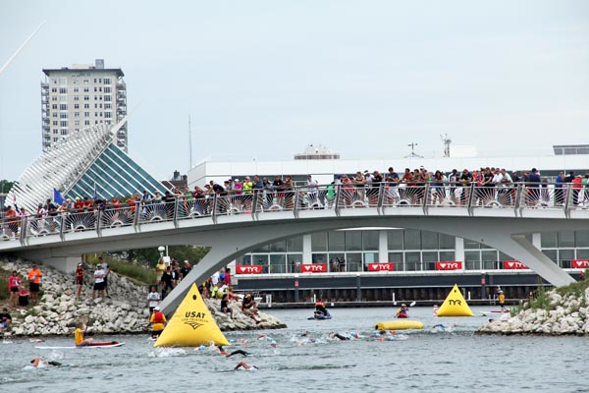
Hypothesis
The use of a multisport (triathlon) based educational and fitness program will positively impact motivation to exercise and, subsequently, perceived and actual levels of leisure time physical activity (PA) in a group of overweight Latino adolescents.

Slide 3
The National Problem (epidemic)
49.5% > 60 minutes per day on 5 or more days; Hispanic female (33.0%) (YRBSS 2011)
Percentage overweight among children and adolescents 6-11 years of age, 2007-2010
Mexican American Non-Hispanic White Mexican American/ Non-Hispanic White Ratio
Girls 22.4 14.0 1.6
Boys 24.3 18.6 1.3
Source: CDC 2013. Health United States, 2012. Table 69.
- See more at: http://minorityhealth.hhs.gov/templates/content.aspx?lvl=3&lvlID=537&ID=6459#sthash.KEjllVwV.dpuf

Slide 4
Breaking the Cycle of Obesity
Normal Development with Healthy Weight
Increased Competition in Sports
Inadequate Interventions
Cycle of Obesity
Success
-Motor Skills
-”Winning”
Exercise
-More Fun
Weight Loss/Maintenance
Strength Increases
Exercise
-Easier
Defeat
Failure/Isolation
Coping Mechanisms
-Sedentary Behaviors
-Increased Food Intake
Weight Gain
Exercise Becomes More Difficult
YES3 Triathlon Club
Autonomy, Relatedness, Competence

Slide 5
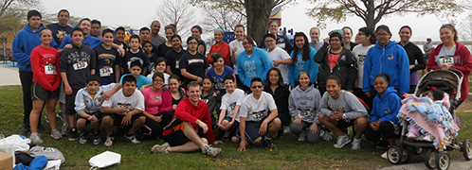
YES³ (Youth Empowered to Succeed)
A program funded by OMH to test novel intervention methods regarding physical activity/nutrition, health (decreased DM, CVD & stroke risk) education, culture and career exploration.
http://www.marquette.edu/youth-empowered-to-succeed/

Slide 6
The Problem……our school
Category
2006
2007
2008
2009
2010
2011
(N = # of students for
(N =
(N =
(N =
(N =
(N =
(N =
which data is
575)
503)
595)
615)
603)
651)
available)
1
–
8
1
–
8
1
–
8
1
–
8
1
–
8
1
–
8
grades
grades
grades
grades
grades
grades
Underweight (< 5th)
1.74%
3.18%
1.51%
0.16%
0.8%
1.5%
Healthy weight
20.87%
16.10%
18.66%
35.1%
32.8%
32.4%
(5th
-
75th)
At risk (75
th
-
85th)
30.43%
30.02%
27.56%
10.89%
11.3%
14.9%
Overweight (85th
-
20.35%
18.69%
21.51%
24.4%
22.4%
21.0%
95th)
Obese (> 95th)
26.61%
32.01%
30.76%
29.4%
32.7%
30.1%
Table 1
: P
ercentage of students by year and weight category
attending BGCS

Slide 7

YES³ Cohort and Barriers to PA
100% Latino
  Cultural Issues
Urban
Gang territory (15 of the largest gangs)
95% Over Weight / Obese / Morbidly Obese
Transportation to school

Slide 8
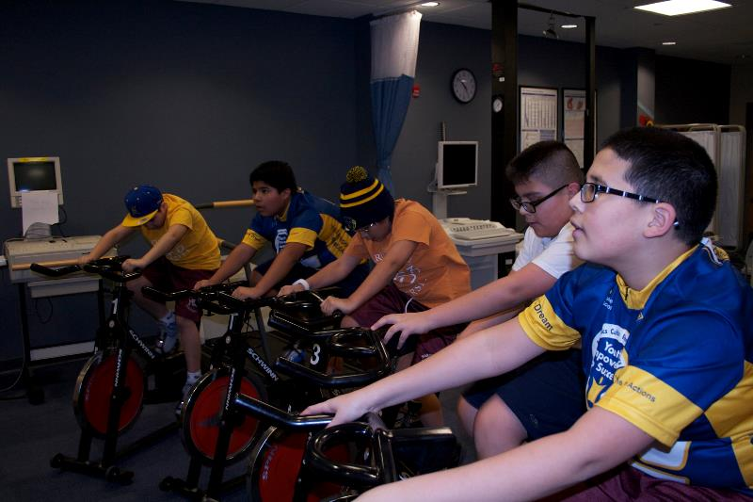
Behavioral/Intervention Components
“Needs Satisfaction”- Autonomy, Competence, Relatedness

Slide 9
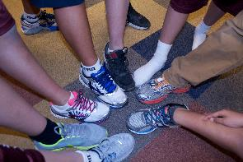
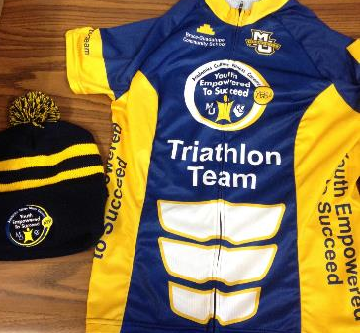
Why Tri??
Unique and novel
Progression for special populations
Life long participation opportunities
Future of the sport
Team and Individual opportunities
Incorporates components of behavioral change theory
Allows for progressive exercise especially for overweight (swim, bike first) before weight bearing and high joint impacts.

Slide 10
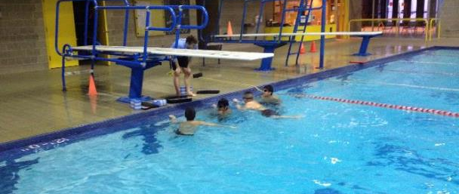
Methods:
Cohort Selection
6th Graders @ BGCS (n=87)
YES3
(n=30)
TriClub
(n=12)
Boot Camp Controls (n=12)
Controls (n=57)
Controls (n=11)
All from a single Middle School
All in 6th Grade

Slide 11
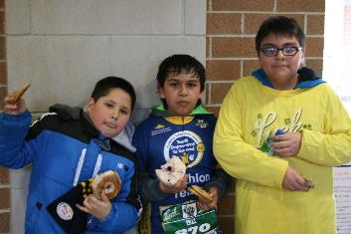
TRICLUB PROTOCOL
Consent/assent obtained
Baseline measurements
12 week intervention
  2 times / wk x 50 mins
4 events – 5K races with chip timers for performance
Post training measurements
    TRI n=8, BOOT n=6, Control n=10
Break for Christmas holiday

Slide 12
Outcome Measures (pre/post design)
Behavorial Change: Motivation
  BREQ-2
    Behavioral Regulation in Exercise Questionnaire
    5 Categories: Amotivation, External, Introjected, Identified, Intrinsic
Physical Activity
  PAQ-C
    Physical Activity Questionnaire for Older Children
Aerobic Fitness (Pacer & Race times)

Slide 13
RESULTS: BREQ-2: Behavioral Regulation in Exercise Questionnaire

Slide 14
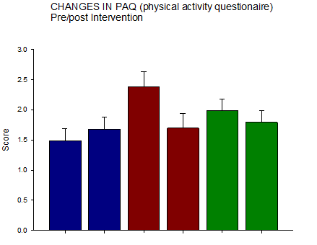
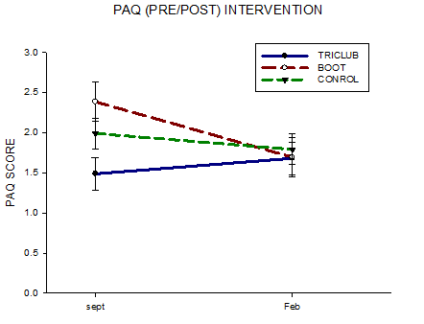
RESULTS
PAQ-C: Physical Activity Questionnaire
Self-reported perceived Physical Activity

Slide 15
Performance times & Aerobic Capacity Improved!

Slide 16
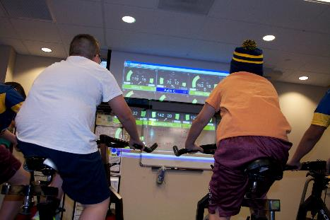
Conclusions:
Only TriClub reported increase in PA.
Triathlon Cohort reported higher motivation for PA in all categories except External Motivation.
Many of the areas approached statistical significance (0.059) but lacked power due to small N’s in boot and control, especially at post. Need more time for changes to reach statistical significance.
In the Future
-6 Mo. Follow up
-Anthropomorphic/Fitness Measures
-Parent Proxy Survey
-Expand Boot and Control Cohorts
-Seasonal Planning
-Qualitative Analysis

Slide 17
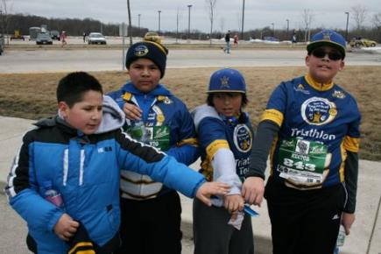
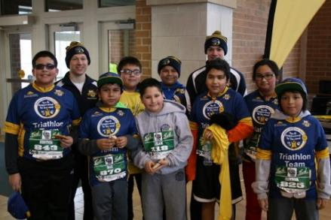
Acknowledgements & Questions
Dr. Paula Papanek
Break the Cycle Committee
Mark Caballero
The Triclub Kids
Kelly Dione
Maria Cevilla
Tim Balke
Bruce Guadalupe School
Funding from OMH
Bikes from Briggs Stratton Co.
Advising Committee:
Dr. Alex Ng
Dr. Carolyn Smith
Mike Danduran, MS
Dr. Lisa Edwards

