Slide 1
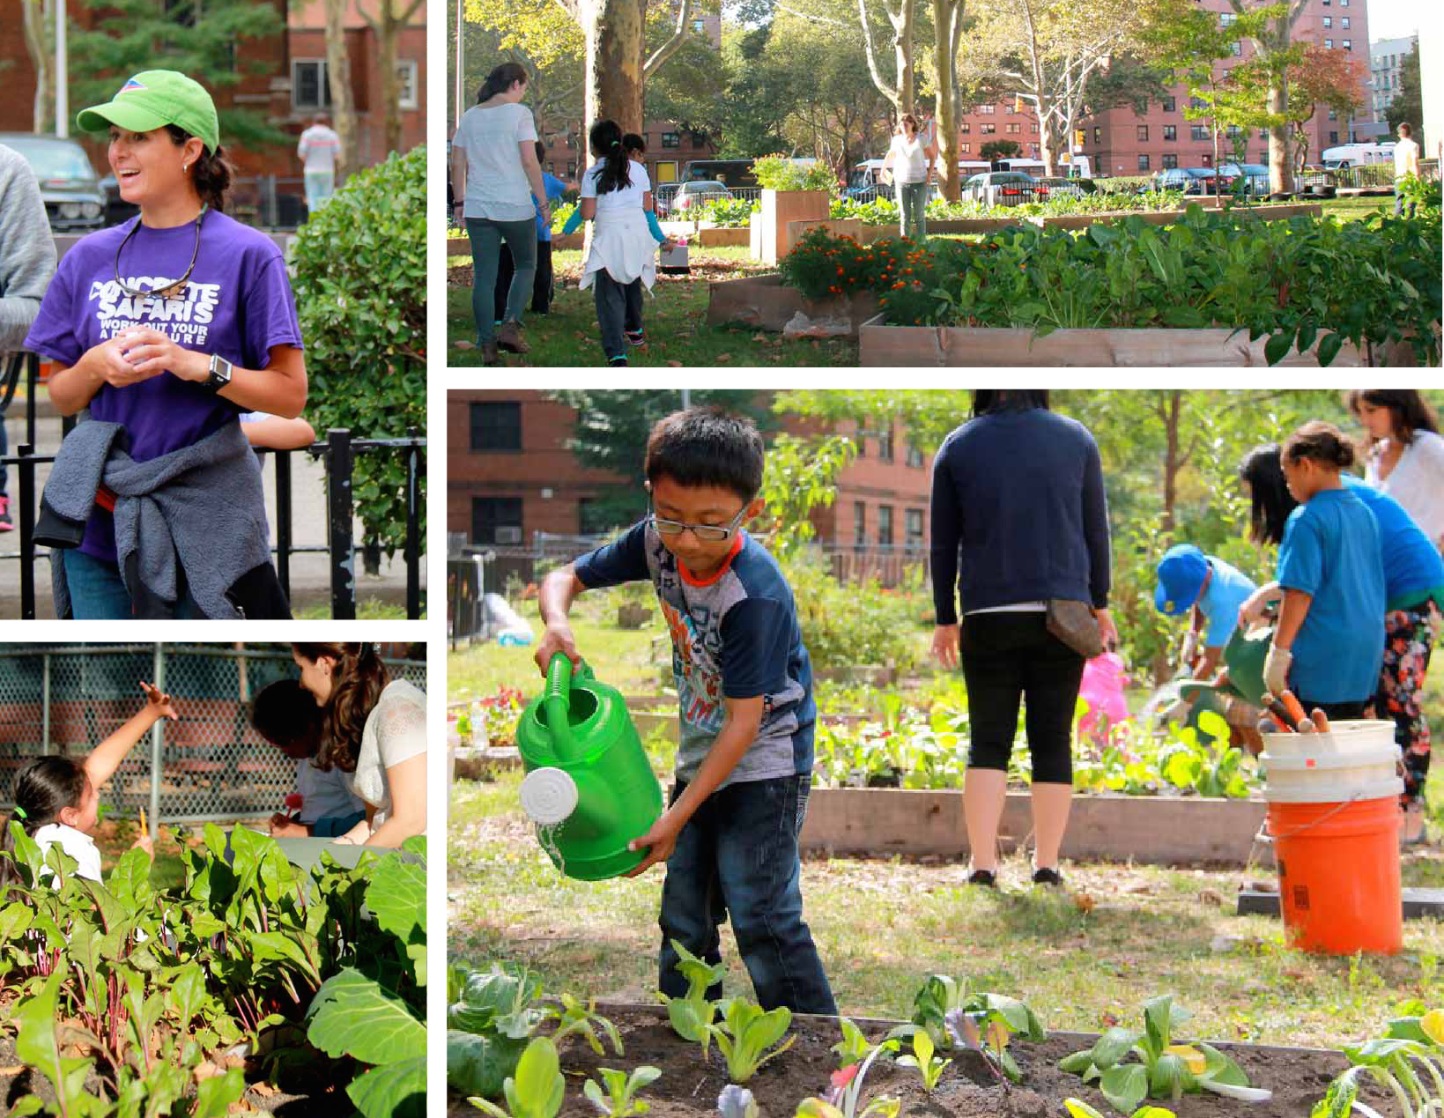
Notes:
However, when you populate the space with activiteis for children at a neighborhood and individual level, they will come. Kind of like the saying in the movie “Field of Dreams” ,“If you build it, they will come”.
Here are some pictures of the implementation of the gardens in the neighborhood and some of the activities the children particpate in with volunteers
Concrete Safaris is an intervention that addresses the root causes of these health disparities. How it does this is it operates as an after school program designed in partnership with children living in East Harlem’s public housing projects to help improve academics, activity levels, calorie expenditure, and decision-making skills. Specifically Concrete Safaris partnered with P.S. 102 in East Harlem to deliver a 5-day per week after school program in which children designed gardens, studied nutrition and cooked, developed bike routes and cycled those routes, and created an annual race to promote fitness among youth and families. The program has been in operation for two full school years since 2012.

Slide 2
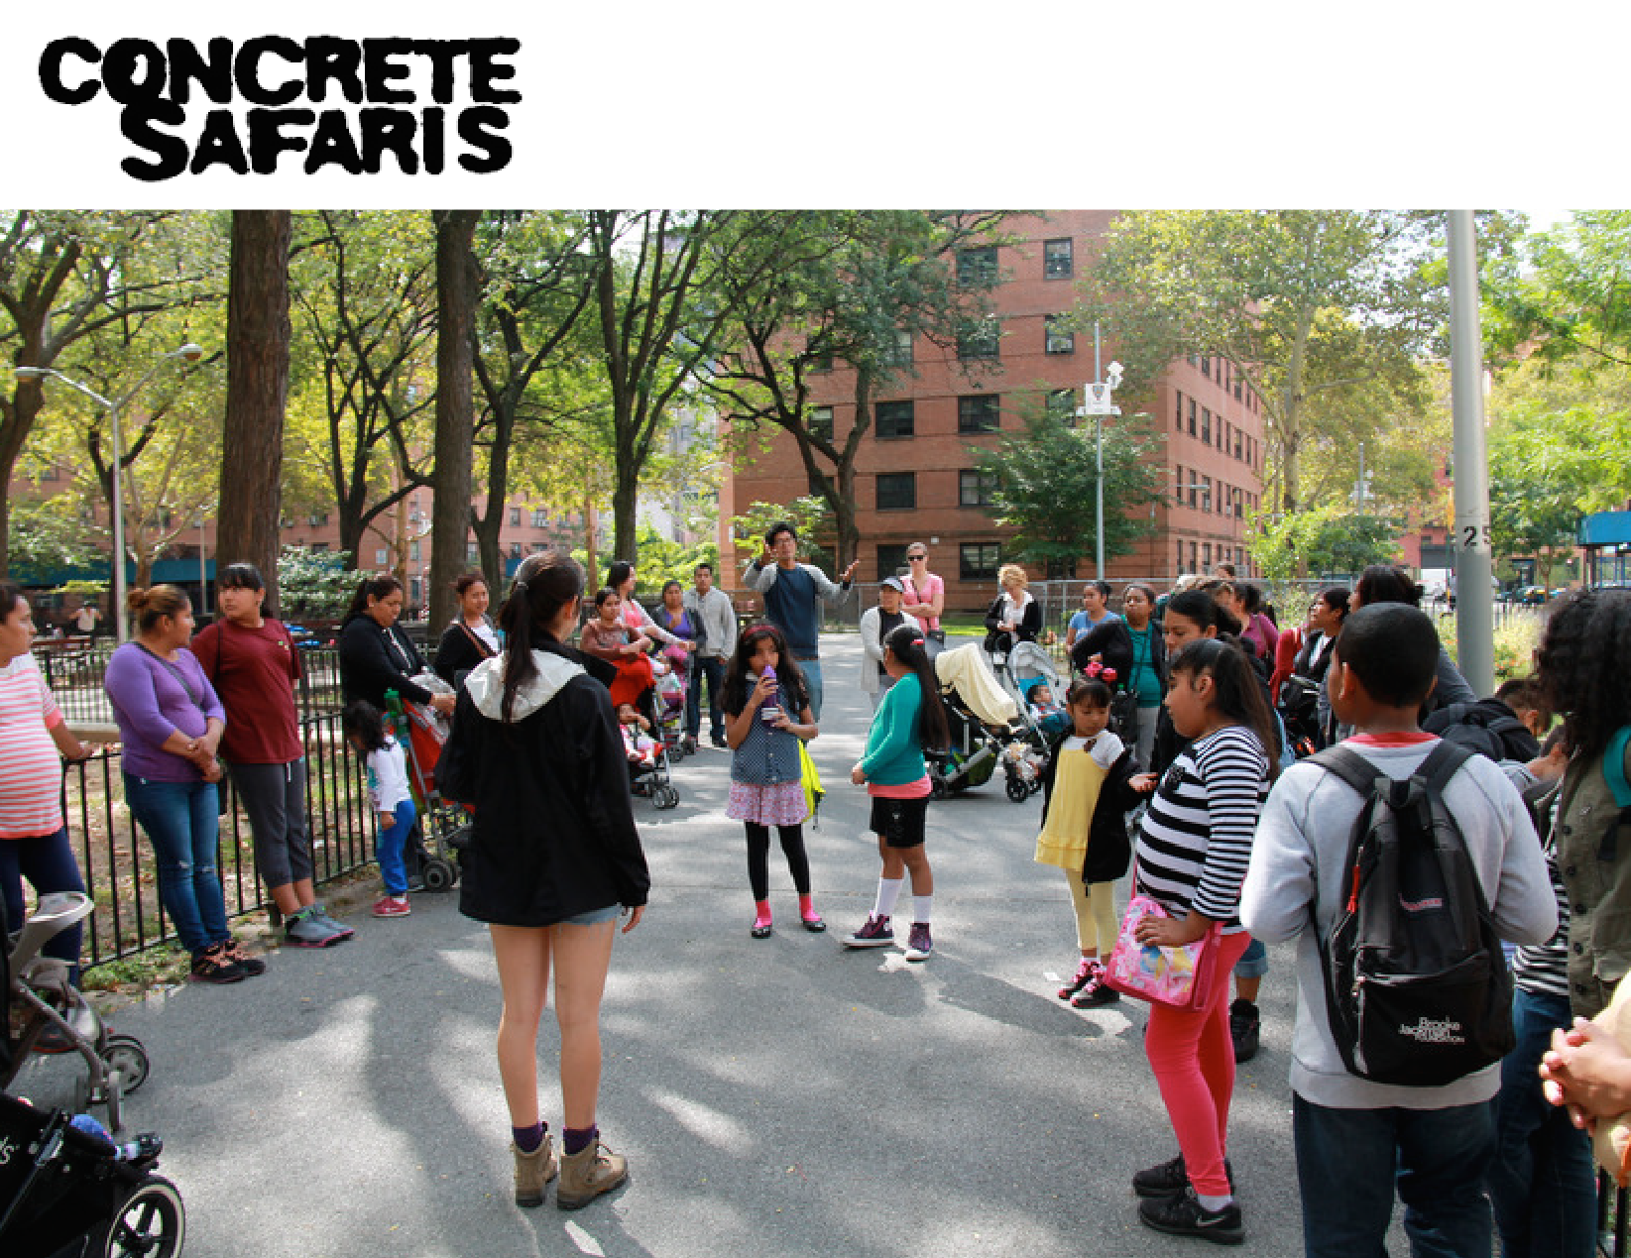
Notes:
However, when you populate the space with activiteis for children at a neighborhood and individual level, they will come. Kind of like the saying in the movie “Field of Dreams” ,“If you build it, they will come”.
Here are some pictures of the implementation of the gardens in the neighborhood and some of the activities the children particpate in with volunteers
Concrete Safaris is an intervention that addresses the root causes of these health disparities. How it does this is it operates as an after school program designed in partnership with children living in East Harlem’s public housing projects to help improve academics, activity levels, calorie expenditure, and decision-making skills. Specifically Concrete Safaris partnered with P.S. 102 in East Harlem to deliver a 5-day per week after school program in which children designed gardens, studied nutrition and cooked, developed bike routes and cycled those routes, and created an annual race to promote fitness among youth and families. The program has been in operation for two full school years since 2012.

Slide 3
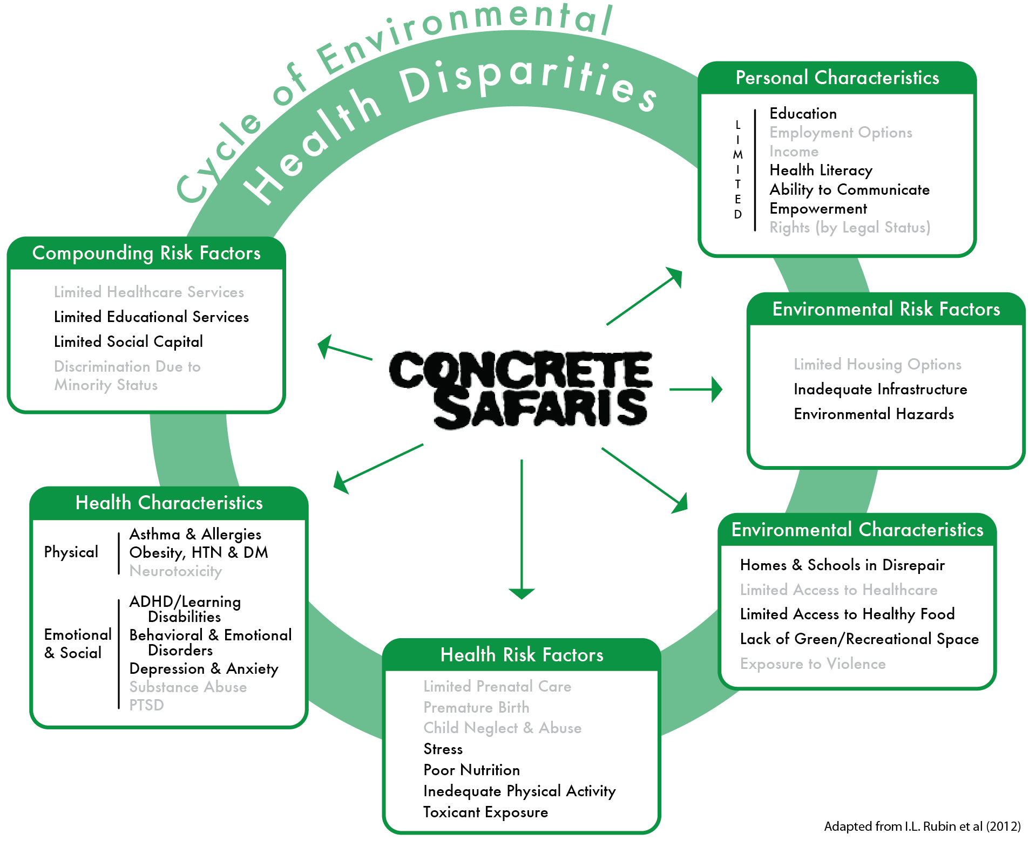
Breaking the Cycle
Notes:
So as you see, Concrete Safaris is an intervention that is indeed working on three levels: Public Policy, the neighborhood, and the individual

Slide 4
Quantitative Results
Results Year over Year | 2012-2013 | 2013-2014
Total Participants | 34 | 33
High Attenders | 16 | 24
Hours of Physical Activity | 4,940 | 5,678
NYC FitnessGrams (BMI Percentile Index) | 70.26 | 73.79
Academic Performance | 2.7 | 2.94
Notes:
So let’s take a look at the results of the 1st year over year comparison:
Total Participants remained flat year over year showing that there is consistent interest in the program and not shown here, 24% of the 2013-2014 participants returning from last year.
The number of attenders that attended the program more than 50% of the available program days increased showing a growing enthusiasm in the program and this data point is in line with the increase in the numbers of hours of physical activity.
The NYC FITNESSGRAMS statistics remained flat while academic perfmance showed slight improvement with the increase coming mostly from the repeat attenders.
While these results are promising, it is to be noted that the program has only been operating for 2 full school years so the program has not yet achieved a steady state.
Much of the real data analysis of how effective the program is in achieving its goals will come in phase two where we will perform a prospective cohort study to assesses academic performance, school attendance and improvement in fitness of the students in the Concrete Safaris program that are high-attenders comparing them to students in the program that are low-attenders and comparing the overall students in the Concrete Safaris program to a control group of students selected from the school district.

Slide 5
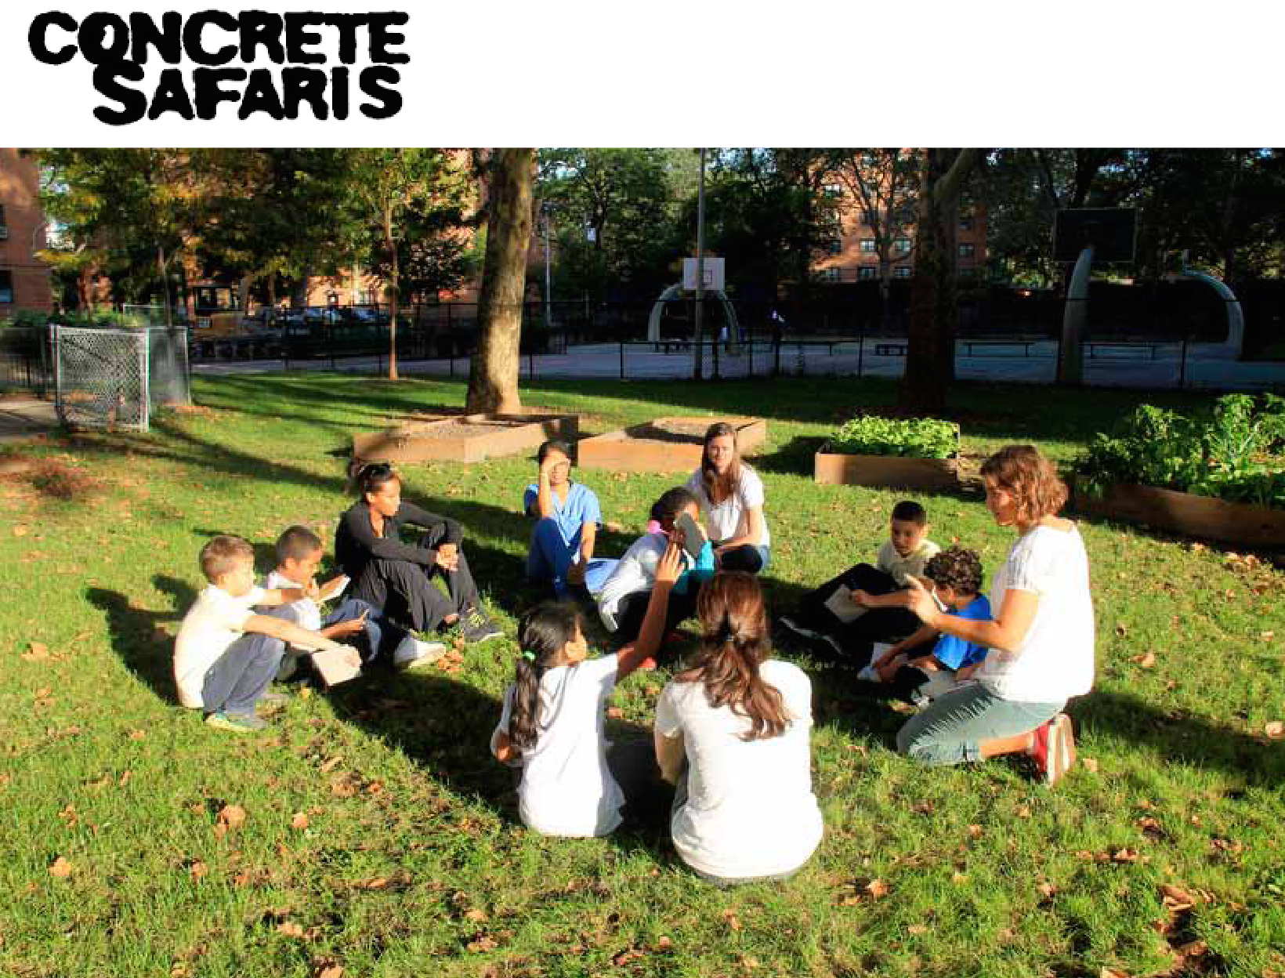
Qualitative Survey Results
Notes:
In addition to the the quantitiative results, we also obtained qualitative data to assess how effective the program is from the parent’s perspective as well and the child’s perspective. We asked a series of value-based questions and the results revealed that….
Since Starting Concrete Safaris…
100% of parents believe their child is making better decisions more often since starting Concrete Safaris
55% of parents state their child plays outdoors outside of the Concrete Safaris Program more often
45% of parents state their child asks to eat fruits and vegetables more often since starting Concrete Safaris
Since Starting Concrete Safaris the children..
State the most that “eating healthy” is the most important thing they have learned
State that they like “biking and gardening” the most about the program
State they dislike the “homework time” the most about the program

Slide 6
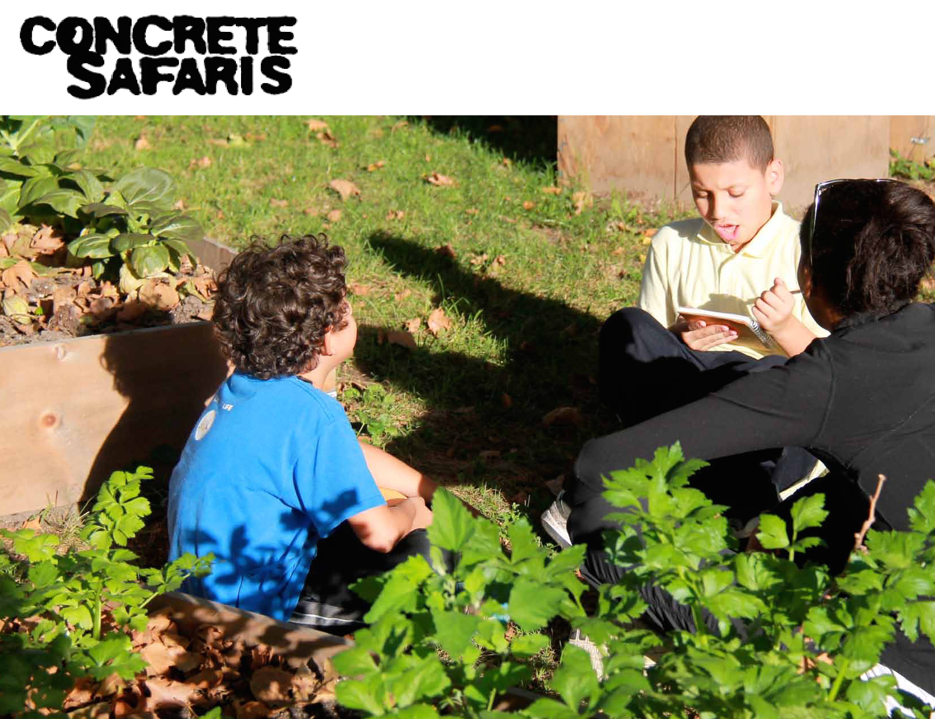
Notes:
As I mentioned, since this intervention is still in its early stages, more robust data analysis is the next step.
The Concrete Safaris Program is robust and we are looking forward to further evaluation of all the program is capable of delivering for children. For example, since Concrete Safaris is a program that is funcitoning on multi-levels we are looking at measuring the quality of the neighborhood environment—measuring statistics such as crime. More to come….
Thank you for your time.

