Slide 1


Mitigating Effects of Positive Learning Environment on Early Life Exposure to ETS on Neurodevelopment in Children
Student: Madeleine Hopson
Mentor: Julie Herbstman, PhD
Columbia University
Notes:
Good morning, my name is Madeleine Hopson and my mentor for this project is Julie Herbstman and we are from Columbia University’s Mailman School of Public Health.
My project looked at how the home environment can mitigate the effects of prenatal environmental tobacco smoke exposure on behavioral outcomes in children.

Slide 2
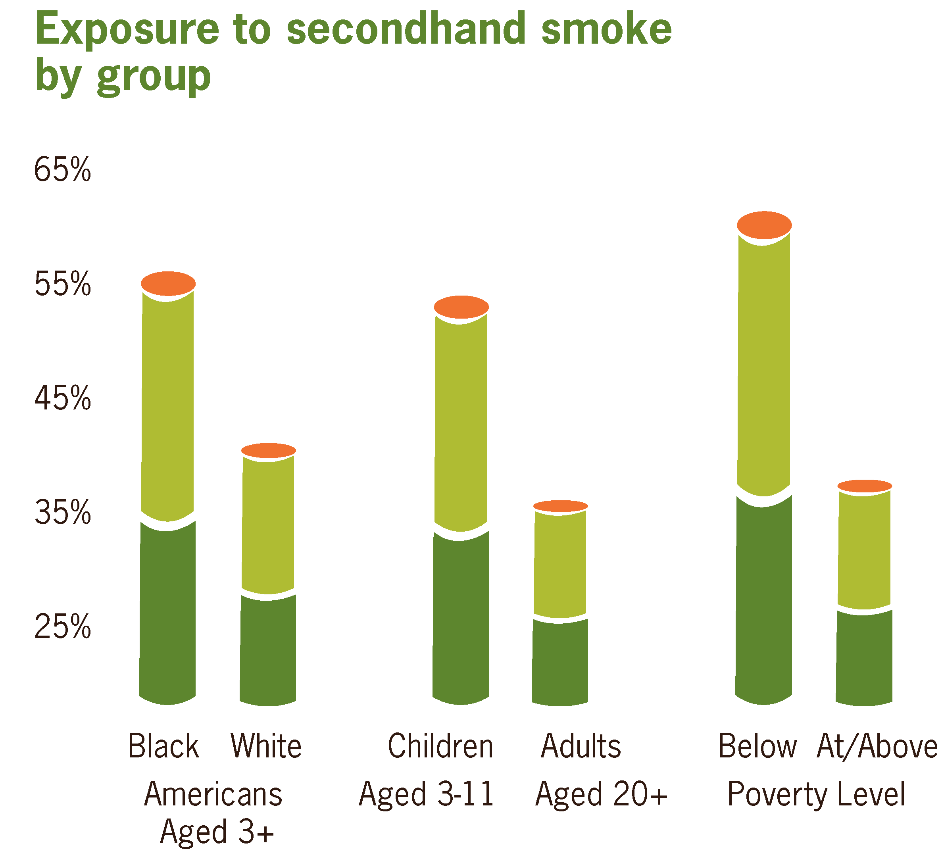
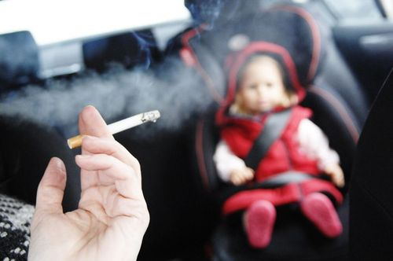
Background: ETS
10 million children under age 6 exposed to residential ETS
  Unequal in minority, low income, and urban populations
Effects on asthma, bronchitis, pneumonia, reduced birthweight & length, cognition, behavior
Notes:
The adverse effects of prenatal maternal active smoking on children’s development has been well documented, but it’s only in last few decades that the effect of environmental tobacco smoke, ETS, or passive, second hand smoking, has been examined.
In 2004, over 10 million children under age 6 were being exposed to residential ETS. And as you can see from this graph from the CDC, there is an unequal distribution of ETS on children from low-income, and minority populations, which also tends to be overrepresented in urban populations.
A lot of the work done on prenatal ETS exposure has shown significant effects on asthma, bronchitis and other respiratory conditions, but there has also been research done on cognitive and behavioral effects in children.
In a study done by Virginia Rauh at Columbia University, children exposed prenatally to ETS had lower cognitive scores at 24 months than unexposed children. And this relationship was mediated (JH: I think you may mean MODIFIED not MEDIATED here. . .I thought material hardship modified the effect of ETS such that kids who were ETS exposed AND had material hardship had lower scores on mental developmental index (MDI) than those who had one or the other or neither exposure. . .) by maternal hardship, so inability to pay electricity, rent, to afford food, etc. So this points to poverty and prenatal ETS exposure, which are already highly correlated, having an additive effect on children’s neurodevelopment.
- Bayley MDI measured at 24 months
Material hardship + prenatal ETS = 7.1 points lower
Puts more kids in developmentally delayed range, more likely to need early intervention services b/c potentially at risk for early school failure
(2004) Rauh et al.
Children with prenatal ETS exposure had cognitive scores on average 5 points lower than unexposed
Worsened when mediated by high material hardship (unmet needs of food, housing, or electricity)

Slide 3
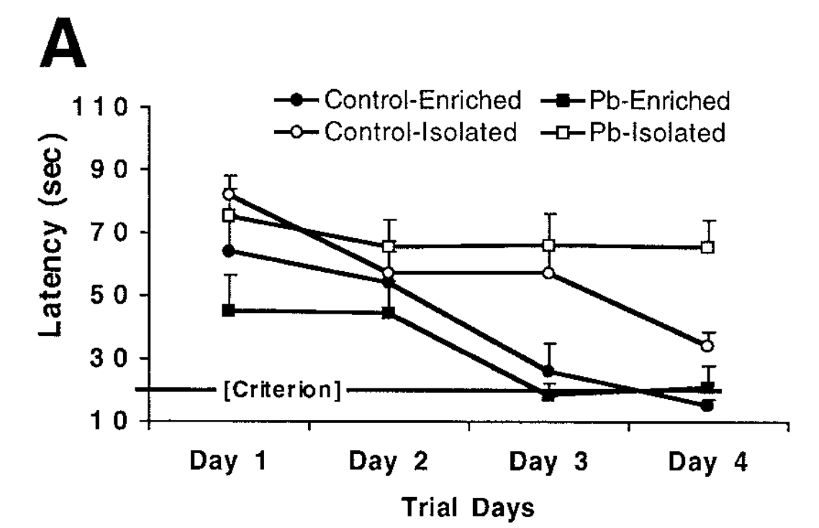
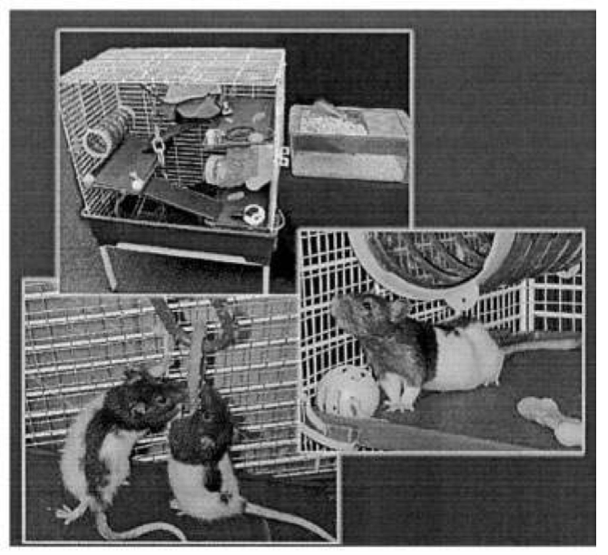
Background: HOME Environment
Environmental enrichment reversed cognitive learning deficits resulting from exposure to lead during gestation
Guilarte, T. et al. 2003. Ann Neurol. 2003; 53: 50-56.
Notes:
So building off that idea, another study done at Columbia University (JH: I think Tom did this work while he was still at Hopkins) showed how the adverse cognitive effects of early life lead exposure in rats was mitigated by a stimulating environment during development.
In this study, there were lead exposed and lead unexposed rats that were randomized to enriched or isolated environments after birth. Enriched environments consisted of living with 7 other rats, being in cages that had a variety of toys, tunnels, and running wheels, and had more human interaction. Isolated rats had none of these. Cognition was measured by how long it took the rats to master a spatial learning task where they are placed in opaque water and need to find a platform, or a latency score.
As you can see in this graph, rats who were lead exposed and grew up in an isolated environment had the worst performance shown by the highest latency scores, or the most time needed to figure out how to get to the platform. In fact almost 50% of rats never even learned where the platform was. However, rats who were lead exposed but grew up in an enriched environment performed just as well as rats who were unexposed to lead but grew up in an enriched environment. This suggests that growing up in an enriched learning environment has the ability to mitigate adverse prenatal effects of prenatal (lead) exposure.
Lead exposed rats in enriched environment performed as well as control-enriched rats on spatial learning task
Enriched: 8 rats, toy variety, tunnels, running wheels, etc.
- Female rats given lead or no lead 10 days before breeding → gestation → weaning
- Pups in isolation or enriched environment until 56 days old
Water maze at 50 days (opaque, measure time it takes to find platform) – have to reach in 20 seconds for 2 consecutive days
Almost 50% of Lead exposed/isolated couldn’t find platform by last day of training
Performed better than control/isolated rats & much better than lead exposed/isolated rats

Slide 4
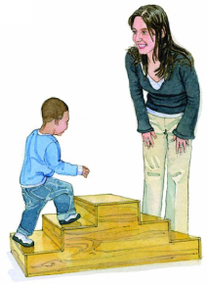
Hypothesis
A Priori:
Adverse cognitive and behavioral effects at age 7 that are associated with prenatal ETS will be mitigated by a positive home environment
Post hoc:
Adverse behavioral effects at age 7 that are associated with prenatal ETS will be exacerbated by growing up in a negative home environment
Notes:
This lead us to the hypothesis that the cognitive and behavioral effects seen in children at age 7 from prenatal ETS exposure could be mitigated by also growing up in an enriched learning environment.
After looking at the data for the study, we found that there was little effect of ETS on cognitive scores, and decided to focus on the adverse behavioral effects of ETS on behavioral outcomes at age 7. We also found much more compelling results regarding exacerbation of ETS-related adverse behavioral effects rather than mitigation and therefore our final hypothesis was that adverse behavioral effects at age 7 that are associated with prenatal ETS exposure would be exacerbated by growing up in a negative home environment.

Slide 5
Methods
Columbia Center for Children’s Environmental Health Cohort:
712 pregnant women between ages 18-35
  African American or Dominican
  Lived in Washington Heights, Central Harlem, or South Bronx
Exclusion criteria:
Active smokers, high-risk pregnancies, living outside neighborhood for more than 1 year
Current study selection:
Children with complete data for CBCL and HOME scores
N = 407 (57.2%)
Notes:
We used data collected by the Columbia Center for Children’s Environmental Health, which has an ongoing cohort study composed of pregnant women enrolled between 1998-2006 and their children, who have been followed up regarding numerous exposures and outcomes. The women and children self-report as African American or Dominican and live in neighborhoods of New York City that have high minority and low SES populations and are characterized as disadvantaged. The red dots on the map shown here display the home addresses of the women and their children, so you can see that the women are primarily from northern Manhattan and the Bronx. (JH: Might want to take a second to orient people to the map. . .people outside of NY may not be familiar with this part of the city so when I talk about it outside NYC, I usually start by orienting people to the top of Central Park. . .)
In order to focus on ETS exposure in these populations, women who were active smokers, had high risk pregnancies or lived outside these neighborhoods for more than 1 year were excluded.
Of the 712 pregnant women enrolled in the overall cohort, we focused on women who had complete data for the cognitive and behavioral outcomes and the home scores and so our final cohort consisted of 407 women and their children, which was 57.2% of the overall cohort.
Enrolled between 1998-2006, registered at NYP or Harlem Hospital by 20th week of pregnancy

Slide 6


Methods
Prenatal ETS measured through prenatal questionnaire
Question example:
  “Can you please tell me the number of smokers in your home (the place where you spend the most time)”
Cotinine levels measured in cord blood
Notes:
Prenatal ETS exposure was measured by a prenatal questionnaire the women took when they first enrolled in the cohort at the prenatal clinic. Some of the questions used to gauge ETS exposure included:
“can you please tell me the number of smokers in your home, which is considered the place you spend the most time” and “In your home during pregnancy, how many consecutive months were you exposed to someone else’s tobacco smoke” We categorized the presence of any smoker in the home as prenatal ETS exposure.
When the women gave birth, umbilical cord blood AND MATERNAL BLOOD was collected and analyzed for cotinine, which is a common, short-term biomarker of cigarette exposure, and and woman with the presence of cotinine in umbilical cord blood OR MATERNAL BLOOD was also considered to have a child that was ETS exposed DURING GESTATION.

Slide 7
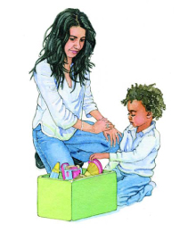
Methods
HOME Inventory
  Learning Materials:
    Child has at least 10 children’s books
    Child has toys which teach colors, sizes, and shapes
  “Bad homes” were those with HOME scores in lowest 25th percentile
Child Behavior Checklist (CBCL)
  Attention Problems: Fails to finish, Can’t sit still
  Rule Breaking Behavior: Lies, cheats, Sets fires
  Aggressive Behavior: Destroys others’ things, Argues
  Externalizing Behavior: Rule breaking & Aggressive
Notes:
The home environment was measured using the HOME Inventory Scale, which is a validated, semi-structured interview given by a trained interviewer in the home of the child. The HOME inventory has 8 different subscales that comprise a total home score. Based on prior research that would be likely to affect behavioral outcomes, we focused on the Learning Materials and Language Stimulation subscales. Some examples of how the Learning Materials subscale was ranked includes whether the child has at least 10 children’s books and whether the child has toys that teach colors, sizes, and shapes and examples of the Language Stimulation subscale include whether the parent teaches the child simple verbal manners and whether the parent encourages the child to talk and takes time to listen.
Based on the distribution of HOME scores in our cohort, we categorized a bad home as those with home scores in the lowest 25th percentile. And “good homes” as those above the 25th percentile of scores.
Lastly, behavioral outcomes were measured using the Child Behavior Checklist, which is questionnaire filled out by the child’s mother regarding their behavior in a variety of subscales. Because we were focusing on ADHD-like behaviors, we looked at the effects on attention problems, rule breaking behavior, aggressive behavior, and externalizing behavior. Attention problems included behaviors such as fails to finish and can’t sit still, rule breaking behavior consists of behaviors such as lying, cheating, setting fires, aggressive behavior consists of behaviors like destroying the things of others and arguing, and externalizing behavior is a composite score of both aggressive and rule breaking behaviors.

Slide 8
Results
All analyses conducted using negative binomial regression in STATA
Covariates:
Main Effect:
Child’s Gender | Ethnicity | Child’s Age at Assessment
Maternal Education | Maternal IQ | Maternal ADHD Symptoms
Material Hardship | Maternal Demoralization
Notes:
All analyses were conducted in STATA using negative binomial regression which IS A TECHNIQUE USED TO ANALYZE ‘COUNT’ DATA AND accounts for the variance in outcome scores being greater than the mean. All analyses were adjusted for the following covariates including child’s gender, ethnicity, and age at assessment and the mother’s educational level, MATERNAL IQ, diagnosis of MATERNAL SYMPTOMS OF ADHD, materIAL hardship and maternal demoralization. MaterIAL hardship included whether the mother indicated that she couldn’t afford food, housing, or gas & electricity and maternal demoralization was included because of the fact that the mother was completing the behavioral checklist and could bias her child’s results if she was feeling demoralized.
We started off by looking at the main effect of prenatal ETS exposure on behavioral outcomes when adjusted for the previous covariates, and as you can see in this graph, there was a SMALL main effect of ETS on all 4 measured behavioral domains, where prenatal ETS exposure was associated with a higher number of behavioral problems in attention, rule breaking, aggressive, and externalizing scores.
Negative binomial regression because of variance being greater than the mean
The impact of ETS differs depending on home environment
No ETS not good
ETS not good
No ETS good
ETS good

Slide 9
Results: Exacerbating Effects
Overall home environment increased number of problems in Aggressive Behaviors (p=0.027) and Externalizing Behaviors (p=0.02) scores
Notes:
I HAVE A QUESTION ABOUT THIS GRAPH: IS IT REALLY GOOD HOME VS. BAD HOME? THE WAY YOU DESCRIBE THE WAY THAT YOU DEFINE GOOD HOME = UPPER 25% AND BAD HOME = LOWER 25%? IF THE LABELS ON THIS GRAPH ARE CORRECT THEN THESE RESULTS ONLY REFLECT 50% OF THE PARTICIPANTS (THOSE IN EITHER GOOD HOMES OR BAD HOMES). IS THIS REALLY WHAT YOU GRAPHED HERE?
I THOUGHT THAT WHAT YOU DID HERE WAS TO LOOK AT BAD HOME (LOWEST 25%) VS. NOT BAD HOME (26-100%) BUT THAT THE LABEL FOR ‘NOT BAD HOME’ WAS CONFUSING SO MAYBE YOU REPLACED THIS WITH ‘GOOD HOME’? IF THIS IS THE CASE, YOU WILL WANT TO CHANGE THE WAY YOU DESCRIBE GOOD HOME DEFINITION ON SLIDE 7.
IF IT REALLY IS GOOD HOME (UPPER 25%) VS. BAD HOME (LOWER 25%), THEN YOU SHOULD MAKE SURE THIS IS CLEAR WHEN YOU DESCRIBE THIS GRAPH IN THAT IT ONLY INCLUDES 50% OF THE DATA. . .
I AM EDITING THE PARAGRAPH BELOW ASSUMING THAT IT INCLUDES ALL THE DATA AND THAT WHEN YOU SAY ‘GOOD HOME’ HERE, IT REFLECTS 26%-100% OF HOME SCORES AND IS REALLY JUST THOSE THAT ARE NOT IN BAD HOMES (LOWEST 25%):
Once we stratified the results by home environment, we saw that the effect of prenatal ETS exposure on behavioral outcomes differed by THE TYPE OF HOME ENVIRONMENT THE CHILD LIVED IN. whether or not the child was raised in a good or bad home environment. More specifically, while the effect of ETS on behavior didn’t matter for children raised in good homes (DEFINE), children raised in bad homes with ETS exposure had significantly more behavioral problems than children raised in bad homes who didn’t have ETS exposure.
You can see that relationship in this graph in which the number of behavioral problems is represented on the y axis and the presence or absence of ETS exposure and the home environment type is located on the X axis. Good homes are represented by the left 2 bars and you there is no significant difference in behavior problems between a child with no ETS exposure in the light blue and a child with ETS exposure in the dark blue. However, for children raised in homes considered bad homes, which are shown in the right 2 bars, you can see that the effect of ETS on the predicted number of problems is much greater between exposed and unexposed children. THE INTERACTION TERMS BETWEEN ETS AND HOME ENVIRONMENT ON BOTH AGGRESSIVE BEHAVIORS AND EXTERNALIZING BEHAVIORS WERE STATISTICALLY SIGNIFIANT.
The graph shown here reflects the total HOME environment score on externalizing behaviors, but the same effect was seen on aggressive behaviors as well.
No ETS not bad
ETS not bad
No ETS bad
ETS bad
When youre not in a bad home, ETS doesn’t matter, but when you are ETS has a greater effect

Slide 10
Results: Exacerbating Effects
Learning Material increased number of problems in Attention Problems (p=0.006), Rule Breaking (p<0.0001), Aggressive Behaviors (p=0.001), and Externalizing Behaviors (p<0.0001) scores
Notes:
While the last graph looked at the overall home score, we also found the same relationship when looking at the effect of the presence of learning materials specifically on behavioral outcomes. As I mentioned earlier, the presence of learning materials consists of having at least 10 books, or a variety of toys, et cetera in the home. Once again, we see the same effect, in which the effect of prenatal ETS exposure differs by whether the child was raised in a home that lacked sufficient learning materials or not. While there was still no difference of ETS exposure on behavioral outcomes in homes where children grew up with an abundance of learning materials, you can see that there is a STATISTICALLY SIGNFICANT difference in the effect of prenatal ETS on behavioral outcomes in homes that lacked learning materials, where we see a much larger adverse effect of prenatal ETS on behavioral problems in homes in which there is a lack of learning materials. This graph again shows the effect on externalizing behaviors, but we see the same relationship on all the behavioral outcomes measured, including attention problems, rule breaking, and aggressive behaviors.

Slide 11
Conclusion:
When a child is in a “good home,” there is no significant effect of prenatal ETS exposure on a child’s behavior
Only when a child is in a “bad home” is there a significant adverse effect of prenatal ETS exposure on behavior
  This is primarily driven by the availability of learning materials
Notes:
So in conclusion, this suggests that when a child is in a good home, there is no significant effect of prenatal ETS exposure on a child’s behavior – so no mitigating effect like we predicted in our hypothesis.
However, when a child is in a bad home, there is a significant adverse effect of prenatal ETS exposure on behavior, meaning that growing up in a bad home exacerbates the already adverse effect of prenatal ETS exposure – almost like a 2-hit model. We also see that this exacerbation is driven primarily by the availability of learning materials in the home.

Slide 12
Limitations
Isolating ETS when toxic exposures rarely occur in isolation and are affected by adverse social circumstances
Self-reported measure of ETS
  Bias can underestimate true ETS effects
  By including cotinine, can reduce misclassification by self-report
Instruments used
  CBCL & HOME designed to pick up negative effects
  Symptoms vs. Diagnosis
  HOME Inventory cutoffs
Notes:
Some of the limitations of this study include how to isolate the effects of just environmental tobacco smoke on behavior since there are many other factors that can play a role, especially adverse social circumstances that many of these children and their family are exposed to. Therefore how to quantify environmental tobacco smoke is difficult. We chose to use a prenatal questionnaire, but the mother may not always be aware of her exposure to secondhand smoke or may not chose to report it. This is why we also chose to look at cotinine as a biomarker which may be a more objective indicator of cigarette exposure, but also has it’s own limitations because it is a very short term measure of exposure. However, this bias would LIKELY end up underestimating the true ETS effects.
Another limitation we had was in trying to measure mitigating effects, and we were limited by using instruments like the CBCL AND THE HOME INVENTORY that are well designed to pick up negative effects, but not so much at picking up positive effects. Additionally, the cutoffs we used for both the CBCL and the HOME inventory may have less of clinical significance than a statistical significance. For example, WE ARE COMPARING THE NUMBER OF ATTENTION PROBLEMS AMONG KIDS WHO ARE EXPOSED AND UNEXPOSED AS OPPOSED TO COMPARING KIDS WITH AN ADHD DIAGNOSIS OR NOT. ALSO, it is hard to quantify how different a HOME score of 5 vs. 6 really is.
Self-report methods tend to under-report ETS exposure
Adverse social effects = nutrition, substance abuse, health service delivery, other environmental agents, stress

Slide 13
Breaking the Cycle
Focus of
Interventions
Ideal
Prenatal ETS
Exposure
Behavioral Issues
Lower Educational Attainment
Lower SES
Higher Stress
Notes:
The cycle then that we envision starts with prenatal ETS exposure, which leads to behavioral issues which can lead to a lower educational attainment, a lower socioeconomic status, higher stress levels and an increase in smoking for the core family unit, which in turn can lead again to prenatal ETS exposure. While the ideal strategy would be to reduce any prenatal exposure to ETS, based on our data, focusing on the improving bad home environments may provide an avenue to break the cycle between prenatal ETS exposure and behavioral issues.
Based on the data presented,
Based on my data, the impact of ETS is only observed when in a bad home environment, so focusing on mitigating the bad home environment could lead to significant improve

Slide 14
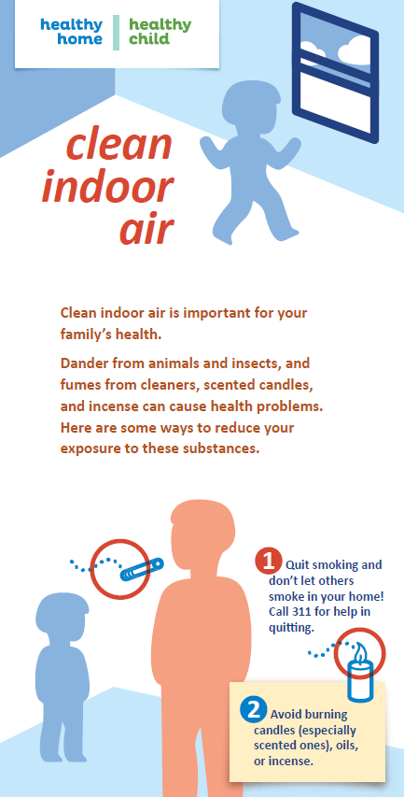

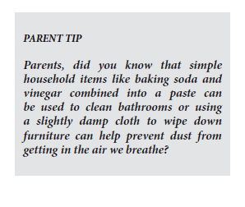
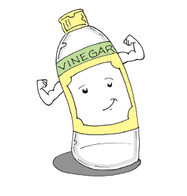
Breaking the Cycle
Modifying learning materials in the home environment
Maternal education about associated risks before, during, and after pregnancy
Written by Sabrina Carter
Illustrated by Jerry Craft
Notes:
More specifically, improving the availability of and access to learning materials in the home environment would help to break this cycle. This would again include providing toys that teach colors, sizes, shapes and that provide free expression, or having more than 10 books in a child’s home. Additionally, parental language stimulation is another aspect of the home environment that we found had strong effects on behavioral scores and depends a lot on a mother or fathers interaction with the child surrounding these learning materials. Finally, educating parents about the risks of prenatal tobacco smoke exposure before, during, and after pregnancy is important, as well as educating parents about the benefits of an enriching home environment. One of the solutions that the Columbia Center for Children’s Environmental health came up with was providing the children and their families with a coloring book, seen here called “Healthy Home, Healthy Child” that is an example of a learning material that also has tips for the children and the parents on how to maintain a healthy home environment, which seems like a solution that incorporates all three of these suggestions.
Toys that teach colors, sizes, shapes
Puzzles
Toys permitting free expression

Slide 15

Acknowledgements
Julie Herbstman, PhD
Virginia Rauh, ScD
Amy Margolis, PhD
Columbia Center for Children’s Environmental Health
  Center Investigators
  Research Workers
  Staff
Study Participants
Notes:
And I just wanted to acknowledge and thank everyone at the Columbia Center for Children’s Environmental Health and my mentor Julie Herbstman for working with me on this project.

