Slide 1
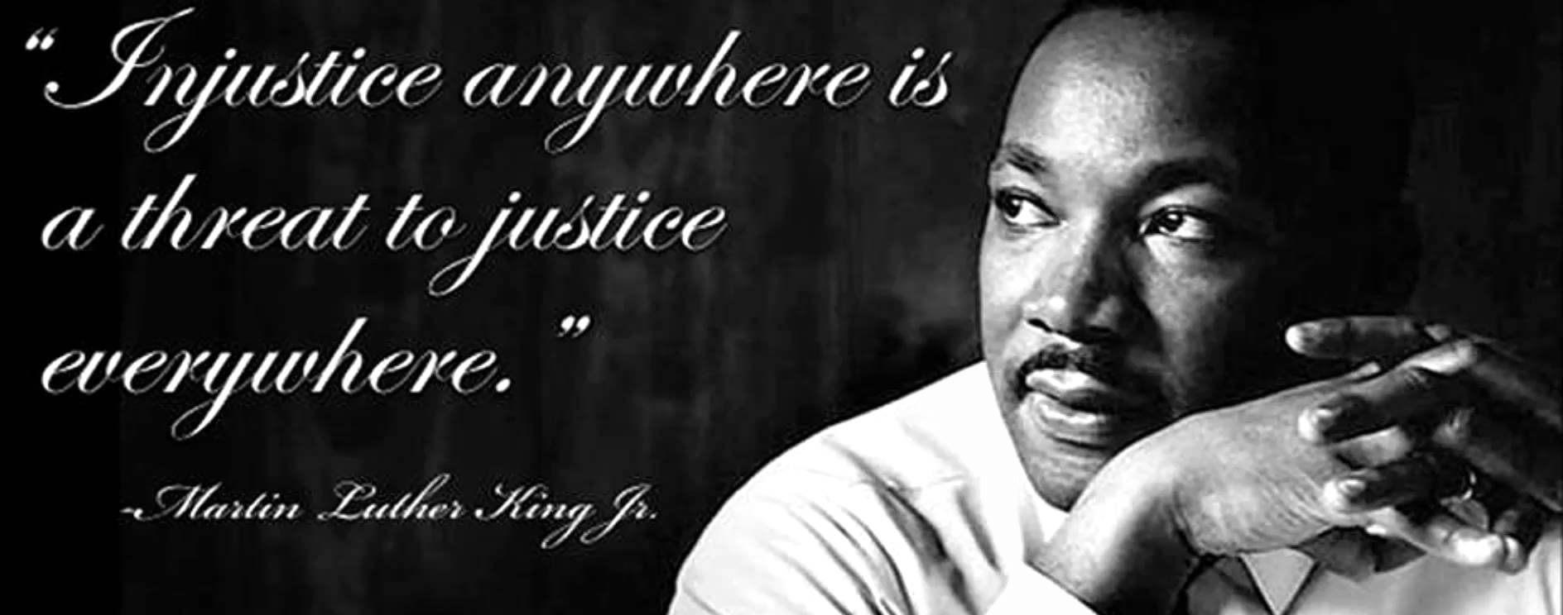
Jerome A. Paulson, MD, FAAP
Professor Emeritus of Pediatrics and of Environmental & Occupational Health
George Washington University School of Medicine and Health Sciences and George Washington University Milken Institute School of Public Health
http://www.cdc.gov/tb/topic/populations/tbinchildren/images/children.jpg

Slide 2
Dr. Paulson has NO conflicts of interest to declare.
This material was developed by the Mid-Atlantic Center for Children’s Health & the Environment and funded under the cooperative agreement award number 1U61TS000118-04 from the Agency for Toxic Substances and Disease Registry (ATSDR).
Acknowledgement: The U.S. Environmental Protection Agency (EPA) supports the PEHSU by providing funds to ATSDR under Inter-Agency Agreement number DW-75-92301301-0. Neither EPA nor ATSDR endorse the purchase of any commercial products or services mentioned in PEHSU publications.

Slide 3
Thank you
Leslie Rubin, MD
Robert Geller, MD
Maeve Howett, PhD, CNP-Ped, IBCLC
Laura Wells, LCSW
Student & Mentors

Slide 4
VISION

Slide 5
An environmental justice case study
http://wsco.org/?page_id=208

Slide 6
Proposed site for homeless shelter

Slide 7
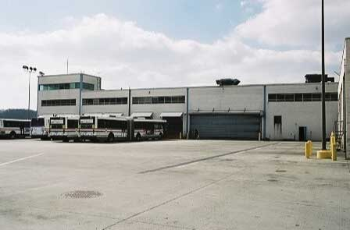
What’s near by?
CSX Rail Line
Concrete Plant
Trash Transfer Station
Bus Parking

Slide 8
Are there grocery stores near by?

Slide 9
Are there schools near by?

Slide 10
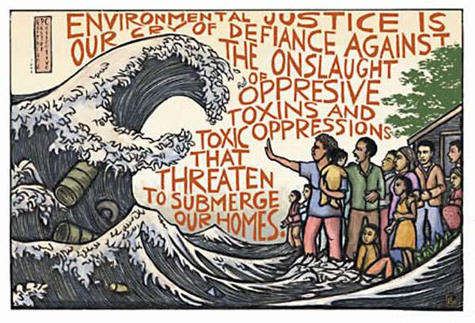
Thoughts or comments?
Illustration by: Ricardo Levins Morales
http://www.columbia.edu/cu/EJ/casestudies_international.html

Slide 11
When Confronted with an Environmental Health Issue Regarding a Child, Where Does One Turn?
To a Pediatric Environmental Health Specialty Unit (PEHSU).
A resource for pediatricians, public health officials, school personnel, parents and others to get questions answered about children’s health and the environment

Slide 12
How Do You Contact Your Regional PEHSU?
All have a toll free phone number
All have a web site
For a list of all PEHSUs and contact information, see http://www.pehsu.net

Slide 13
Questions?
http://smartgrowth.org/wp-content/uploads/2015/10/environmental-justice.jpg

