Slide 1


Racial and SES disparities in the population surrounding nuclear power plants
Break the Cycle 10
April 23-24, 2015
Christina Sauer
Pamela J. Maxson, PhD

Slide 2
Sarah’s Story

Slide 3
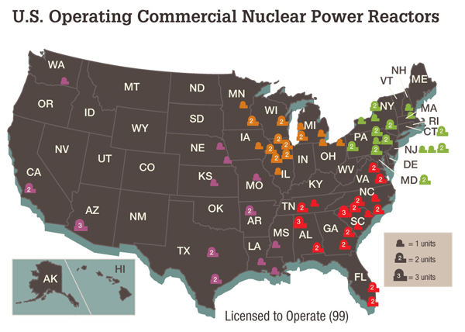

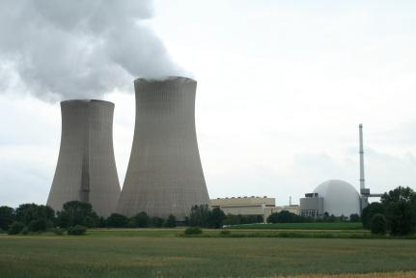

The problem
Notes:
http://www.nrc.gov/reactors/operating/map-power-reactors.html
http://energy.gov/sites/prod/files/The%20History%20of%20Nuclear%20Energy_0.pdf
http://www.nrc.gov/reading-rm/doc-collections/fact-sheets/radwaste.html
http://upload.wikimedia.org/wikipedia/commons/8/8d/Nuclear_Power_Plant_-_Grohnde_-_Germany_-_1-2.JPG

Slide 4







Reference Man

Slide 5
Cycle of Disadvantage
PERSONAL CHARACTERISTICS
Limited Income
ENVIRONMENTAL CHARACTERISTICS
HEALTH CHARACTERISTICS
ENVIRONMENTAL RISK FACTORS
Environmental Hazards
HEALTH RISK FACTORS
Toxicant Exposure
COMPOUNDING RISK FACTORS
Discrimination Due to Minority Status

Slide 6
How do we break the cycle?

Slide 7
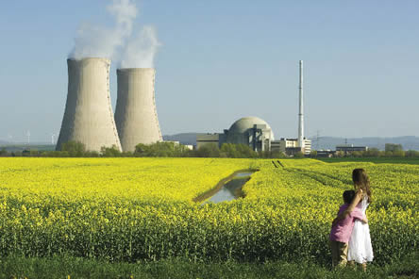
Research Question
Is the percentage of non-Hispanic black children, Hispanic children, and families in poverty associated with proximity to a nuclear power plant?
Notes:
http://www.earthisland.org/journal/images/Autumn2007/HappyNuke.jpeg

Slide 8
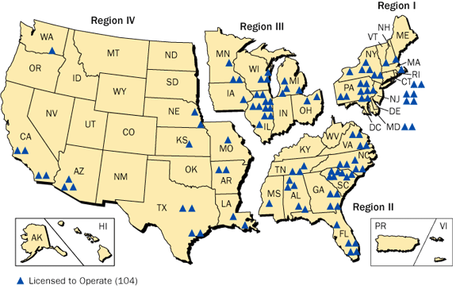
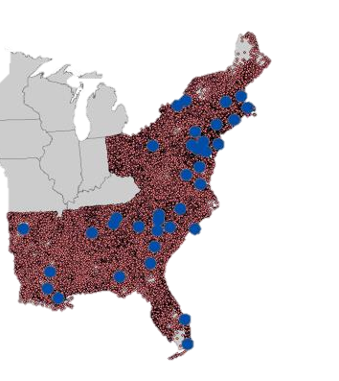
Nuclear Power Plants along East Coast
&
30-mile buffer zones

Slide 9

Methods
Block group population centroids within 30 miles of a nuclear power plant were identified using a buffer region
For each block group in our study area, I calculated
  % non-Hispanic black children
  % Hispanic children
  % families living below the poverty line
Each of the variables listed was collapsed into tertiles.

Slide 10
Methods
Multilevel logistic regression
Hypothesis:
  A block group’s population centroid being in close proximity to a nuclear power plant is associated with:
    (1) a higher percentage of non-Hispanic black children
    (2) a higher percentage of Hispanic children
    (3) a higher percentage of families under the poverty line

Slide 11
Results
Block groups with a higher % of non-Hispanic black children were more likely to have their population centroid be within 30 miles of a nuclear power plant
  Compared to block groups with a lower % of non-Hispanic black, when low/medium % Hispanic and high % of families living under the poverty line
Block groups with a higher % of Hispanic children were more likely to have their population centroid within 30 miles of a nuclear power plant
  Compared to lower % of Hispanic children
  Strong association

Slide 12
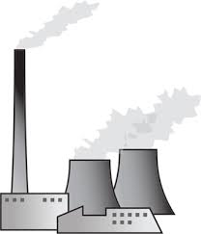

Results
Racial and SES characteristics of a block group are associated with proximity to a nuclear power plant.
Notes:
http://www.healthline.com/health-news/policy-closing-nuclear-plant-prevents-thousands-of-cancer-cases-032813#1
Mangano and Sherman 2013.

Slide 13
Cycle of Disadvantage
PERSONAL CHARACTERISTICS
Limited Income
ENVIRONMENTAL CHARACTERISTICS
HEALTH CHARACTERISTICS
ENVIRONMENTAL RISK FACTORS
Environmental Hazards
HEALTH RISK FACTORS
Toxicant Exposure
COMPOUNDING RISK FACTORS
Discrimination Due to Minority Status

Slide 14
Breaking the Cycle
Block groups with a higher percentage of Hispanic children, a higher percentage of non-Hispanic black children*, and a higher percentage of families in poverty* are more likely to live within 30 miles of a nuclear power plant**
-Limited Income
-Discrimination Due to Minority Status
Break the Cycle:
Call Nuclear Regulatory Commission to reevaluate “Reference Man” to include the most vulnerable in “Reference Family”
-Environmental Hazards/Toxicant exposure
Need to protect children in these areas; not discriminate based on age, race, or SES
Notes:
*In specific cases.
**Compared to their reference groups.

Slide 15


Reference Family

Slide 16


Conclusion
Is the percentage of non-Hispanic black children, Hispanic children, and families in poverty associated with proximity to a nuclear power plant?
YES
Notes:
Precautionary principle, permissible does not mean safe for children,
*Using block group level data.

Slide 17


Slide 18
Acknowledgments
Southeast PEHSU
Innovative Solutions for Disadvantage and Disability Sustainability Initiatives at Emory University
CEHI

