Slide 1

Mothers in Prison: The effects of mass incarceration on children’s behavioral health outcomes
Tatenda Mangurenje
Cultural Anthropology PhD Student
Mentors: Peter J. Brown, PhD; Melvin Konner, MD/PhD
Emory University
Break the Cycle - Atlanta - April 2017

Slide 2
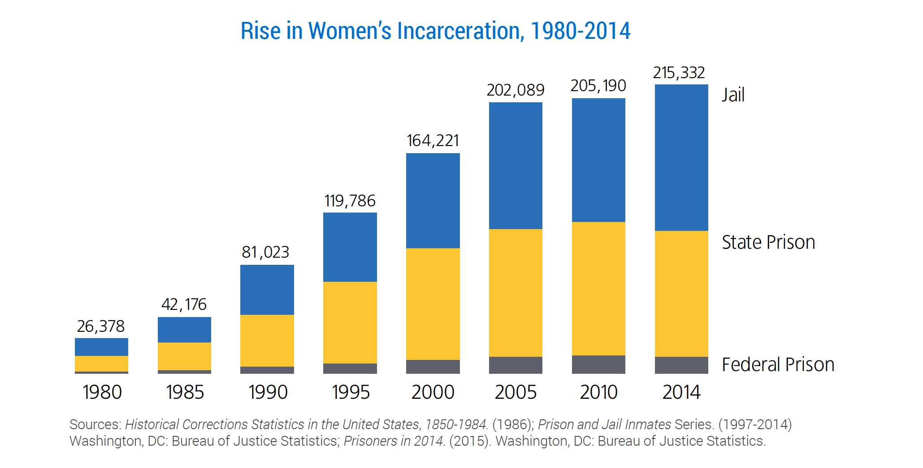
The Rise in Women’s Incarceration
Notes:
When we think about America’s prison system, we think almost exclusively about young men—and for good reason, as more than 93% of inmates are male, according to the Federal Bureau of Prisons.
In fact, women are the fastest growing segment of the prison population in the country, and the rate of incarceration for women has been growing nearly twice as fast as that of men since 1985, according to the ACLU.
The drastic increase in the number of women is due to the past two decades' war on drugs, said Congresswoman Karen Bass (D-CA). Many of the women in today's prisons are there because of romantic or other relationships with male drug dealers, who give their names to officials in exchange for more lenient sentencing, she explained. In 2000, 40% of women's criminal convictions leading to incarceration were for drug crimes, according to the ACLU.

Slide 3
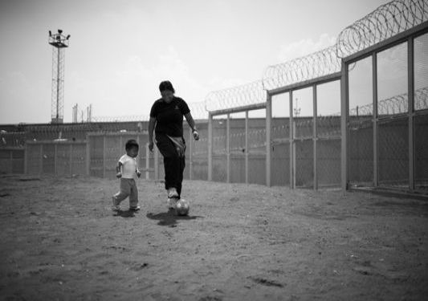
Background: Mothers in Prison
The number of incarcerated women has increased 131% since 1991
70% of these women have children under the age of 18
62% of incarcerated mothers were their children’s primary caregivers and financial providers
Dallaire D.H., Zeman, J.L., & Thrash, T.M. (2015) Journal of Clinical Child and Adolescent Psychology.
Mumola, C.J. (2000). Washington, DC: Bureau of Justice Statistics
Murray, J., & Farrington, D. (2008 ). Crime and Justice.
Schafer, N. E., & Dellinger, A. B. (1999). Women and Crime.
Notes:
“When you send women to jail, it divides the family. It hurts the whole community.”
Women tend to be in prison often for different reasons than men are—the majority are non-violent offenders—and have different needs than male prisoners.
Incarcerated mothers face other obstacles, including the sky-high cost of phone calls, and strict reunification laws that prevent mothers who are in jail for longer than a specific period of time to regain custody of their children once they are released. Mignon Clyburn, chairwoman of the Federal Communications Commission, said that some families spend up to $30,000 on phone bills so that children can stay in touch with their mothers—and as a result, only 38% do.
Colette Payne, community organizer with Cabrini-Green Legal Aid
Barnes, S. L., & Stringer, E. C. (2013). Is Motherhood Important? Imprisoned Women's Maternal Experiences Before and During Confinement and Their Postrelease Expectations. Feminist Criminology, 9(1), 3-23.
Glaze, L., & Maruschak, L. (2008). Parents in prison and their minor children. (Special Report No. NCJ 222984) Washington, DC: Bureau of Justice Statistics, U.S. Department of Justice.
Mumola, C.J. (2000, August). Incarcerated parents and their children. Washington, DC: Bureau of Justice Statistics.
Schafer, N. E., & Dellinger, A. B. (1999). Jailed parents: An assessment. Women & Criminal Justice, 10, 73- 91. doi: 10.1300/J012v10n04_04

Slide 4
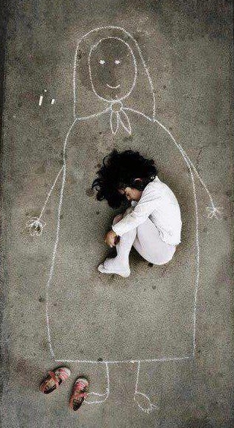
Background: Children of Female Prisoners
Hidden victims of the criminal justice system
Children of incarcerated women are more likely to:
  perform poorly in school
  abuse drugs
  have mental health problems
  live in poverty
  be incarcerated later in life
Dallaire D.H. (2007). Family Relations
Dallaire D.H., Zeman, J.L., & Thrash, T.M. (2015) Journal of Clinical Child and Adolescent Psychology.
Kjellstrand J.M., & Eddy J.M (2011). Journal of Offender Rehabilitation
Murray, J., & Farrington, D. (2008 ). Crime and Justice
Notes:
Least understood and perhaps most consequential implication of American mass incarceration
Parental imprisonment is a risk factor for:
Antisocial behavior
Drug abuse
School failure
Unemployment
Mental health problems
Incarceration
5. Dallaire, D. H., Zeman, J. L., & Thrash, T. M. (2015). Children’s Experiences of Maternal Incarceration-Specific Risks: Predictions to Psychological Maladaptation. Journal of Clinical Child and Adolescent Psychology : The Official Journal for the Society of Clinical Child and Adolescent Psychology, American Psychological Association, Division 53, 44(1), 109–122.
6. Dallaire DH (2007). Incarcerated mothers and fathers: A comparison of risks for children and families. Family Relations: 56:440–453.
7. Kjellstrand JM, Eddy JM (2011). Parental incarceration during childhood and its relationship to family and youth functioning across adolescence. Journal of Offender Rehabilitation: 50:18–36
8. Murray, J., & Farrington, D. (2008). The Effects of Parental Imprisonment on Children. Crime and Justice, 37(1), 133-206.
9. Cunningham, Alison, and Linda Baker. 2003. Waiting for Mommy: Giving a
Voice to the Hidden Victims of Imprisonment. London, Canada: Centre for Children and Families in the Justice System.

Slide 5
Research Question/Hypothesis
Research Question
  Do children with incarcerated mothers report higher rates of behavior problems compared to children separated from their mothers at birth?
Hypothesis
  Children with incarcerated mothers will report higher rates of internalizing and externalizing behavior problems.
Notes:
This project lies at the intersection of female incarceration and motherhood

Slide 6
Personal Characteristics
• Limited Education
• Limited Employment Opportunities
• Limited Income
• Incarceration risks
Environmental Risk Factors
• Limited Housing Options
• Inadequate Infrastructure
Environmental Characteristics
• Residential instability
• Limited Access to Prisons
• Exposure to Violence
Health Risk Factors
• Child Neglect & abuse
• Stress
•Trauma
Compound Risk Factors
• Limited Healthcare Services
• Limited Educational Services
• Limited Social Capital
• Limited Financial Capital
• Stigma
Health Characteristics
•ADHD/Learning Disabilities
• Behavior &Emotional Disorders
• Depression & Anxiety
• Substance Abuse
• PTSD
Cycle of Environmental
Health
Disparities

Slide 7
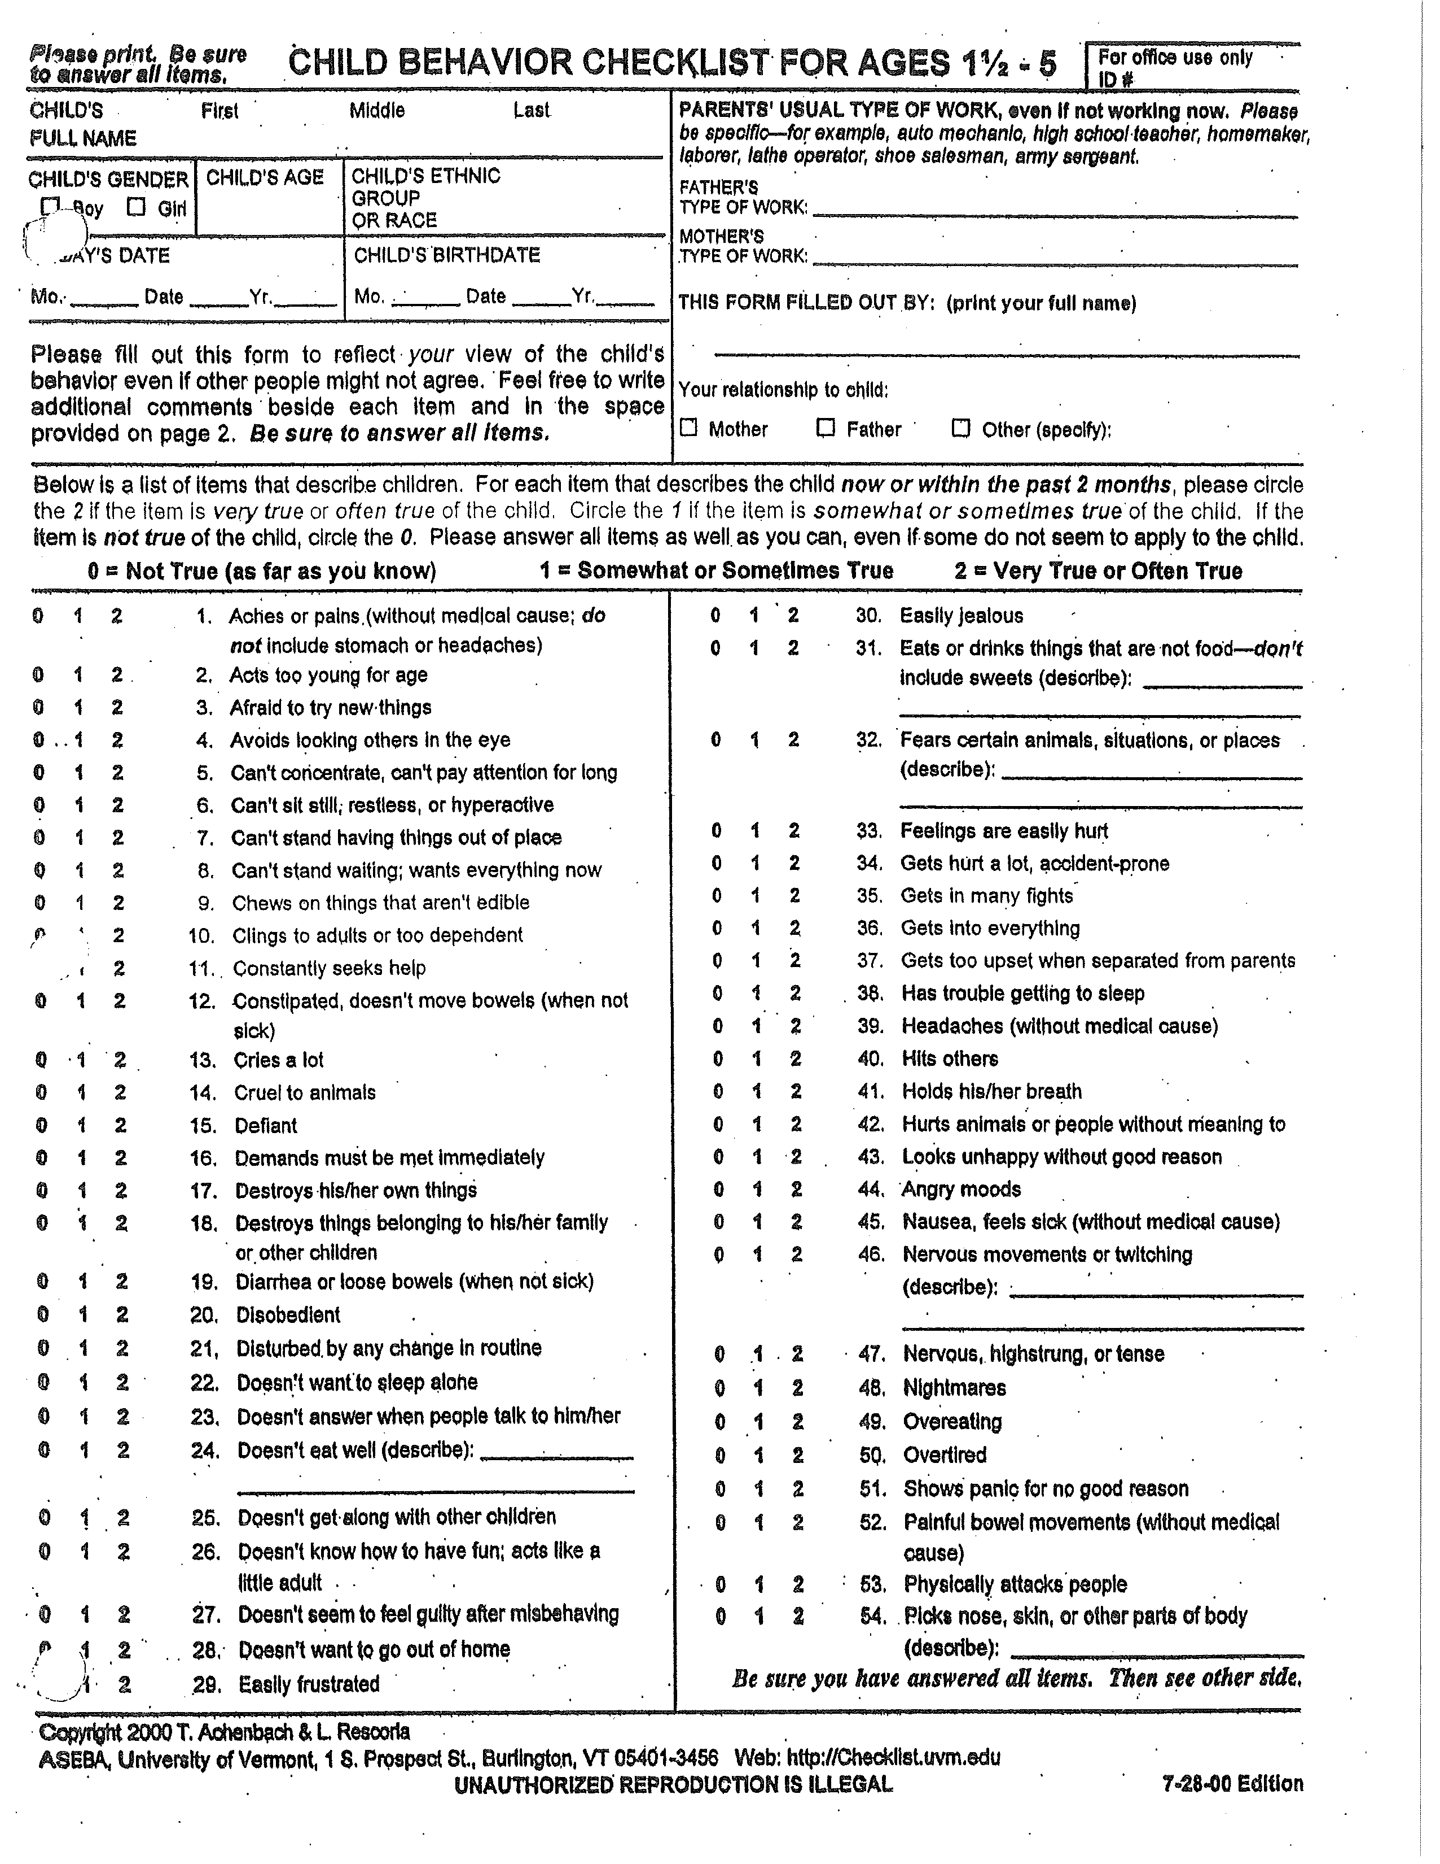
Methods: Sample and Analysis
  Data Source: Emory Maternal Substance Abuse and Child Development Clinic
    Case-Control
    Secondary data
    Caregiver Child Behavior Checklist (CBCL) reports of children from 3-8 years old
    Clinical sample
Statistical Analysis
  Multiple Regression
Thematic Text Analysis
Notes:
What is it: widely used and validated caregiver report form identifying problem behavior in children
Who came up with it: it is a component in the Achenback System of Empirically Based Assessment developed by Thomas Achenbach.
Two versions:
Parents/caregivers: Preschool (1^{1/2}- 5 years): Parents or others who interact with the child in regular contexts rate the child’s behavior. Respondents rate the child’s behavior on a 3-point scale (not true, somewhat or sometimes true and very true or often true), and are instructed to rate the behavior as it occurs now or within the previous two months.
Parents/caregivers; Teachers: School Age (6-18): Patent or close caregiver and then there is also the alternative measure is available for teachers (The Teacher’s Report Form)
Example of Form

Slide 8
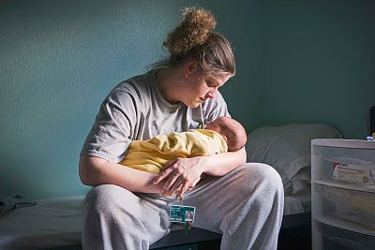
Methods: Key Variables
Outcome Variables:
    Internalizing behavior problems
    Externalizing behavior problems
Main Predictor Variable:
  Maternal incarceration
Notes:
Reason for removal from maternal custody
Length of time living with birth mother
Length of time separated from birth mother
Number of placements between last and most current placements
Relationship between child and current placement
Age
Family Structure
Race and ethnicity
Number of placements
Parental Incarceration/Parental Separation
Time living with/apart from biological parent

Slide 9
Methods: Covariates
Family Composition
Time in birth mother’s custody
Time with current caregiver
Number of children in caregiver’s care
Demographics
Age
Gender
Race/ethnicity
Notes:
Demographics
Age
Gender
Race/ethnicity
Residential Characteristics
Length of time in birth mother’s custody
Length of time separated from birth mother
Number of placements between last and most current placement
Relationship between child and current placement
Household composition – number of children in the household

Slide 10
Demographics
Total Case Participants n = 20
Total Control Participants n = 20
Variable |  | Category | n (%)
Age (years) |  | Mean = 5 yrs., 5.8 months | 20 (100)
Sex |  | Male | 12 (60)
 |  | Female | 8 (40)
Race |  | Black | 7 (35)
 |  | White | 10 (50)
 |  | Mixed Raced | 3 (15)
Variable | Category | n (%)
Age (years) | Mean = 5yrs., 9.1 months | 20 (100)
Sex | Male | 13 (65)
 | Female | 7 (35)
Race | Black | 6 (30)
 | White | 9 (45)
 | Mixed Race | 4 (20)
 | Asian | 1 (5)
Notes:
Total number of participants (N=40)
Case: Children with incarcerated mothers (n=20)
Control: Children separated from mothers at birth (n=20)
Age : case = 5 years, 5.8 months
Sex: case: male = 60% female = 40%
Race: case: black = 35% White = 50% Mixed = 15%
------------------------------------------------------------------------------------------------------------------------
Age : control = 5 years, 9.1 months
Sex: control: male = 65% female = 35%
Race: control: black = 30% White = 45% Mixed = 20% Asian = 5
Household income will be determined by analyzing participants zipcodes
cj

Slide 11
Child Behavior Checklist: Case and Control Scores
Notes:
It is very likely (99% and 98% respectively) that the mean internalizing and externalizing scores of the case group do not differ from those of the control group. There is no support for the hypothesis that the case group differs substantially from the control group.

Slide 12
Maternal Incarceration and Child Behavioral Checklist Scores
Notes:
There is no significant evidence to suggest that the mean scores differ for those whose mothers were previously incarcerated and those whose mothers were not. There is no support for the hypothesis that children of women who were previously incarcerated will exhibit higher scores than those whose mothers were not incarcerated

Slide 13
Internalizing Behavior Problems Regression Results
Variable | coefficient | p value
Time with Current Caregiver (months) | -0.045 | 0.335
Time with Birth Mother (months) | -2.543 | 0.153
Maternal Incarceration | 3.331 | 0.340
Number of children in current caregiver’s care | 1.082 | 0.341
Notes:
Internalizing problems sums the Anxious/depressed, Withdrawn-depressed, and Somatic complaints scores; Externalizing problems combines Rule-breaking and Aggressive behavior. There also is a Total problems score, which is the sum of the scores of all the problem items.

Slide 14
Externalizing Behavior Problems Regression Results
Variable | coefficient | p value
Time with Current Caregiver (months) | -0.019 | 0.389
Time with Birth Mother (months) | -2.961 | 0.127
Maternal Incarceration | 4.968 | 0.298
Number of children in current caregiver’s care | 2.597 | 0.189
Notes:
For every unit increase in externalizing behavior, time with birth mother decreased by 2 units (hours etc) – while not significant (small sample size) it does suggest that they might be a relationship between time with birth mother and externalizing behavior problems. This is something that I will explore with future work.

Slide 15
Sexual Abuse, Limited Education and Poverty
“”
Her biological mother initiated substance use as young as 11 years of age when she began smoking….Her mother reportedly had her first child at 14 and was forcibly raped before she was 16 years of age. She reportedly quit school during the 9th grade as a result of her 1st pregnancy. She also had a long history of stays with the juvenile justice program in her youth. (Case, 6693)
“”
Ben was born to Quinn McBerry, who was 20 years old at the time of Ben’s birth…Ms. McBerry completed the 8th grade. Per reports, Ms. McBerry drank alcohol while pregnant, with a pattern of binge-drinking on weekends, and was also using marijuana, methamphetamine, and tobacco during the pregnancy. (Control, 545)
Notes:
Text analysis reveals the cycle, what exactly is going on in these households?
who these children are, who their parents are and can offer ideas on how to break the cycle. We need to tackle education reform, no child left behind. Work on teen pregnancy and early exposure to drugs and alcohol

Slide 16
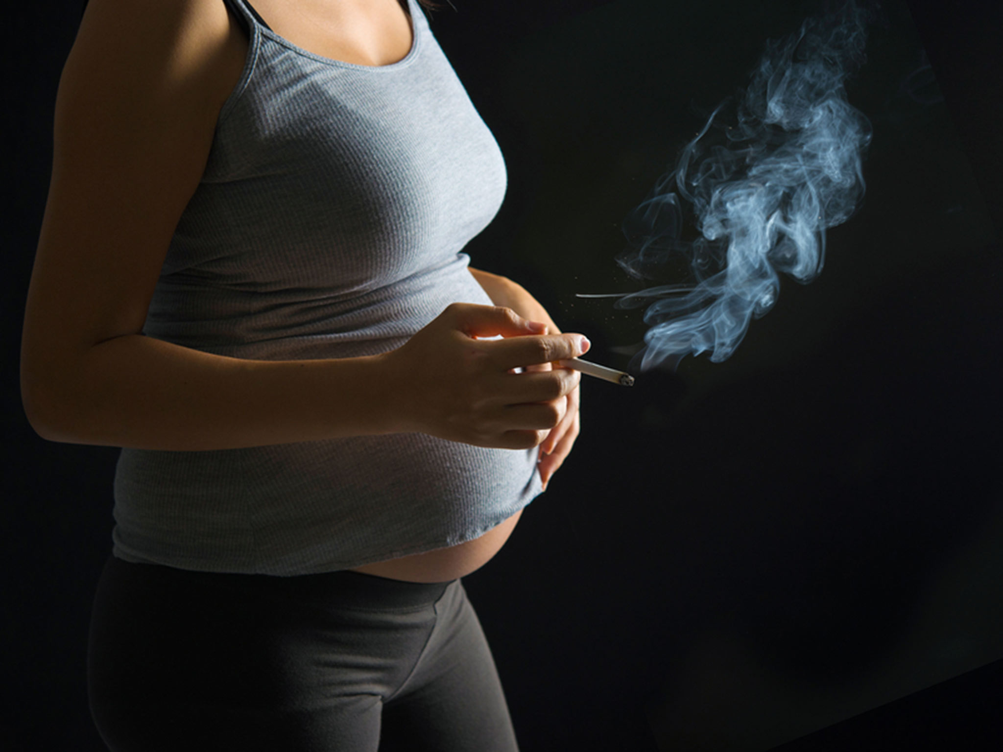
Reproducing the Cycle: Drug Use and Child Neglect
‘’’’
The Department of Children and Family Services removed her from her biological mother as a result of neglect, substance abuse, unstable housing and employment, a previous removal of her other two children, and incarceration related to a probation violation for a shop-lifting conviction.” (Case, 6693)
’’’’
Jeremy was taken into the Brown home immediately from the neonatal nursery and has never lived elsewhere. His biological mother had a history of substance abuse and social and legal problems.” (Control, 545)

Slide 17
Breaking the
Cycle
Personal Characteristics
• Education
• Mentoring/peer programs
Environmental Risk Factors
• Limited Housing Options
• Inadequate Infrastructure
Environmental Interventions
• Improving access to prison transportation
• Increasing prison visitations
• Increasing foster parenting incentives
Compound Protective Factors
• Reducing social isolation
• Improving economic and opportunities
• Improving social services to caregivers of children
Health Interventions
•Early detection and intervention
Health Risk Factors
• Child Neglect & abuse
• Stress
• Trauma
Breaking the Cycle of Environmental
Health
Disparities
Notes:
Maternal incarceration is just the symptom. To break the cycle, we have to break the causes of incarceration, substance abuse
Look at time away from bm, number of placements
Looking at these children at maternal incarceration is too late. This vulnerable population is at risk long before their mothers are incarcerated. Breaking the cycle needs to happen before the children, with interventions aimed at mothers.
Mothers backgrounds tell us a lot about these children. Drug abuse, limited education and domestic and sexual violence as well as poverty in their own pasts
The reason why this clinical sample shows similar results in both control and case studies is because the mothers have similar life histories. The only difference is that a few and increasingly many more are getting arrested instead of receiving help. We are criminalizing poverty....
The importance of qual data. Quantitative data tells us these two groups are similar but not how. The life histories of these women reveal where strategies to break the cycle should be aimed and they are before the shackles to the prison

Slide 18
Limitations/Future Directions
Limitations
  Clinical sample that is not representative of the general population
  Small study sample
  Control group cannot be exactly matched to case group
Future directions
  Collect longitudinal primary data on incarcerated mothers, caregivers and children
  Aim: understand the effects of maternal incarceration on child behavioral health outcomes

Slide 19
Thank you!
Acknowledgements
Dr. Peter Brown
Dr. Melvin Konner
Dr. Claire Coles and Mikayla Charles and the Emory Maternal Substance Abuse and Child Development staff
Adam Zabzdyr Reynolds
Laura Wells and The Break the Cycle Team

Slide 20
Appendix!

Slide 21
Example of codebook entry
Code | Separation from BM
Inclusion Criteria | Reasons child was separation from biological mother (BM)
Exclusion Criteria | Discussion of children either staying or returning to their BM’s custody
Close But No | Discussion of separation from birth father or other biological family members

