Slide 1


Impact of Housing on Pubertal Timing
Farah Dadabhoy MS2
University of Cincinnati College of Medicine
Notes:
BCERP is a network of studies across the United States that are examining what factors affect the start of puberty and how they may further affect the eventual risk of breast cancer
Puberty studies carried out at multiple centers
SF, NY, Cincinnati
Longitudinal study - The study has been following 12000 girls nationwide.

Slide 2
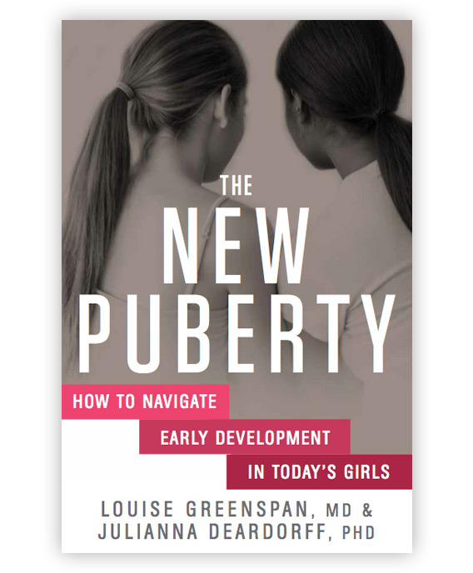
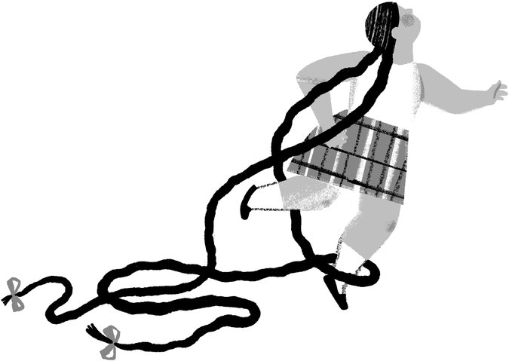

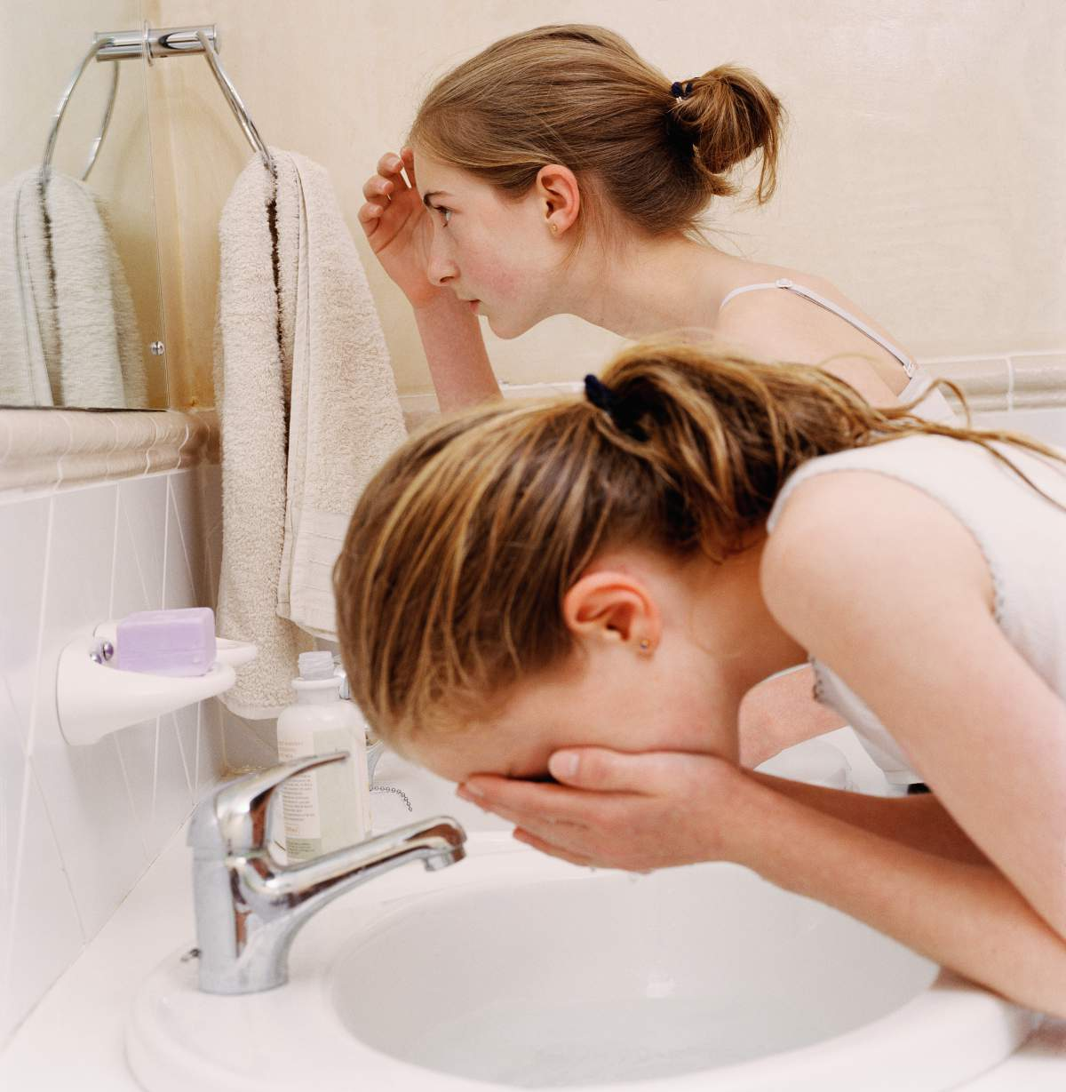
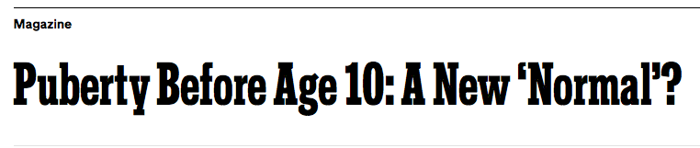
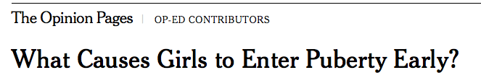



Puberty in America
Notes:
The issue of “early puberty” weaves in an out of the news. Recently, more so in the news than out of it. The times recently did a story, NPR, Huffington Post
The question is – is this a real phenomenon, and if it is what are the implications?
Since the mid-1900s there have been multiple studies measuring the timing of puberty in girls. While the timing of puberty is different for every child, ongoing research indicates that, overall, girls’ bodies have begun to show signs of entering puberty earlier now than in the recent past.
What are the factors contributing to this trend?
, how do we slow it down?
what are the biological and social
most importantly how do we help parents, children, educator navigate this challenging period?

Slide 3

Events of Puberty
Breast Budding
Gonadal axis
Pubic Hair Development
Adrenal Axis
Menstruation
Estrogen
Cortisol
Final event
Pollution
Stress
Dust mites
Endocrine disruptors
Adipose tissue
Notes:
The main events of puberty
There is a misconception that puberty begins with menstruation or when a girl gets her period
In fact, this is not the case, puberty is a physiological and psychological change that spans between 2 and 4 years
Breast budding appears to be the first, event of the onset of puberty; and numerous studies, have shown that this is the most important and reliable indicator
Breast budding is governed by the ovarian axis, which in turn is driven by the production of estrogen
This is followed by pubertal hair growth –which is primarily due to the effects of androgens from the adrenal gland; This event is is closely associated with the first appearance of axillary hair, apocrine body odor, and acne.
There are specific “windows of susceptibility” during pregnancy and preadolescence when the body is most susceptible to environmental influences
During these windows of susceptibility, exposure to harmful environmental factors may have a greater effect and may increase the risk of developing health conditions later in life.
One analogy that has been used by experts is that of the canary in a coal mine.
Onset of puberty barometer for other things that we're all being exposed to in our environments that may not be healthy for other reasons — we're just not seeing those as obviously

Slide 4
Health Risks
Behavioral
Body Image
Academic performance
Physical
Breast cancer
Substance abuse
Delinquency and aggression
Depression
Ovarian cancer
Cardiovascular disease
Diabetes
Notes:
It has been established that girls who enter puberty earlier are more likely to have negative body image, perform poorly in school, manifest symptoms of anxiety, exhibit higher levels of depression, and initiate sex and sexual behaviors earlier
Physiologically, it is well established that the incidence of breast cancer and ovarian cancer increases which decreasing pubertal onset
Product of prolonged exposure to estrogen
Early pubic hair growth has been linked to increased blood insulin levels, polycystic ovarian syndrome, diabetes, obesity and cardiovascular disease

Slide 5
Housing
Psychosocial
Chemical
Notes:
How I came to examine housing
Housing is an important social determinant of health and where environmental and chemical risk factors intersect

Slide 6
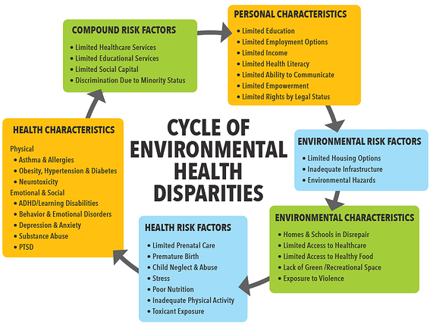
Notes:
Break the cycle at the level of environmental risk factors – by addressing housing

Slide 7

Evidence from Studies
Animal Studies
older age and a lower rate of puberty in less crowded pens
Frequent, stressful, transport induced puberty earlier
Human Studies
neighborhood recreational outlets linked to onset of breast and pubic hair
Notes:
When I first started looking housing and puberty, all the search results were related to gilt and sows
You call a female pig prior to puberty a gilt
A sow is a mature female pig
It is well known in pig literature that attainment of puberty is influenced by many intrinsic and extrinsic factors, such as genotype, environment and boar contact
Historically it has been observed that
The onset of puberty in gilts often coincides with relocation or transport of animals from the gilt developer to the sow farm. Undoubtedly, the best-known stress factor in pigs is that of transportation.
Gilts housed in less crowded pens reached puberty later

Slide 8
Public vs. Private Housing
Public Housing
Hypertension
Diabetes
Cardiovascular Disease
Higher consumption of soda
Asthma
Notes:
Over 7 million residents of public housing
4 in 10 units occupied by families with children
Study conducted in the Bronx (compared to low income subjects who had Section 8 vouchers, or were living in market values homs)
• Public housing residents were more likely than Section 8 residents to report cardiovascular disease.
• Public housing residents were more likely to have diabetes (25 percent) than Section 8 residents (19 percent). Low-income families in general were least likely to have diabetes (13 percent).
• 10 percent of public housing residents had suffered a heart attack compared with 4 percent of Section 8 voucher holders and less than 1 percent of those eligible but receiving no housing subsidies.
• 53 percent of public housing residents had hypertension, compared with 33 percent of those without any housing assistance.

Slide 9
Research Question
Examine associations between housing type and pubertal timing
Notes:
Median age at breast budding
Median age at pubic hair development

Slide 10
Notes:
East harlem housing –
Number 1 in terms of hoursing concerns

Slide 11
Methods
Growing Up Healthy (n=416 girls)
  longitudinal study of environment on growth and development
  40% Black and 60% Hispanic
  6-8 years at recruitment
  Housing data available (n=331 girls)
Notes:
Multi state study
1200 girls across

Slide 12
Median Weight
Notes:
No weight differences between housing groups

Slide 13
Socioeconomic Status
Education
Income
Notes:
No Income and education differences in housing

Slide 14
Housing
Housing type available (n=331 girls)
Notes:
Housing type available (n=331 girls)
In private housing had occupancy of 31% of african americans and 69% hispanics
Public housing was more evenly divided, with 55% blacks and 45% hispanics

Slide 15
Median Age of Recruitment and Puberty
  By age 7
    11% of Black girls and 25% of Hispanic girls had breast budding
    17% of Black girls and 11% of Hispanic girls had pubic hair development
Notes:
Median Ages of the girls at baseline and then at breast budding and pubic hair growth
By age 7
11% of Black girls and 25% of Hispanic girls had breast budding
17% of Black girls and 11% of Hispanic girls had pubic hair development
Current guidelines In the United States define of precocious puberty as the appearance of breast development before the age of eight years in girls
Precisely because of the numbers demonstrated here, the age threshold for undertaking a clinical evaluation for early puberty remains a subject of ongoing discussion.
For girls who develop signs of puberty between six and eight years of age, the need for clinical evaluation depends on the degree and rate of maturation as well as the family history of pubertal timing.

Slide 16
Our Findings
Notes:
Among Hispanic girls, 48% of those living in private housing began pubic hair development before 10 years old whereas 79% of those living in public housing began pubic hair development before 10 years old.
The proportion of girls having earlier B2+ was similar among Black and Hispanic girls regardless of housing type.
Pubic hair development occurred earlier in Hispanic girls living in public housing compared to those living in private housing
(p < 0.01, adjusted for BMI and caregiver education).

Slide 17
Hypotheses and Implications
Excess cortisol
Adrenal Axis
Adverse health outcomes
Early puberty
Adversity
Notes:
Pubic hair growth appears to be under the control of adrenal androgens and is a process that is independent of although associated with breast development (which is controlled by the ovaries)
Evolutionary biology suggest that a adversity , chronic stress and unpredictability results in cortisol release primary component of stress response, may awaken the HPA axis and accelerate pubic hair development
Another way to put this is early exposure to stress in the family environment may influence how the body behaves biochemically in response to stress which may subsequently accelerate hormonal responses
This is disconcerting for a number of reasons –
- Girls who mature early will reach peak height velocity sooner and attain their final height earlier.
- Other studies have linked puberty to adverse health outcomes including –
Increased insulin levels, which are predictive of diabetes, and the subsequent predisposition to PCOS.
--------------------------------------------------------------------------------------------------
OTHER IDEAS
Although the hypothalamic-pituitary axis has been well characterized in recent years, our understanding of the mechanism of control of adrenal androgen secretion is still somewhat rudimentary. The adrenal cortex normally secretes the weak androgens (DHEA), its sulfate, and androstenedione in increasing amounts beginning at about 6 to 7 years of age in girls
A continued rise in adrenal androgen secretion persists until late puberty.
Thus, adrenarche, which later culminates in pubic hair sprouting, in actually commences years before gonadarche (the secretion of gonadal sex steroids). Thus may be more sensitive

Slide 18
Interventions
Breaking the Cycle
Lifestyle
Exposures
Built Environment
Support
Notes:
Environmental factors are not predetermined for life and can be influenced by individual behavior, parental protective measures, or public health policies.
This raises the possibility that early puberty and associated risks could be lowered through control of environmental factors.
There’s research to show that certain aspects of the neighborhood context and also schools can be protective
African American girls who lived in neighborhoods with availability to parks, walking or hiking trails, playing fields, and basketball or tennis courts had lower onset of breast and pubic hair development by ages 10 to 12 years.
having safe access to a park was associated with regular physical activity in urban areas
children with less desirable eating habits lived in areas with little open space and small streets bounded by busy roads and many food outlets selling snack food, sweets and take-away meals, whereas children with more desirable eating habits lived in areas with open green space, wider streets and fewer food outlets.
It can completely mitigate the risk associated with early puberty on girls' emotional and behavioral functioning
The family can serve as a huge buffer against some of those negative effects of early puberty

Slide 19
Acknowledgements
Dr. Maida Galvez
Dr. Susan Teitelbaum, Dr. Mary Wolff, Ashley Pajak and the Growing Up Healthy team
Department of Preventive Medicine, Icahn School of Medicine at Mount Sinai
Dr. Nick Newman at Cincinnati Children’s Hospital
National Institute of Environmental Health Sciences (NIH 5 T35 ES 007269-24 Grant)
Break the Cycle 10

Slide 20
References
Biro FM, Greenspan LC, Galvez MP, et al. Onset of breast development in a longitudinal cohort. Pediatrics. 2013;132(6):1019-27.
Deardorff J, Fyfe M, Ekwaru JP, Kushi LH, Greenspan LC, Yen IH. Does neighborhood environment influence girls' pubertal onset? findings from a cohort study. BMC Pediatr. 2012;12:27.
Deierlein AL, Galvez MP, Yen IH, et al. Local food environments are associated with girls' energy, sugar-sweetened beverage and snack-food intakes. Public Health Nutr. 2014;17(10):2194-200.
Herman-giddens ME. The decline in the age of menarche in the United States: should we be concerned?. J Adolesc Health. 2007;40(3):201-3.
Herman-giddens ME. The enigmatic pursuit of puberty in girls. Pediatrics. 2013;132(6):1125-6.
Hong CC, Pajak A, Teitelbaum SL, et al. Younger pubertal age is associated with allergy and other atopic conditions in girls. Pediatr Allergy Immunol. 2014;25(8):773-80.
Kraeling RR, Webel SK. Current strategies for reproductive management of gilts and sows in North America. J Anim Sci Biotechnol. 2015;6(1):3.
Mervish NA, Gardiner EW, Galvez MP, et al. Dietary flavonol intake is associated with age of puberty in a longitudinal cohort of girls. Nutr Res. 2013;33(7):534-42.
Vangeepuram N, Mcgovern KJ, Teitelbaum S, et al. Asthma and physical activity in multiracial girls from three US sites. J Asthma. 2014;51(2):193-9.

