Slide 1
Impact of Housing Instability on Child Behavior at Age 7
Student: Abby Gaylord
Mentor: Julie Herbstman
Columbia University Mailman School of Public Health

Slide 2
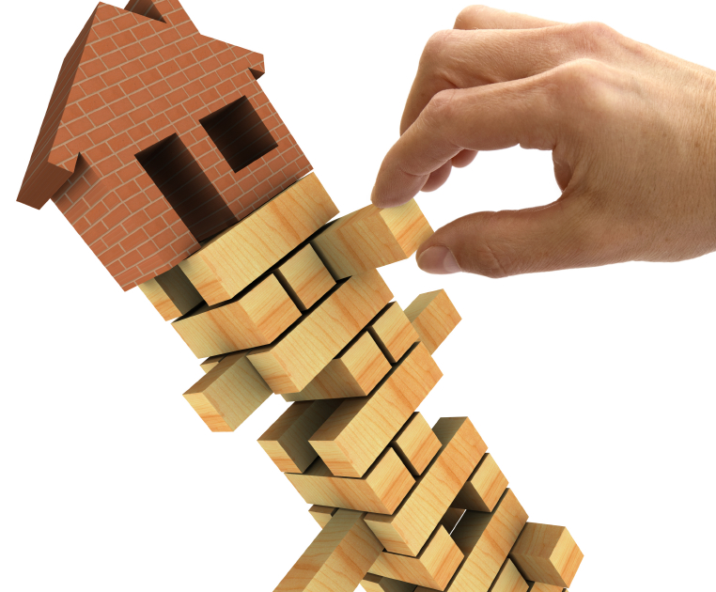
Background–Housing Instability
NYC Housing Statistics, 2014:
29.9% of rental households were severely rent-burdened
Over 307,000 children living in households with income <$25,000
Median monthly rent increased by 12% between 2008 and 2014
Source: Citizen’s Committee for Children of New York, Inc.
Notes:
Reference: http://www.cccnewyork.org/blog/keeping-track-housing-instability-and-homelessness-in-new-york-city/
Image Source: http://www.keepingcurrentmatters.com/2010/02/02/jenga-blocks/

Slide 3
Study Sample
Columbia Center for Children’s Environmental Health Cohort
The Mothers & Newborns Study
Sample Size = 727
Analysis Size = 497
Pregnant women between the ages of 18-35
African American or Dominican
Addresses in Northern Manhattan & South Bronx
Assessments at prenatal & 1, 2, 3, 5, and 7 years
Notes:
Image Source: Columbia Center for Children’s Environmental Health (ccceh.org)

Slide 4
Child Behavior Checklist (CBCL)
8 Syndrome Scores
Anxiety & depression
Withdrawn
Somatic
Social
Thought
Attention
Rule breaking
Aggressive
Externalizing Behavior
Internalizing Behavior
Total Behavior Problems
Notes:
Image Source: Columbia Center for Children’s Environmental Health (ccceh.org)

Slide 5
Housing Instability & Child Behavior
Covariates
Maternal education
Child age at CBCL
Child gender
Ethnicity
Material hardship
Maternal demoralization

Slide 6
Results
Children experiencing >3 moves over 7 years:
Significantly higher number of thought-related problems (p=0.022)
Seeing or hearing things
Repeating acts
Strange ideas and behavior
Significantly higher number of attention-related problems (p=0.044)
Concentration difficulties
Problems sitting still
Impulsivity
Day dreaming
Nervousness
Poor performance in school
Increased total (p=0.150) and internalizing (p=0.248) problem scores
Notes:
Image Source: http://www.livestrong.com/article/238802-how-to-diagnose-common-behavioral-problems-in-children/

Slide 7
Conceptual Diagram
Satisfaction with Living Conditions
Housing Disrepair
+
Housing Instability
Child Behavior
Material Hardship

Slide 8
Conceptual Diagram
Satisfaction with Living Conditions
Housing Disrepair
+
Housing Instability
Child Behavior
Material Hardship

Slide 9
Material Hardship
Material hardship characterized by ability to afford:
Rent
Food
Gas/Electricity
Clothing
Source: Perera et al., 2017

Slide 10
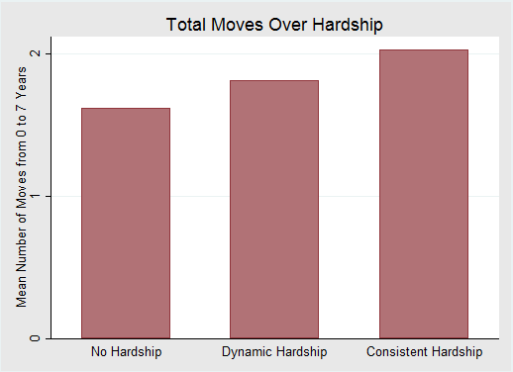
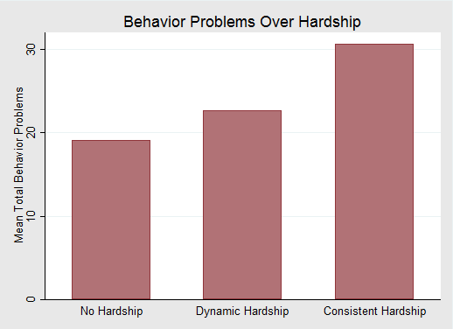
Material Hardship
Material hardship is associated with movement
Material hardship is associated with child behavior problems
Notes:
Number of moves over hardship

Slide 11
Conceptual Diagram
Satisfaction with Living Conditions
Housing Disrepair
+
Housing Instability
Child Behavior
+
+
Material Hardship

Slide 12
Conceptual Diagram
Satisfaction with Living Conditions
Housing Disrepair
+
Housing Instability
Child Behavior
+
+
Material Hardship

Slide 13
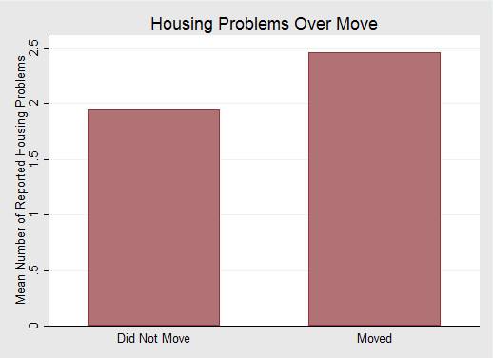
Housing Disrepair
Objective building disrepair variables
Paint chips/dust
Holes in ceiling
Mold
Leaky pipes
Objective pest variables
Roaches
Rodents
Other insects

Slide 14
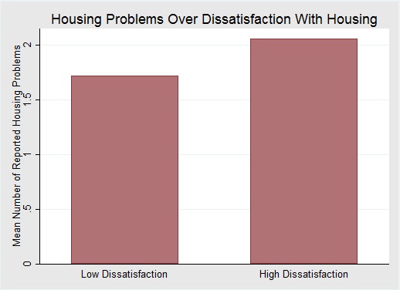
Satisfaction with Living Conditions
Housing disrepair predicts dissatisfaction with housing

Slide 15
Satisfaction with Living Conditions
Satisfaction with housing does not predict
housing instability

Slide 16
Conceptual Diagram
+
Satisfaction with Living Conditions
Housing Disrepair
-
+
+
Housing Instability
Child Behavior
+
+
Material Hardship

Slide 17
Breaking the Cycle
Behavioral Problems
Social/Emotional Rejection
Lower Educational Attainment
Unemployment
Substance Use/Abuse
Incarceration
Material Hardship
Housing Disrepair
Housing Instability
Meaningful Intervention Point

Slide 18
Breaking the Cycle
Behavioral Problems
Social/Emotional Rejection
Lower Educational Attainment
Unemployment
Substance Use/Abuse
Incarceration
Material Hardship
Housing Disrepair
Housing Instability
Meaningful Intervention Point

Slide 19
Limitations & New Directions
Limitations
Longitudinal vs. cross-sectional data analysis
Could not distinguish “good” versus “bad” moves
Loss to follow-up
Directions for future analyses
Understanding the relationship between material hardship and housing disrepair
Effects of social circles and social support on movement
Analyzing movement with neighborhood-level variables
Notes:
Image Source: Columbia Center for Children’s Environmental Health (ccceh.org)

Slide 20
Acknowledgements
Julie Herbstman, PhD
Virginia Rauh, ScD
Whitney Cowell
Ya Wang
Andrew Rundle, PhD
Lori Hoepner, DrPH
Howard Andrews, PhD
Columbia Center for Children’s Environmental Health
Investigators
Research Assistants
Project Coordinators
Staff
Study Participants

