Slide 1
Silver Lining for High-Risk Infants: Coordinated Medical, Legal, and Developmental Services from 0-6 Years
Lea Redd, BA
Brianne Dotts, JD
The Chicago Medical-Legal Partnership for Children
Bree Andrews, MD, MPH
Center for Healthy Families

Slide 2
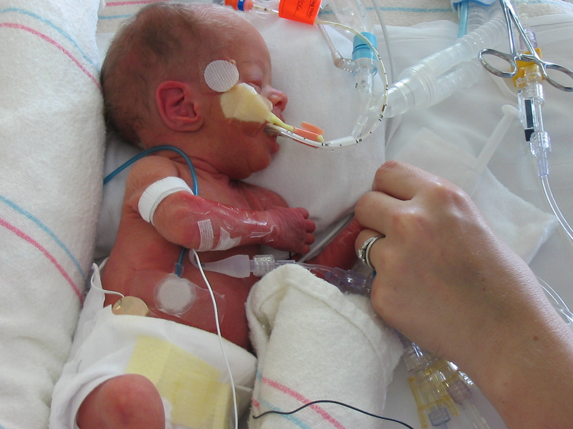
Background
NICU graduates have extensive medical, developmental, and social needs
Medical Complexities include:
BPD
G-tube
Tracheostomy
VP shunt
Developmental Delays include:
ADD, ADHD, Autism Spectrum and other intellectual impairments
Cerebral Palsy and other motor delays
Need for glasses and hearing aids
1.
Notes:
Thank you to Emory for hosting us today. Let’s get started- Neonatal Intensive Care Unit graduates….
Their medical complexities include bronchopulmonary dysplasia
Gastrostomy, feeding tubes
Over the first few years of life , we can often see significant developmental delay. One of the main motor delays seen at the Center for Healthy Families is cerebral palsy. We often also see visual and hearing impairments

Slide 3
ENVIRONMENT
SELF WORTH
PREGNANCY
RISK FACTORS
POTENTIAL OUTCOMES
NEWBORN INFANT
Poverty
Poor community support
Poor health services
Poor education
Despair
Substance abuse
Promiscuity
Limited prenatal care
Tobacco, alcohol & drug use
Risk of STD’s/HIV
Prematurity
Low birth weight
Fetal Alcohol Syndrome
Infant with increased needs
Medical needs
Developmental needs
Increased irritability
Increased demands
Lack of supports
Substance abuse
Health concerns
Neurodevelopmental disabilities
Child neglect and abuse
Foster care placement
Mother under stress
CYCLE OF DISADVANTAGE AND DISABILITY
Notes:
This NICU graduate population is at significant risk for falling into the cycle of disadvantage and disability. Moms and Dads may lack supports. As I just mentioned these children have ongoing health concerns and true disabilities. This could lead to poor education and health services. Our project aims to interrupt this cycle by providing support for families in obtaining education assistance and public benefits through a medical-legal partnership.

Slide 4
Goal: Evaluate coordinated legal advocacy to improve access to public benefits for medically complex children who come from low income, minority families
These children are at increased risk of having adverse health outcomes
Notes:
These children are at a clear increased risk for adverse health outcomes

Slide 5
Medical-Legal Partnerships (MLP)
Social determinants of health
Health is modified by illness, chronic disease, access to healthcare, access to public benefits
Lawyers are sometimes the best subspecialists
Understanding of health-related law: insurance, public benefits, housing, developmental and educational supports through IDEA
Notes:
MLPs try to address the social determinants of health. These partnerships acknowledge that health can be modified by illness and chronic disease as much as by access to healthcare and public benefits. Because of this, legal advocates are sometimes the best subspecialists. Their understanding of health-related law especially the supports available through the Individuals with Disabilities Education Act can greatly impact our NICU graduate population. As a result these types of partnerships are often able to address the larger picture.

Slide 6
Cartoon courtesy of Jack Maypole, MD (jackmaypole@yahoo.com)
Notes:
This cartoon is representative of that. Only a small part of the picture is Dr. Andrews celebrating a resolved ear infection, but when we look at the whole picture, we often see Mom or Dad in the background stressed about a number of other concerns like food or school enrollment for their medically complex child.
When hospitals and clinics partner with legal advocates, it allows us to address the needs of the family as a whole.

Slide 7
Early Steps
Project Access, a MLP project at the University of Chicago from 2000-2004
3-5 unmet legal needs between NICU discharge and 2yrs
Most needs around public benefits
Established the Chicago Medical-Legal Partnership for Children permanently in 2006
A program of Legal Council for Health Justice
Project Access: used ‘rescue’ legal services
Silver Lining Project: anticipate and introduce legal advocates earlier
Notes:
randomized patients to one of two groups. Either to usual case management OR case management plus legal care
BUT in both groups, they found that families had 3-5 unmet legal needs
Most families…

Slide 8
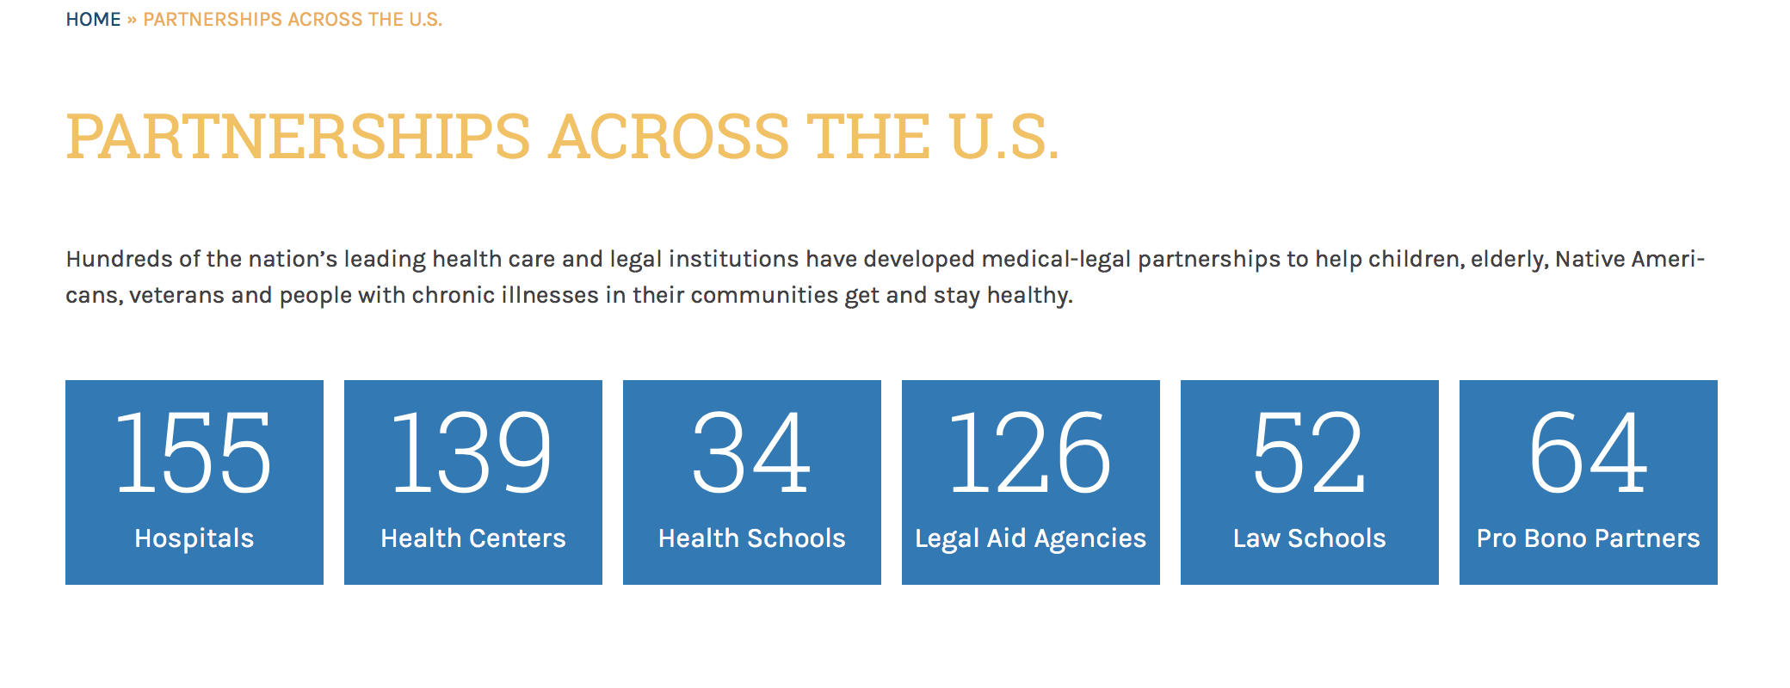
Medical-Legal Partnerships
Notes:
The CMLPC partnership with the Univerisity of Chicago is just one of the many hospital and healthcare based partnerships that are growing across the nation.

Slide 9
Hypothesis
Improving the process of obtaining public benefits improves functional outcomes for children and parents
Using advocacy allows families to receive services earlier and more efficiently than if families have to navigate the system on their own
Notes:
Knowing that Public Benefit processes are complex…A
We thought introducing legal advocates would help families navigate the system more efficiently than if families did it on their own.
We thought our partnership would be particularly helpful with families gaining access to Early Intervention services sooner

Slide 10
Contact information given
Early Intervention contacted
Local School contacted
IFSP created
IEP created
SSI applications
Representation for benefits
Implementation of benefits
Methods Overview
100 families of NICU graduates with complex medical needs
29 families offered legal services through our MLP
25 families consented to IRB approved study
Medical and Legal Care
Action Plan Created
Notes:
At the time of their regularly scheduled clinic visit.
Famillies met with the physician and the legal advocate. Together, all three participants created an action plan
That then dictated the legal and medical care that would follow
This might look like the legal advocate contacting the local early intervention center or school. It might also look like the legal advocate assisting the parent in obtaining social security benefits, or setting an individualized education plan meeting based on documentation provided by the physician
Individual Family Service Plan
Individual Education Plan

Slide 11
Methods Overview
Contact information given
Early Intervention contacted
Local School contacted
IFSP created
IEP created
SSI applications
Representation for benefits
Implementation of benefits
25 families consented for IRB approved study at regular doctor’s visit
Medical and Legal Care
Action Plan Created
Exit Interviews and post - PDH
PDH WIDEA-FS
Action Plan Reviewed
Notes:
In terms of evaluation, we administered the Parenting Daily Hassles Questionnaire as well as a functional scales test called the Warner Initial Developmental Evaluation of Adaptive and Functional Scales
We periodically review the action plans and as we near the end of our study, we are conducting exit interviews with parents that include a second parenting daily hassles survey to assess if family functioning has improved

Slide 12
Results
Patient Population: | Pre-Term Infants (n=21) | Term Infants (n=4)
Mean NICU LOS: | 100 days | 60 days
Mean BW: | 820 grams | 2650 grams
Mean GA (weeks): | 26 wks ± 1.7 wks | 36 wks ± 2.5 wks
Male : Female | 13:8 | 3:1
Mean age at enrollment: | 3.3 yrs / 39 months | 2.4 yrs / 29 months
Monthly Income/ % of Poverty | $1470 / 80 % | $1820 / 92 %
Extent of Delays
Bayley III scores at 2 years were < 85 for one domain: cognitive, motor, and speech
Extent of Medical Problems
Mean NICU stay was 94 days, with at least 3 NICU morbidities before discharge
* One patient died before study completion
Notes:
We enrolled 21 pre-term infants with a mean NICU stay of 100 days and mean BW of less than 1000 appropriate to their gestational age. We enrolled 4 term infants with a mean NICU stay of 60 days and a mean birth weight of 2600 grams also gestational age appropriate. There is a higher proportion of males with a MEAN AGE at enrollment of 39 months for preterm infants and 29 months for term to near-term infants.
By age 2, all children in our cohort had impairments with at least one major domain scoring below 85 on the Bayley III Scale
Bronchopulmonary dysplasia,

Slide 13
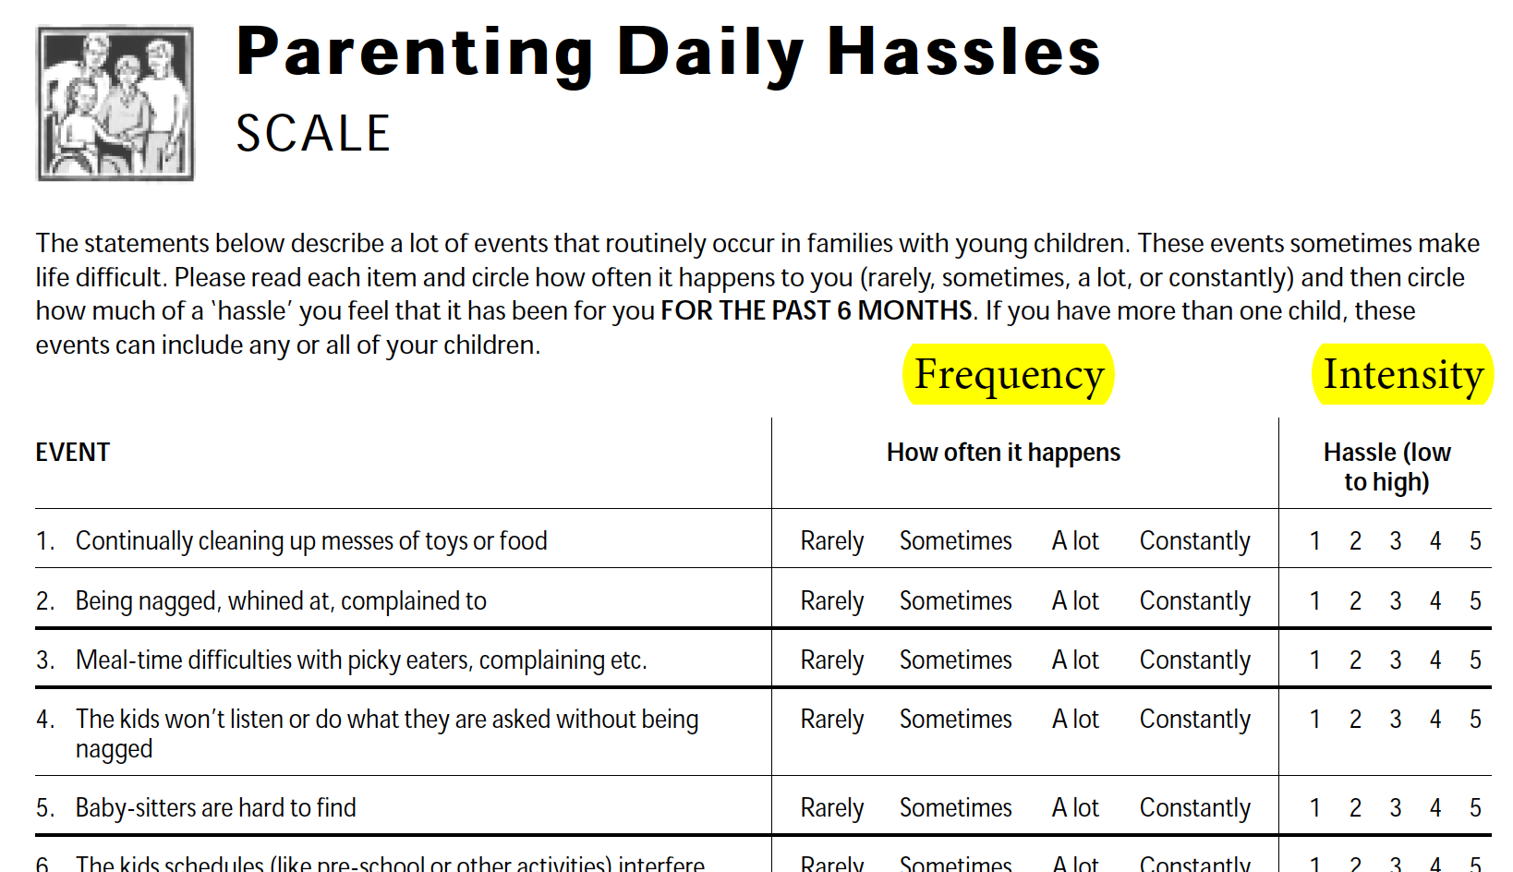
1 2 3 4
Mean Frequency score= 2
Mean no. of events with above average frequency: 6/20
Notes:
This is a screenshot of the Parenting Daily Hassles Questionnaire. It lists 20 routinely occurring events in families with young children. For example, the first event is continually cleaning up messes of toys or food. Each event can be scored based on how often it happens (the frequency), and then when it does happen, how much of a problem it becomes (the intensity). If a parent identifies any event with a frequency of 3-4, then the event is happening with above average frequency. If an event is scored with an intensity of 4-5, then it indicates a significant problem for the parent. At the time of consent, parents identified an average of 6 out of 20 events with a high frequency even though the mean frequency was just 2.

Slide 14
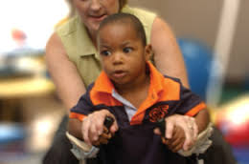
WIDEA - FS
Functional skills were an average of 6-12 months behind for current age
Despite the functional scale being designed for children < 42 months, few patients had scores of 190-200 (top of the scoring scale) even though many were over 42 months
Notes:
6 years is 72 months
Warner Initial Developmental Evaluation of Adaptive and Functional Scales

Slide 15
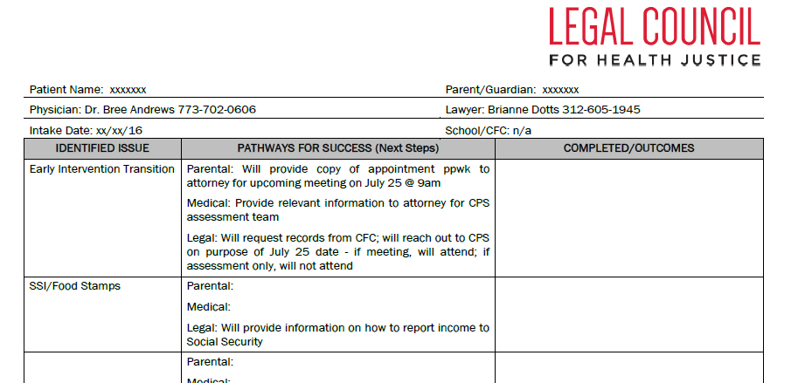
Action Plan:
Action Plan Items range: 2 - 6 items per child
80% items accomplished by parents, physician, legal advocate
6 out of 25 families have had legal representation in IEP meetings
Notes:
-Contact information for the Parent
-During the initial visit, the physician and legal advocate partnered with the parent to identify the issues that the parent would need help with, and then we identified the pathway for each participant to take
-On assessment, 80% of the action items identified, had been successfully accomplished by the parent, physician, or legal advocate
On average action items generated 3-6 contact points with the legal advocate. This occured between either parents---lawyer, lawyer---doctor, parents---public benefits.

Slide 16
Qualitative Results
Six interviews after legal intervention:
“I am now more confident and willing to ask questions.”
“It’s very convenient and helpful to have the lawyer at the doctor’s office.”
Notes:
During these interviews, one parent said…. She was also able to identify both the physician and the legal team as her and her child’s advocates
While another parents expressed that….
-Additionally, our medical team has realized how to use the MLP to write compelling letters, forms, and requests on behalf of parents/patients

Slide 17
Impact
Action Plans help families move forward in difficult processes related to public benefits
Almost all processes could be deconstructed effectively
Typed document with action plan, resources, phone numbers, and contact points was feasible and helpful
Notes:
Action plans are something that could be implemented to help improve family functioning

Slide 18
Limitations
A functional scale that adapts as children age past 42 months might have been more helpful than the WIDEA-FS
The Action Plan process is one part of the larger roadmap to success
Needs in the NICU follow up population were very high
Only short term outcomes are currently available
Notes:
Our study has a couple of limitations.
First, in hindsight, we wish we would have used a functional scale that was more appropriate to our age group. We had many older patients who needed medical-legal assistance when trying to enroll in school.
Our population is very needy, if a less needy population were assessed, the problems are likely to seem less pressing

Slide 19
Discussion
How can this process be taught?
How can other types of clinics benefit?
How do most clinicians obtain legal counsel for patients when needed?
Should it be the standard of care?
Notes:
Legal Aid Services are often available to patients outside of MLPs
We also wonder if legal advocacy in the clinic is a feasible standard of care

Slide 20
References
http://legalcouncil.org/cmlpc/
http://legalcouncil.org/wp-content/uploads/2015/01/Project_Access_Final_Report.pdf
Notes:
Legal Aid Services are often available to patients outside of MLPs
How to disseminate Action Plan process

Slide 21
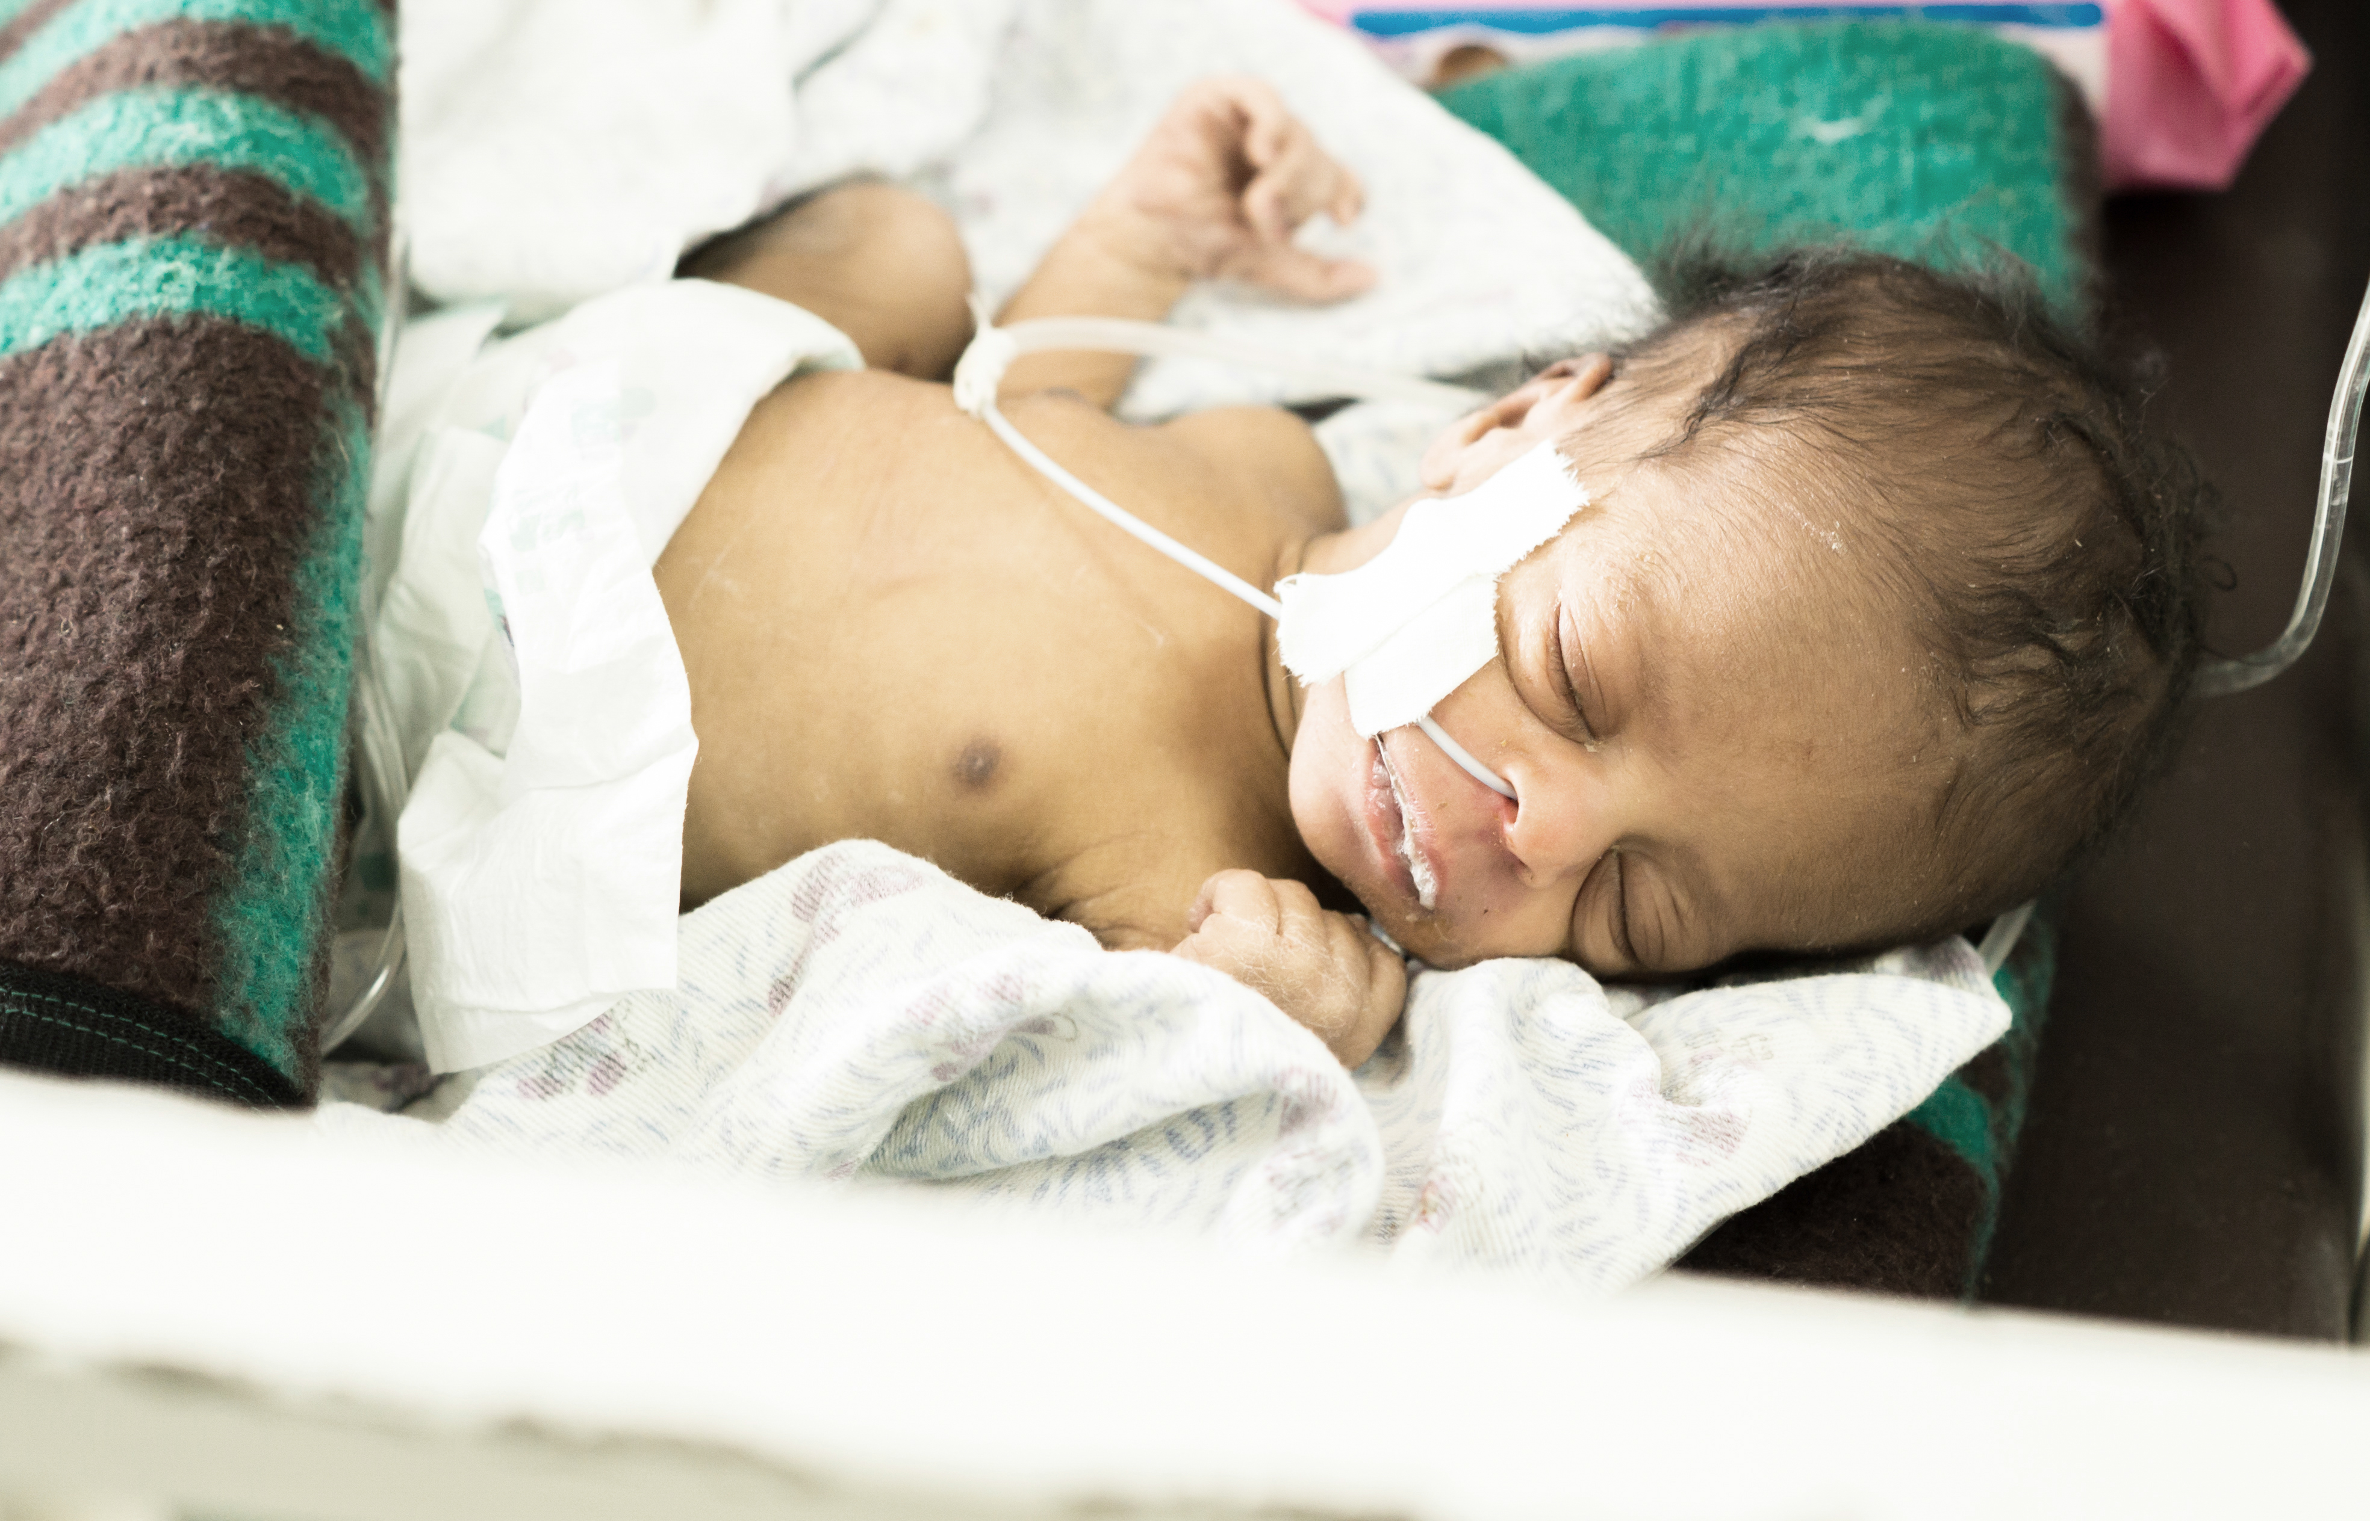
Notes:
Legal Aid Services are often available to patients outside of MLPs
How to disseminate Action Plan process

