Slide 1
Factors Associated with Maternal Drug Use and the Severity of Neonatal Abstinence Syndrome
Dr. Pratibha Agarwal, Student
Dr. David Wood, Mentor
Beth Bailey, PhD, Statistician
Jesi Hall, Research Assistant

Slide 2
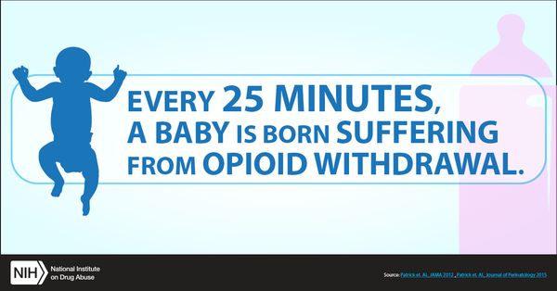
Problem Statement
What is NAS ?
Symptoms: Neurologic excitability and gastrointestinal dysfunction
Source: National Institute of Drug Use
Notes:
Why is this such a big problem ? To understand that lets first talk
Drug withdrawal syndrome seen shortly after birth in babies who were exposed to opioids in utero
Tremors Irritability Increased wakefulness High-pitched crying Increased muscle tone Hyperactive deep tendon reflexes Exaggerated Moro reflex Seizures Frequent yawning and sneezing.
Poor feeding Uncoordinated and constant sucking Vomiting Diarrhea Dehydration Poor wt gain Autonomic signs Increased sweating Nasal stuffiness Fever Mottling Temperature instability

Slide 3
Drugs causing NAS
Most likely opioids
  Percocet
  Heroin
  Methadone
  Buprenorphine
Others
  Cocaine
  Amphetamines
  Barbiturates
  Benzodiazepines
Notes:
These could be pain relievers, illicit substance, opiod maintenance therapy (Long-term treatment for opioid use disorder, under medical supervision, with a longer-acting but less euphoric opioid)
Source: https://www.cdc.gov/cdcgrandrounds/pdf/archives/2016/august2016.pdf

Slide 4
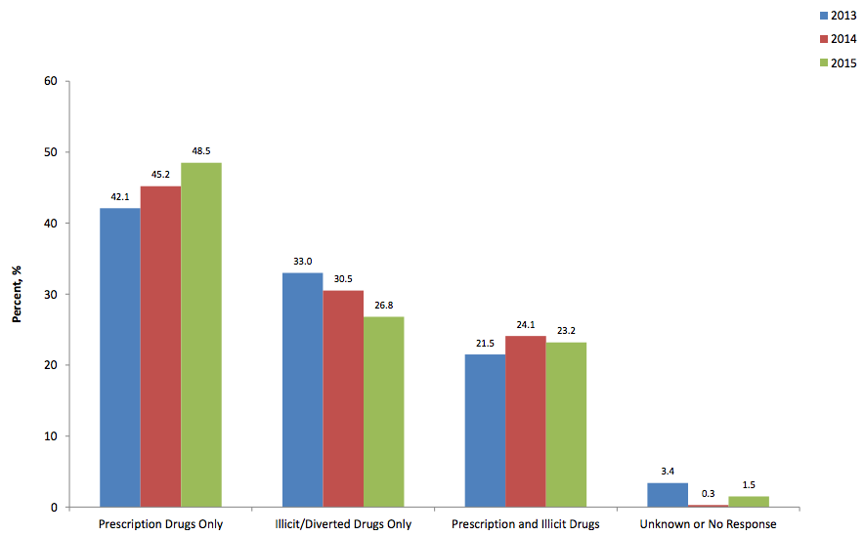
Source: Neonatal Abstinence Syndrome Surveillance Annual Report 2015
Notes:
Figure 2: Mutually Exclusive Sources of Exposure for Neonatal Abstinence Syndrome Cases, Tennessee 2013-2015. The increase in exposure to prescription drugs only was statistically significant (p=0.01). Time trends did not reach statistical significance for exposure to illicit/diverted drugs only (p=0.07) or prescription and illicit drugs (p=0.55).
??Need info for our study sample, illicit vs MAT

Slide 5
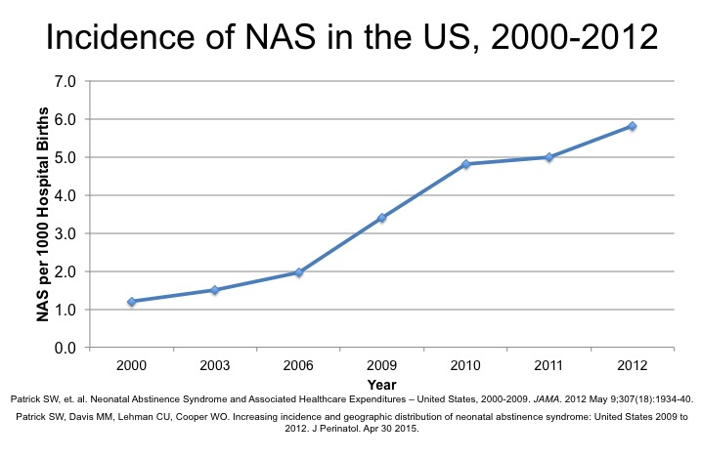
Add Title Here
Bullet points
Go here

Slide 6
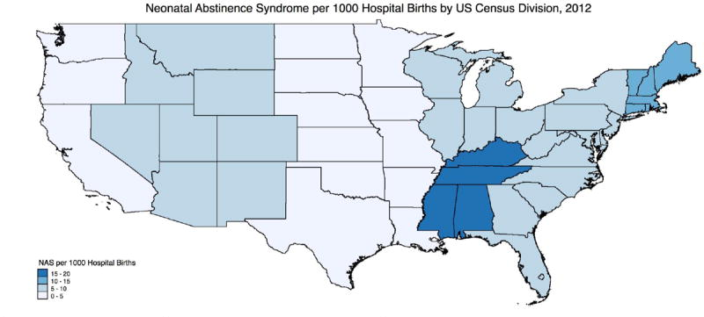
NAS Epidemic
Source: Patrick, S. W., Davis, M. M., Lehmann, C. U., & Cooper, W. O. (2015). Increasing incidence and geographic distribution of neonatal abstinence syndrome: United States 2009 to 2012. Journal of Perinatology, 35(8), 650-655.
Notes:
An epidemic of NAS is evolving in the United States and TN is the epicenter as it is the second highest prescribing state (after Alabama)
For both opiates and benzodiazepines, Alabama, Tennessee, and West Virginia were the three highest-prescribing states.
?? Incidence in north-east TN over 50 per 1000 live births
142.9, 142.8 prescriptions per 100 persons
Paulozzi, L. J., Mack, K. A., & Hockenberry, J. M. (2014). Vital signs: variation among states in prescribing of opioid pain relievers and benzodiazepines—United States, 2012. MMWR Morb Mortal Wkly Rep, 63(26), 563-8.

Slide 7
Aims & Objectives
Describe our study sample
Determine maternal and fetal risk factors affecting the severity of NAS

Slide 8
Methodology
Retrospective chart review ( 2013 – 2016)
73 infants admitted to Neonatal ICU with a diagnoses of NAS
Multiple sources used
  Prenatal records
  birth history
  urine drug screen
  infant cord tissue analysis
  admission history and physical
  discharge summary

Slide 9
Maternal Health Information
Demographics
Age
Maternal Habits
Maternal tobacco use (>5 cigs/day in last trimester)
Maternal alcohol intake
Past Medical Hx
Hx of mental illness
Hepatitis C status
Parity
Marital status
Education level
Insurance type
Type of delivery
Drug use
UDS (prenatal,admission)

Slide 10
Infant Health Information
Length of stay | Gestational age
Feeding status | Gender
Pharmacologic treatment | Birth weight
Non pharmacologic treatment | Highest Finnegan score

Slide 11
Results
Descriptive statistics
  Mothers
  Infants
Bivariate analysis
Multivariate analysis
Notes:
Can remove this slide if exceeding >10 mins

Slide 12
Results (cont.)
Mothers mean age was 28.3 (s.d. = 4.8)
Mean parity was 1.74 (s.d. = 0.49)
Social factors
  72 % were unmarried
  34.2% had less than HS and 38.4% had HS education
  87% were on public health insurance (proxy for poverty)
Notes:
Can remove this slide if exceeding >10 mins

Slide 13
Results (cont.)
34% delivered by C section
53% had a history of mental illness
37% were positive for hepatitis C
53% smoked more than 5 cigarettes per day in last trimester
Notes:
Can remove this slide if exceeding >10 mins

Slide 14
Drugs used by Mothers
Buprenorphine (89%)
BZDs
(34%)
Methadone (9%)
61%
POSITIVE CORD
TISSUE ANALYSIS
POSITIVE CORD
TISSUE ANALYSIS
9%
Notes:
Though 89% reported using buprenorphine/being prescribed buprenorphine, ONLY 61% had POSITIVE CORD TISSUE ANALYSIS
Though 34% reported using BZDs/being prescribed BZD, ONLY 9% had POSITIVE CORD TISSUE ANALYSIS

Slide 15
Results (cont.)
Infant’s mean LOS 17.7 days (s.d. = 11.6)
15% were low birthweight
Average gestational age: 38.8 (s.d. = 1.8)
60% were male
41% were breast fed
52% received nonpharmacological
86% received pharmacologic (morphine) treatment for NAS
Highest Finnegan score was a mean of 13.06 (s.d. = 2.7)
Notes:
Can remove this slide if exceeding >10 mins

Slide 16
Predictors of Length of Stay
*** smoked >5 cig/d in last trimester
*only if Cord tissue was positive
+for every increase in BW by 1000g, LOS decreased by 5days
Notes:
Backward elimination of variables that were found to be significant in bivariate analysis (p=0.15)
infants exposed to benzodiazepines had 12.7 day longer LOS on average (p = 0.07)
infants born to mothers smoking > 5 cigarettes per day in the last trimester had 6.4 day longer LOS on average (p = 0.022)
Gestational age ( p= 0.027)
BW (p= 0.149)

Slide 17
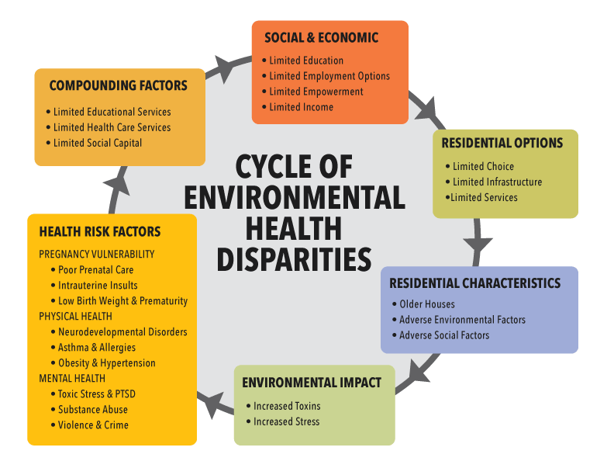
Disrupted maternal infant bonding
Notes:
Explain all the factors in relationship to this cycle --- > poverty, relationship instability, low education levels
High risk health factors – mental illness, hep c, poly drug

Slide 18
Conclusion
Tertiary prevention
Need to conduct to determine best practices for treatment of infants exposed to opioids and other substances in utero
Secondary prevention
Primary prevention
Decrease opioid prescribing by providers
Treat/prevent mental health illness in women of child bearing age
Prevent childhood trauma associated with poverty, family instability, parental drug use
Increase access to LARCs and other contraception options for women
Increase access to drug and smoking prevention and treatment for pregnant women and women of child bearing age
Routine universal screening through brief questionnaires for drug, alcohol, and tobacco use before and throughout pregnancy
Patrick SW, et. Al. A Public Health Response to Opioid Use in Pregnancy.
PEDIATRICS Volume 1 39, M arch 2017: e2 0164070
Notes:
A public health approach to substance use in pregnancy should begin with primary prevention: preventing substance and opioid misuse before pregnancy. In 2011, the White House Office of National Drug Control Policy released a plan to respond to the prescription opioid epidemic that has 4 main pillars: (1) improve public and provider education about the abuse potential of opioids, (2) reduce the abuse of prescription opioids by bolstering prescription drug monitoring programs, (3) ensure that unused opioids are properly disposed, and (4) provide law enforcement with the tools needed to stop illegal prescribing or dispensing of opioids. 8 Public health and policy approaches to the prescription opioid epidemic will help eliminate the burden of opioid use disorder before pregnancy begins.
Preconception and interconception (between pregnancies) care plays an important role in improving outcomes for pregnant women. Counseling during these crucial periods may play a role in identifying and mitigating risk to mothers and their infants. 9 Although 31% to 47% of US pregnancies are unintended, research suggests that, for women with opioid use disorder, the proportion of unintended pregnancies was higher than 85%. 10 Education and expansion of access to effective contraception, particularly long-acting reversible contraception (LARC) methods, 11 are important components of primary prevention. Access to LARC methods is supported by both the American Academy of Family Physicians (AAFP) and the American College of Obstetricians and Gynecologists (ACOG) 12, 13 during both the pre- and interconception periods.
,
Drug screening and testing in pregnancy should be used to identify women with substance use disorder and enable access to comprehensive treatment. Access to comprehensive prenatal care and treatment of women with substance use disorders is associated with fewer preterm deliveries, small-for-gestational-age infants, and infants with low birth weight. 27 – 30 The literature suggests that pregnancy can motivate women with substance use disorders to seek treatment.31 However, there remains a dearth of comprehensive treatment programs geared toward pregnant and parenting women. Only 19 states have treatment programs specifically designed for pregnant women. 32 Furthermore, only 15% of current treatment centers across the country offer specific services for pregnant women with substance use disorders, and the majority of these are located in urban areas. 33 Women with substance use disorder report high rates of past trauma, including physical and sexual abuse, and need access to gender-specific, family-friendly addiction treatment programs, psychosocial services, and mental health treatment. 34 –36 Trauma-informed services should

Slide 19
Limitations
Limited power to the study
Lack of availability of all Finnegan scores
Retrospective

Slide 20
Ongoing Project
Retrospective chart review
  ~ 600 total infants with NAS
Prospective data collection on pregnant women and infants with drug exposure

Slide 21


Slide 22
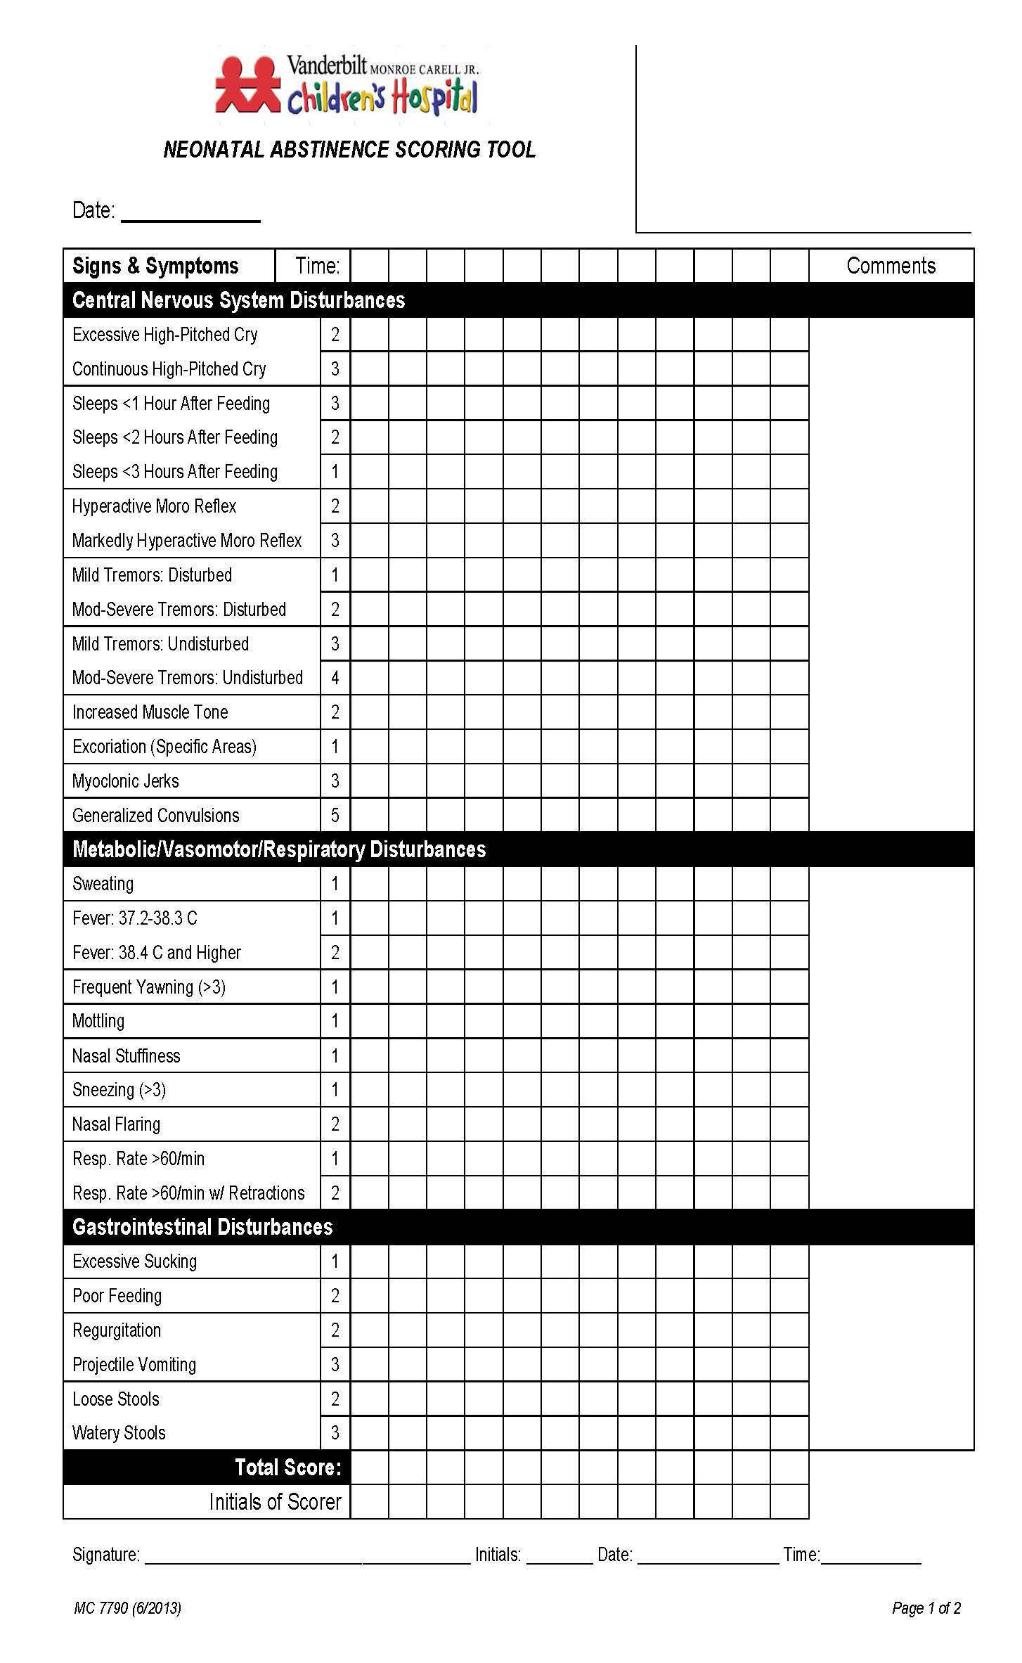
Finnegan Score
Sheet
Source: http://www.vuneo.org/npNAS.htm

Slide 23
Description of variables
MatMH (Maternal Mental Health)
Mention of mental illness in history and physical AND/OR
Mention of maternal history of psychiatric illness in admission record AND/OR
Mother received alprazolam while in the hospital AND/OR
Mother received clonazepam while in the hospital AND/OR
Mother received paroxetine while in the hospital AND/OR
Mother received sertraline while in the hospital

Slide 24
Preg_Bupr
Mother was taking buprenorphine when she was admitted to the hospital AND/OR
Mother received buprenorphine while in the hospital AND/OR
Mother mentioned receiving buprenorphine in her history and physical AND/OR
Mother mentioned that she was receiving a prescription for buprenorphine in her admission record AND/OR
Baby’s cord stat was positive for buprenorphine
Preg_methdn
Mother was taking methadone on admission to the hospital AND/OR
Baby’s cord state was positive for methadone AND/OR
Mother’s history and physical mentioned methadone

Slide 25
Preg_benzo
Mother has positive UDS for benzos AND/OR
Mother was taking clonazepam on admission to the hospital AND/OR
Mother was taking alprazolam on admission to the hospital AND/OR
Mother received alprazolam/clonazepam/lorazepam while in the hospital AND/OR
Baby’s cord stat was positive for benzos AND/OR
Mother’s history and physical mentioned clonazepam/benzos/Xanax
Preg_opi
Baby’s cord stat tested positive for oxy/opiates/tramodol AND/OR
Mother mentioned cocaine/crack use in the admission record AND/OR
Mother received opiate while in the hospital (fentanyl, hydrocodone, hydromorphone, oxycodone, or tramadol) AND/OR
Mother mentioned use of an opiate in her admission record or H&P

