Slide 1
Healthy Home Environment, Low-Income Children and The Patient-Centered Medical Home
Break the Cycle
Xin Hu
2015

Slide 2
Patient-Centered Medical Homes (PCMH)
PCMH is an approach to providing comprehensive primary care for children, youth and adults. It is a health care setting that facilitates partnerships between individual patients, and their personal physicians, and when appropriate, the patient's family.
In 2007, the AAP, AAFP, ACP, and AOA developed joint principles to describe the PCMH, including:
Accessible care
Comprehensive care
Patient-Centered
Coordinated care
Safety and quality
Personal physician
Physician directed medical practice (team-based practice)
Whole person orientation
Care is coordinated and/or integrated
Quality and safety
Enhanced access
Payment

Slide 3
Literature: PCMH
1. Predictors of enrollment:
(Cross-sectional)
2. Impacts on Health outcomes:
(RCT & Cross-sectional)
PCMH
Race/ethnicity
SES
Primary language
Health insurance
Health Conditions (mental & behavioral)
Diseases
Health care utilization
  Readmission rate
  Emergency visits
Health care expenditure
Satisfaction
Missed school days
Family functioning
3. Quality of care: inconsistency between provider and consumer reports
Consumer reports of care quality (using PCMH criteria)
vs.
State PCMH implementation level
Securing PCMH supplies does not guarantee high quality of health care

Slide 4
Literature:
Caregiver Characteristic: Home Environment
  Previous literature overlooked factors on caregivers side
  Substantial evidence of direct impact on children’s health
    Avoiding second-hand smoke → reduced risks of asthma
    Sharing family meals→ healthy diet, maintaining BMI
  Overlooked indirect impact on children’s health
    Decision maker: choose child’s health provider
    Create home environment (Healthy child-rearing behaviors)→ Health awareness→ Health care→ Health outcomes
PCMH
Home environment (Caregiver characteristics)
Children’s
health outcomes

Slide 5
This study explores whether living in a healthier home environment is associated with a child’s use of higher quality of care (Use of PCMH) for low-income families
H1: Home environment is positively associated with children’s use of high quality physician practices
And how this association will change when we minimize the supply side effects
H1a: Within states that have the least access restrictions to PCMH, the association between home environment and children’s quality of healthcare services will be positive and stronger compared to states with less developed programs

Slide 6
METHOD: Sample
Data Source: 2011-2012 National Survey of Children’s Health (NSCH)
  Telephone survey
  Weighted (national level and state level)
  95,677 non-institutional children from 0-17 years old
Sample selection
Full sample
(n=95,677)
With public insurance (n=27,381)
Used medical services last year (n=26,254)
Limit to states with advanced PCMH implementation:
CO, MI, MN, NC, NH, RI, and VT
Missing values (n=5,453)
Analytic sample
(n=20,801)
Subset sample
(n=2,693)

Slide 7
KEY VARIABLES
Dependent Variable: Health care quality (measured by PCMH)
Level 0: met none or only one of the first two criteria
Level 1: met the first two but not the other three criteria
Level 2: met all criteria (the last two were applicable when needed)
Independent Variable: Home environment
Home Environment Criteria | Age Group
 | 0-5 year | 6-17 year
No exposure to household smoking
Family shares meals
Children watch less than 2 hours TV per day
Children are read/sung to everyday
Children were breastfed ever
Children always do required homework
Parents met most of child’s friends
Level 0 (0-2 criteria)
Level 1 (3 criteria)
Level 2 (4-5 criteria)

Slide 8
Model & Analysis
Other covariates:
Children Race/ethnicity
Children Religious Services
Number of children in household
Mother’s age
Caregiver education
Caregiver physical health status
Caregiver mental health status
Primary language
Family structure
Poverty level
Home ownership
Frequency of moving
Rundown housing in the neighborhood
Feel safe in the neighborhood
Gender
Age
Children physical health status
Children special health care needs
Ordinal logistic regression model
  Differentiate the home environment effects on each PCMH levels
Subset analysis
  Limited to states that had more advanced PCMH implementation
  CO, MI, MN, NC, NH, RI, VT

Slide 9
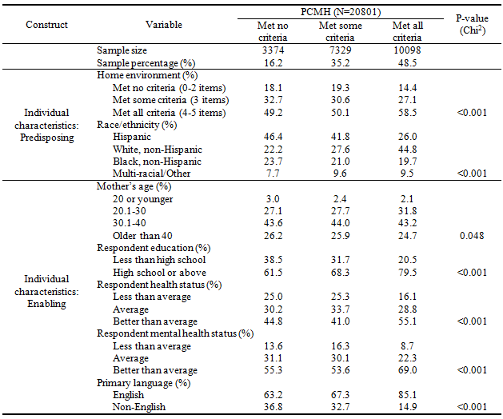
Table 1. Children and caregiver characteristics across PCMH levels
*Other covariates were also included in the model (See handouts)

Slide 10
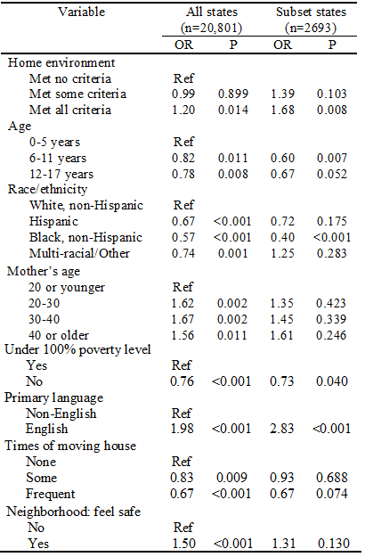
Table 5. Odds ratios of Home environment and other confounders for all states and subset states

Slide 11
KEY FINDINGS
Results suggest that caregivers who engage in healthier child rearing behaviors are more likely to chose higher quality of physician practices as measured by PCMH criteria
  Subset analysis where we secured sufficient PCMH providers, showed even more dramatic effect of home environment on PCMH use
Certain minority groups are LESS LIKELY to use PCMH
  African-American
  Younger children
  Non-English speaking families
  Families under 100% FPL
  Younger mother
  Less educated caregivers
**Concordant with previous research

Slide 12
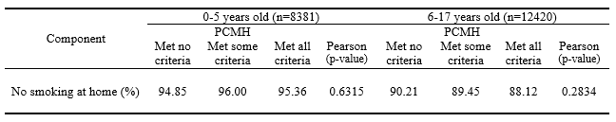
LIMITATIONS
Cross-sectional data: Cannot prove causality
Survey data:
  Self-report bias (i.e. smoking status being underestimated)
  However, other components of Home Environment showed validity and variability.
  Missing values: unknown bias
  Mother’s age (14.3%) - overestimated or underestimated results

Slide 13
POLICY IMPLICATION
Add to evidence base
  Home environment as a important predictor for children’s use of PCMH
  Need to control for Home Environment in studies which examine health benefits of PCMH use as justification for care-management payments
    Impact of PCMH may be overestimated
Consumers can report on physician quality using the same indicators used by supply side agents (i.e. National Quality Assessment Organization)
Future study:
  Longitudinal: clarify health effects brought by PCMH vs. home environment
  Compare consumer reports of PCMH with supply side ratings claimed by physicians that practice PCMH

Slide 14
Break the Cycle
Personal Characteristics
Age
Gender
Race/ethnicity
……
Compound Risk Factors
Health care quality
(Use of PCMH)
Environmental Risk Factors
Health Characteristics
Environmental Characteristics
Health Risk Factors
HOME ENVIRONMENT
Poor Nutrition
Physical Activity
Toxicant Exposure
Child Neglect & Abuse

Slide 15
Thank you!

Slide 16
APPENDIX

Slide 17
PCMH Implementation
1. PCMH Accreditation/Recognition
Based on physician reports (supply side evaluation)
Consumer reports (demand side evaluation)
  Measure of quality and a proxy of enrollment
  Not yet used for reimbursement, just research
2. Financial incentives for PCMH recognition
FFS: lump sum payments; monthly payment; higher payment levels
P4P: comprehensive payment
Federal/State grants

Slide 18
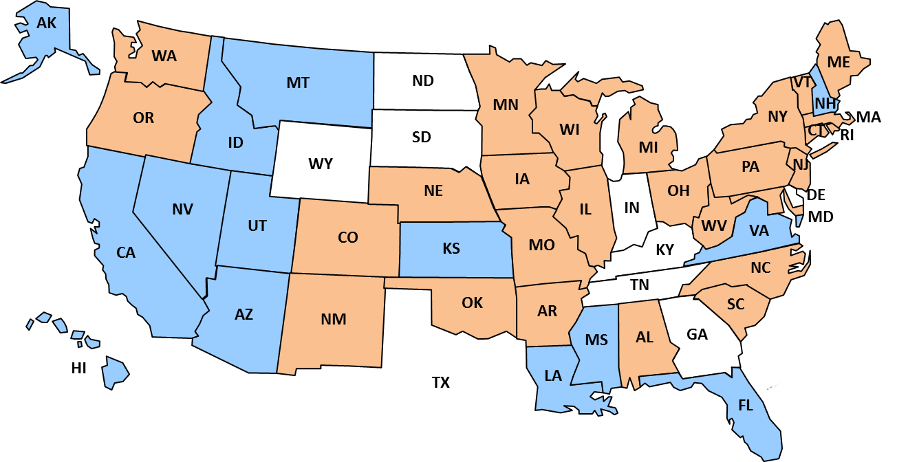
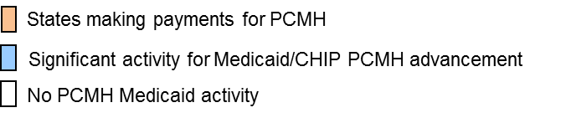
Overview of Medicaid/CHIP Medical Home Activity
Among 42 State Medicaid/CHIP Programs Planning/Implementing PCMH, 27 Making Medical Home Payments
Source: National Academy for State Health Policy State Scan, October 2012, http://www.nashp.org/med-home-map.

Slide 19
VARIABLE
DV: PCMH
Level 2
No
Need referrals?
Personal Doctor/Nurse
Yes
Usual Source of Care
Yes
Family Centered Care
Level 2
No
No
No
No
Level 0
Level 0
Level 1
Yes
Need care coordination?
Getting referrals
Yes
Level 0: met none or only one of the first two criteria
Level 1: met the first two but not the other three criteria
Level 2: met all criteria (the last two were applicable when needed)
No
Yes
Level 1
Getting care coordination
Yes
Level 2
No
Level 1

Slide 20
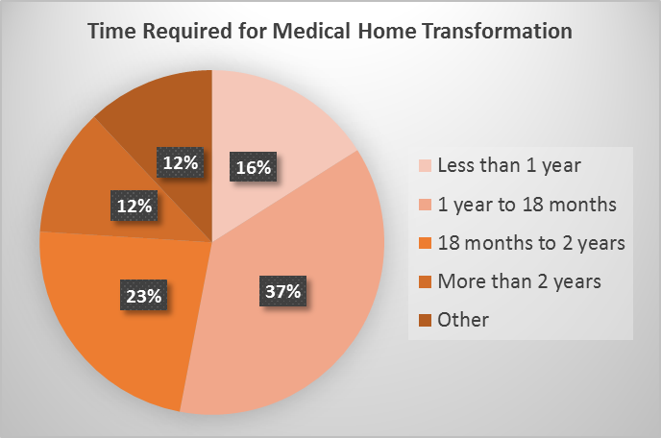
APPENDIX
Standards for advanced PCMH implementation:
  First PCMH pilot/project was launched before 2009 (2 years before the 2011-2012 NSCH took place)
  Considerable amount PCMH activities
The majority require 1 to 2 years for Medical Home transformation
Source: Healthcare Intelligence Network Patient-Centered Medical Home Survey, March 2010

Slide 21
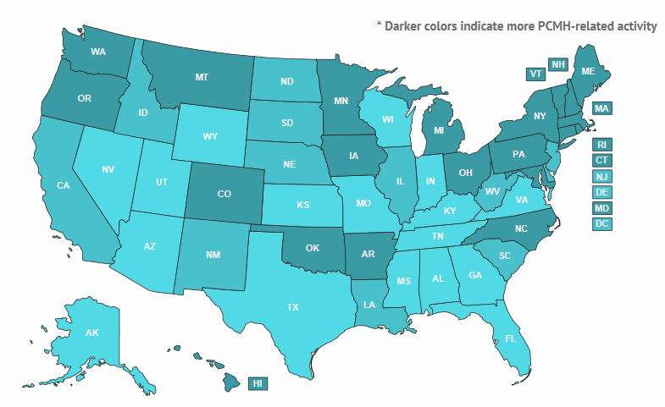
PCMH Activities by State
Source: Patient-Centered Primary Care Collaborative, 2014

Slide 22
Table 2. Comparison of individual characteristics between all states and subset states
Similar, except: subset states have less Hispanic, more English-speaking families and highly educated parents, and children with better health status

Slide 23
Table 3. Home environment component across PCMH levels for all states
Table 4. Home environment component across PCMH levels for subset states

Slide 24
Mis-specified relationship in a previous study
One study (Arauz Boudreau AD et al., 2012) claimed that PCMH is associated with better family functioning
Family functioning shared similar concepts of home environment
No model or evidence to suggest that use of a PCMH affects caregivers child-rearing behaviors:
- Direct interventions on caregivers showed weak effects
- Limited duration of PCMH existence: not enough time to have effects

Slide 25
Construct | Variable | Indicator used for variable |  | Variable Type | Variable Label
Independent Variable (Individual predisposing) | Home Environment | 0-5 year old 1. ind6_4a_11: Does anyone living inside smoke cigarettes in the home? (No exposure to household smoking) 2. ind6_8_11: How many days did all the family members eat a meal together last week? (4 or more days per week) 3. tv_0to5: Hours of TV or Video watching per weekday (less than 2 hours per day) 4. ind1_3_11: Was the child ever breastfed or fed breast milk? (yes) 5. ind6_7_11 & ind6_7a_11: How many days did you or other family members read/sing to the child last week? (everyday) | 6-17 year old 1. ind6_4a_11: Does anyone living inside smoke cigarettes in the home? (No exposure to household smoking) 2. ind6_8_11: How many days did all the family members eat a meal together last week? (4 or more days per week) 3. tv_6to17: Hours of TV or Video watching per weekday (less than 2 hours per day) 4. K7Q34: Have you met all of/most of/some of/none of child’s friends? (met most or all of child’s friends) 5. K7Q83: Does he/she do all required homework? (usually or always) | Ordinal | 0 = “Met no/little (0-2) criteria” 1 = “Met some (3) criteria” 2 = “Met all (4-5) criteria”
Dependent Variable | Patient-Centered Medical Home | ind4_8_11: The level that children (age 0-17) receiving coordinated, ongoing, comprehensive care within a medical home [Component] ind4_9_11: Personal Doctor or Nurse ind4_9a_11: Usual Sources for Sick Care ind4_9b_11: Family-centered care ind4_9c_11: Getting Needed Referrals ind4_9d_11: Effective Care Coordination |  | Ordinal | 0 = “Met no/little criteria” 1 = “Met some criteria” 2 = “Met all criteria”
Individual characteristics: Predisposing | Race/ethnicity | race4_11 |  | Categorical | 1 = "Hispanic" 2 = "White " 3 = "Black " 4 = "Multi-racial/Other "
 | Children religious services | K8Q12 |  | Dichotomous | 0 = “No” 1 = “Yes”
 | Number of children in household | TOTKIDS4 |  | Dichotomous | 0 = “One child” 1 = “More than one child”

Slide 26
Construct | Variable | Indicator used for variable | Variable Type | Variable Label
Individual characteristics: Enabling | Mother’s age | K9Q16R | Ordinal | 0 = “20 or younger” 1 = “20-30 years old” 2 = “30-40 years old” 3 = “40 or older”
 | Respondent education | Relation: Interviewee’s relationship with children EDUC_MOMR: Mother’s highest grade of school EDUC_DADR: Father’s highest grade of school EDUC_RESR: Non-parent respondent’s highest grade of school | Dichotomous | 0 = “Less than high school” 1 = “High school or above”
 | Respondent’s Health Status | Relation: Interviewee’s relationship with children K9Q20: Mother’s health status K9Q21: Father’s health status K9Q22: Non-parent’s health status | Ordinal | 0 = “Less than average” 1 = “Average” 2 = “Better than average”
 | Respondent’s mental health status | Relation: Interviewee’s relationship with children K9Q23: Mother’s mental health status K9Q24: Father’s mental health status K9Q25: Non-parent’s mental health status | Ordinal | 0 = “Less than average” 1 = “Average” 2 = “Better than average”
 | Primary language | planguage | Dichotomous | 0 = “Non-English” 1 = “English”
 | Family Structure | famstruct_11 | Dichotomous | 0 = "Other than two-parent" 1 = "Two-parent"
 | Own or rent home | C10Q41 | Dichotomous | 0 = “Rent or other” 1 = “Own”
 | Times of moving house | K11Q43 | Ordinal | 0 = “None” 1 = “Some” 2 = “Frequent”
 | Is there rundown housing in your neighborhood? | K10Q22 | Dichotomous | 0 = “No” 1 = “Yes”
 | How often do you feel the child is safe in your neighborhood? | K10Q40 | Dichotomous | 0 = “Sometimes or less” 1 = “More than sometimes”
Individual characteristics: Need | Gender | sex_11 | Dichotomous | 0 = “Male” 1 = “Female”
 | Age | AGEYR_CHILD | Ordinal | 0 = “0-5 years old” 1 = “6-11 years old” 2 = “12-17 years old”
 | Child’s Health Status | K2Q01 | Ordinal | 0 = “Average or less” 1 = “Good” 2 = “Excellent”
 | Special Healthcare Needs | CSHCN | Dichotomous | 0 = “No” 1 = “Yes”

