Slide 1
Positing Change in Lives Through Evidence-inspired, United Action and Community Service
Break the Cycle of Environmental Health Disparities
April 19, 2016
Carol J. R. Hogue, PhD, MPH
Emory University

Slide 2
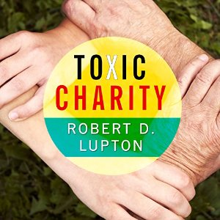
Positing change: Who wants it and why?*
1) Don't TELL people what they need from you -- ASK them
2) Support programs that stay on the ground year-round
3) If volunteers build a school or a clinic, make sure they have a plan to continue to support the staff
4) Assess local assets. Support programs that work with the local infrastructure to assure buy-in and local oversight
5) Ask yourself, “who will benefit from this investment?”
Toxic Charity: How Churches and Charities Hurt Those They Help (And How to Reverse It) ©2011 Robert D. Lupton. (P)2015 Tantor

Slide 3
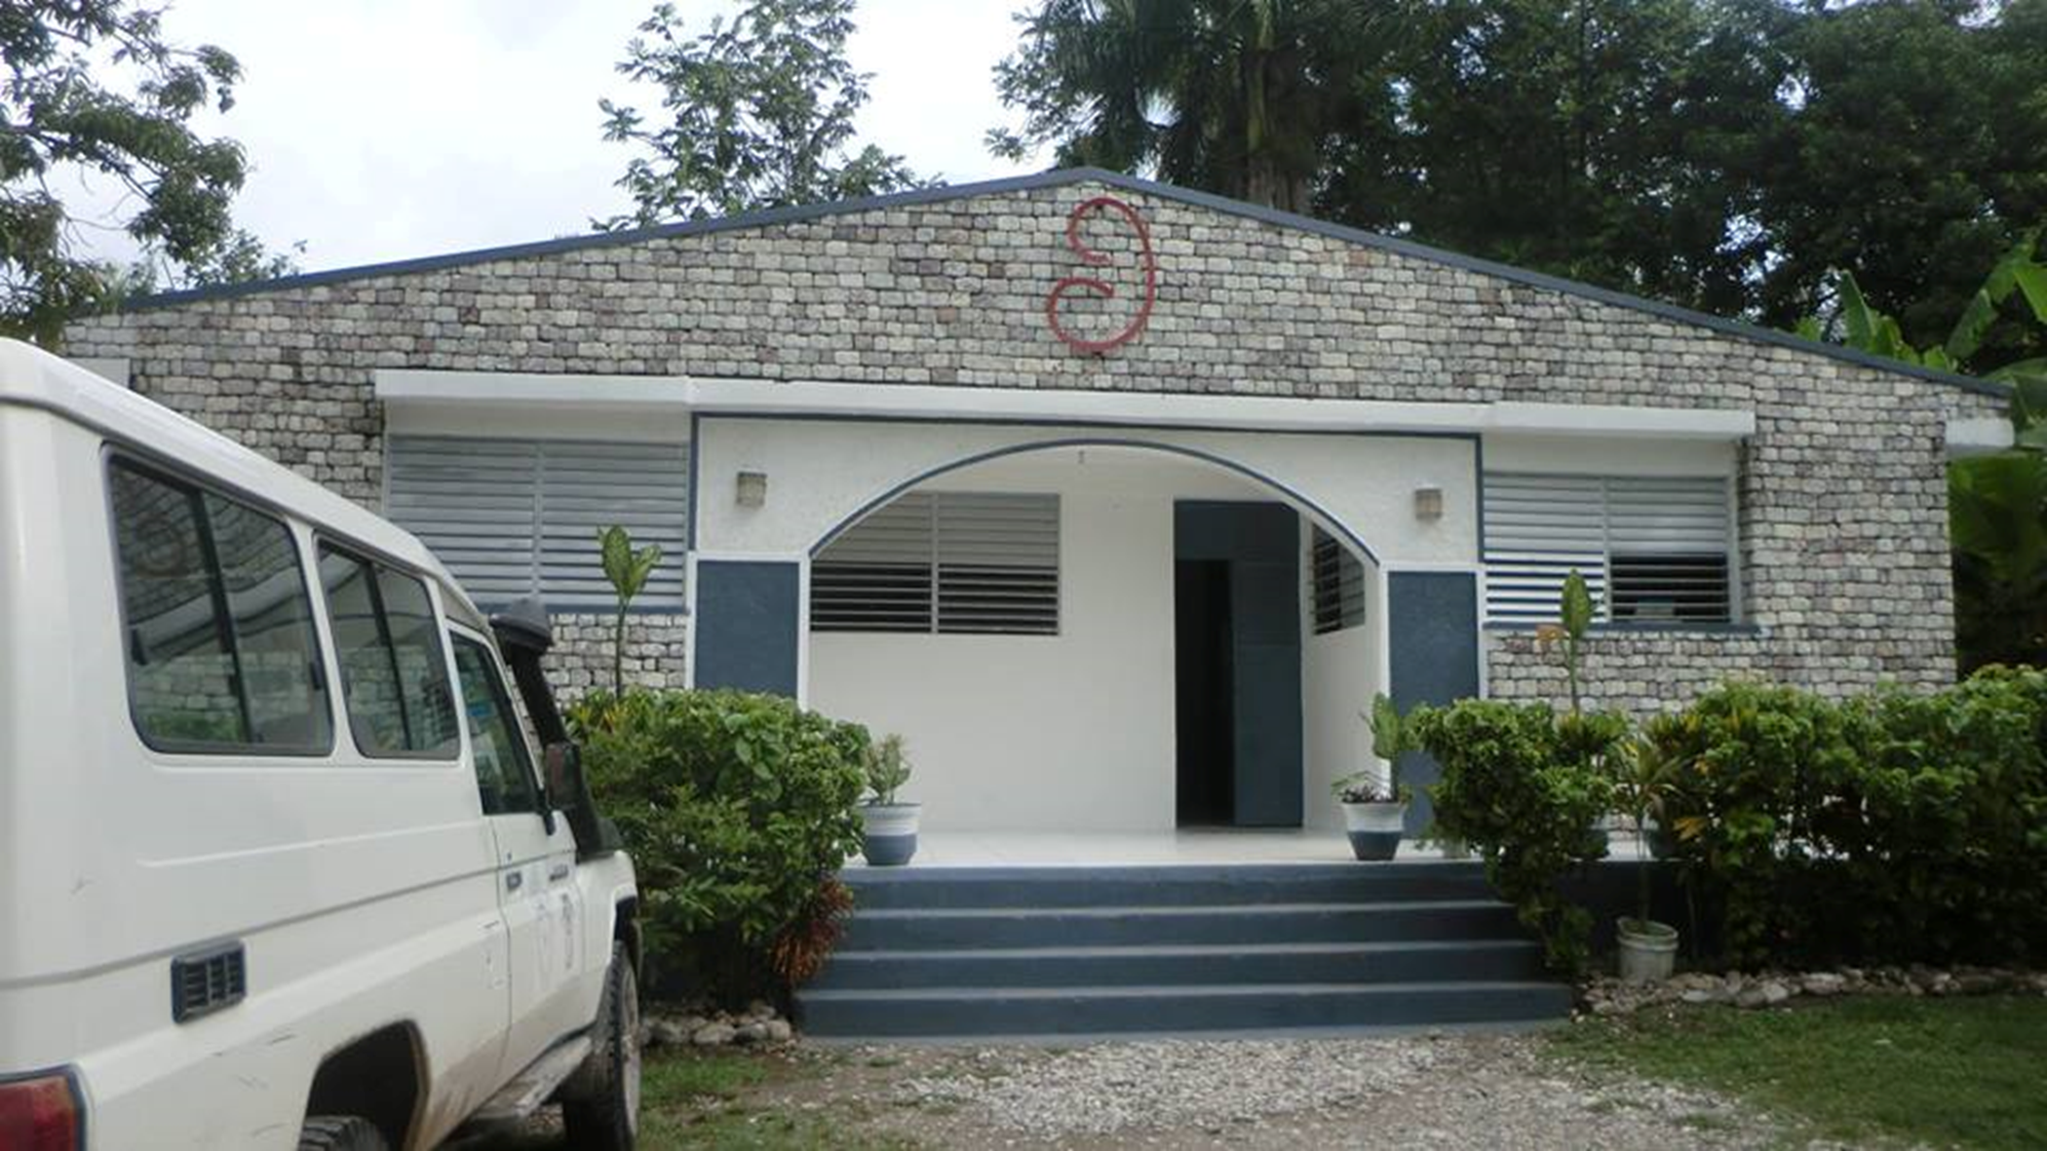
Notes:
Maison de Naissance, (MN), “Home of Birth,” sponsored by Global Birthing Home Foundation, is a modern maternal health center supporting healthy mothers and healthy babies in Haiti.

Slide 4
All Haitian staff
Led by Certified Nurse Midwife, Mme. Rosena Baptiste
Women entrepreneurs program
Community health workers
Electronic health records since clinic founded in 2004

Slide 5
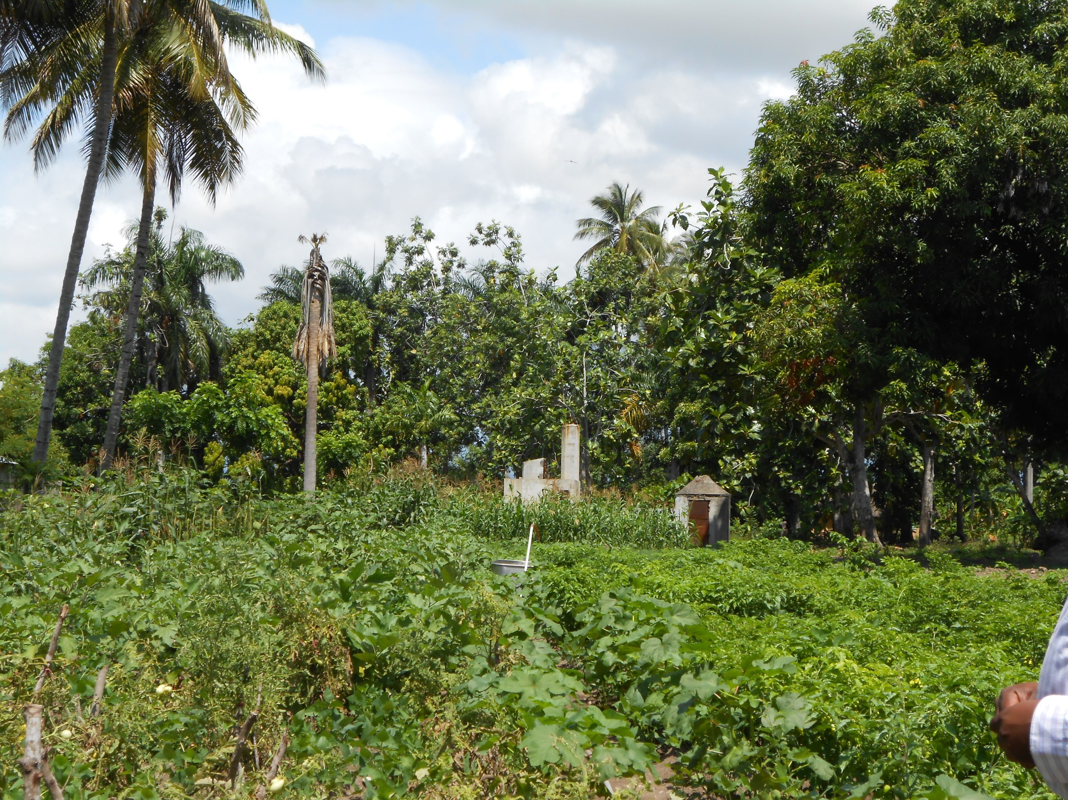
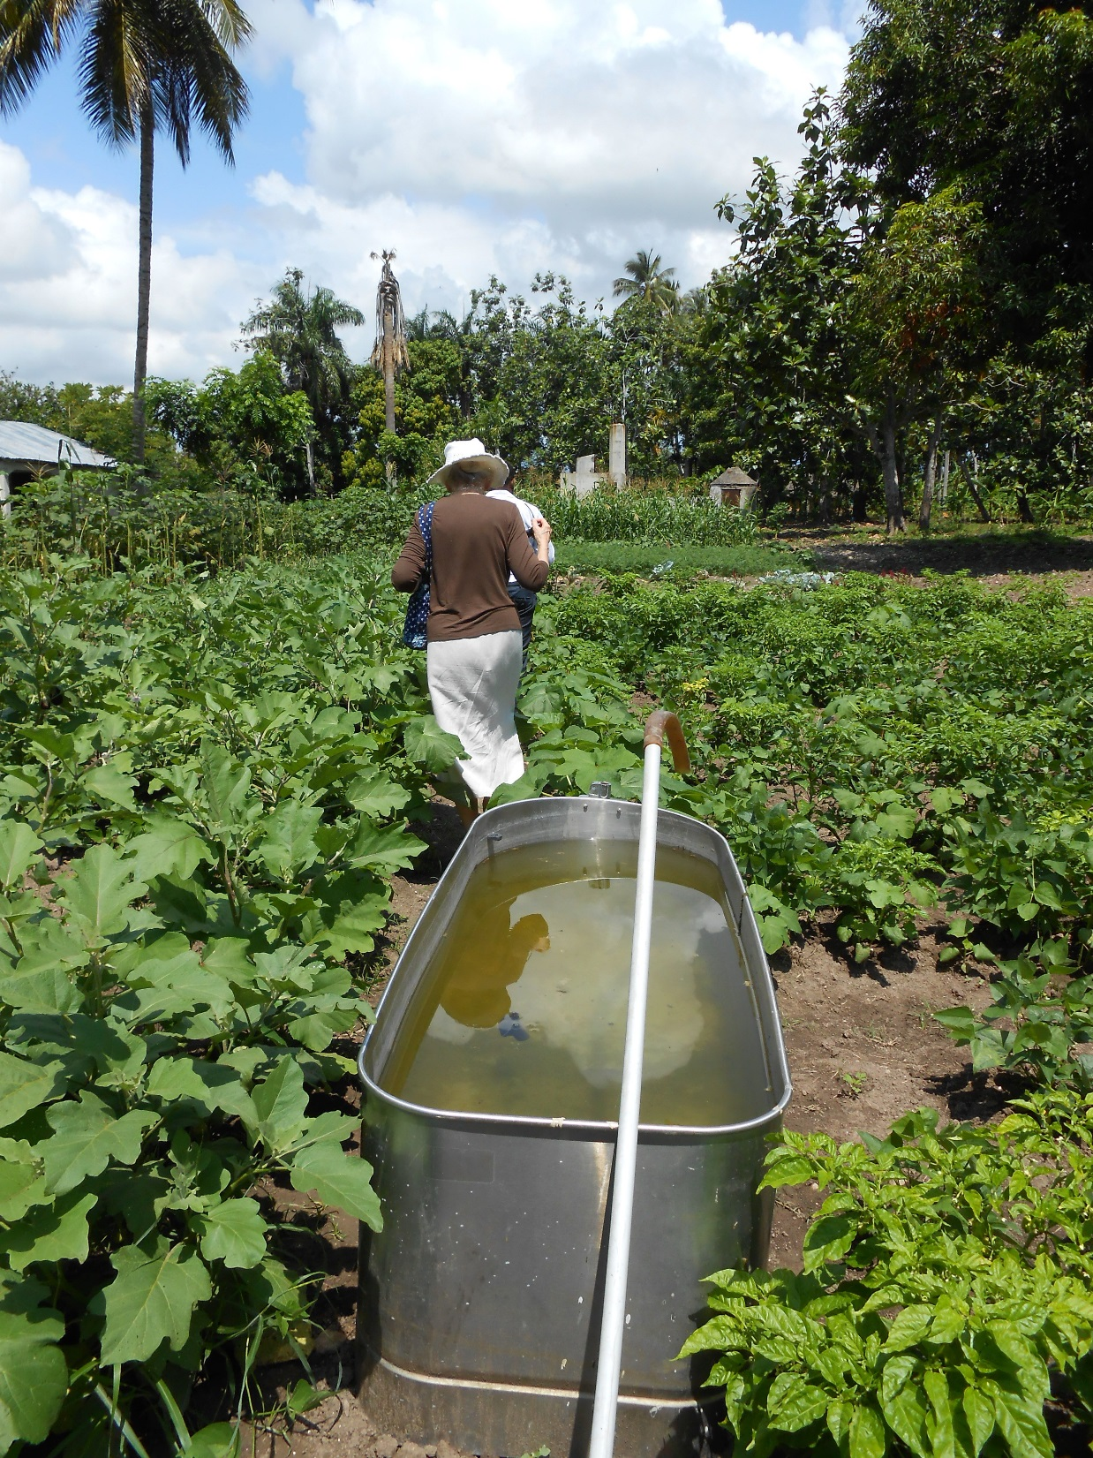

Slide 6
Lives are changed – with unanticipated consequences
When systems are disrupted, lives are changed (out-of-area deliveries)
The law of unanticipated consequences kicks in (free is not healthy)
Not everyone will be happy with the changes (who is this for and why?)
Build a robust network through collective impact

Slide 7
Collective impact in Larnage, Torbeck Commune, South Department, Haiti
Four “legs” to the “partners stool”
Sustainable Seat
Consumers
Government
Grants/contracts/research
Fund raising by related NGO(s)
Community Advisory Board
Ministry of Health (MSPP)
e.g. PEPFAR
GBHF
Partners require:
Communication
Transparency
Trust
Mutual respect
Unambiguous, relevant roles

Slide 8
“Collective Impact,” John Kania & Mark Kramer. Stanford Social Innovation Review. Winter 2011.
“[T]he commitment of a group of important actors from different sectors to a common agenda for solving a specific social problem.”
A proven approach to “adaptive problems” – “complex, the answer is not known, . . ., no single entity has the resources or authority to bring about the necessary change”
Examples:
Strive – increase high school graduation in Cincinnati, Ohio
Elizabeth River Project (eastern Virginia) – since 1993 1,000 acres of watershed land restored, 215 million pounds of pollution reduced, water quality improved
Shape up Somerville (Mass) – to reduce childhood obesity involved schools, restaurants, government, nonprofits who collectively defined wellness and introduced farmers’ markets, reduced-gym memberships, sidewalks, etc.

Slide 9
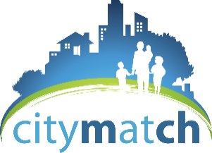
Collective impact = United Action Learning Collaborative Best Change Process Assessment
Analyze information about the problem or goal(s)
Establish a vision and mission
Develop an organizational structure (backbone support organization with project management, data management, and facilitation)
Develop and use strategic and action plans
Develop leadership (“[R]eaching an effective solution requires learning by the stakeholders involved in the problem, who must then change their own behavior in order to create a solution” (Kania & Kramer, p. 38)
Document progress and use data (“Collecting data and measuring results consistently on a short list of indicators at the community level and across all participating organizations not only ensures that all efforts remain aligned, it also enables the participants to hold each others accountable and learn from each other’s successes and failures.” (Kania & Kramer, p. 40)

Slide 10
Service – Collective impact is “a new way of seeing, learning, and doing that marries emergent solutions with intentional outcomes.” (Kania & Kramer, 2013;3*)
“When you are moving towards an objective, it is very important to pay attention to the road. It is the road that teaches us the best way to get there, and the road enriches us as we walk its length.” (Paulo Coelho, quoted in Kania & Kramer, 2013;13)
“[W]e live in a complex world, we often don’t know what is going on, and we won’t be able to understand its complexity unless we spend more time not knowing . . . Curiosity is what we need.” (Margaret Wheatley, quoted in Kania & Kramer, 2013;13)
*“Embracing emergence: How collective impact addresses complexity,”
Stanford Social Innovation 10th Anniversary 2013;1-14.

