Slide 1
The Family Check Up in a Pediatric Clinic: An Integrated Care Delivery Model to Improve Behaviors in the Home Environment
Break the Cycle
April 23, 2015
Presented by Courtney Smith

Slide 2
Interdisciplinary Team
Courtney Smith, M.A.
Clinical Psychology Doctoral Candidate
Behavioral Health Consultant
Department of Psychology
East Tennessee State University
Karen Schetzina, MD, MPH, CLC
Associate Professor
Director, Division of Community Pediatrics Research
Department of Pediatrics
ETSU Quillen College of Medicine
David Wood, M.D., MPH
Chair of Pediatrics
Chief Medical Officer of Niswonger Children’s Medical Hospital
Department of Pediatrics
ETSU Quilllen College of Medicine
Jodi Polaha, PhD
Clinical Psychologist
Associate Professor
Department of Psychology
East Tennessee State University

Slide 3
Background
Health disparities among rural children
Low birth weight¹
Poorer nutrition²
Higher prevalence of obesity⁵
Greater alcohol and drug use⁶
Greater rates of behavioral and psychosocial concerns⁷
¹Hulme & Blegen (1999); ²Stroehla, Malcoe, & Velie (2005); ³Lutifyya, Lipsky, Wisdom-Behounek, & Inpanbutr-Martinkus, 2007; CDC (2009) ⁴Johnson et al. (2008); ⁵Polaha, Dalotn & Allen (2009)

Slide 4
Background
Northeastern TN sees higher rates of parent-reported behavioral concerns (21% vs. 10-14% nationally)¹
Parents seek help for their child’s behavior from pediatricians (62.5%) over mental health services (24.7%)¹
¹Polaha, Dalton, & Allen (2011)

Slide 5
Background
Behavioral concerns in children are predictive of negative outcomes^{1,2}
¹Campbell, Shaw, & Gilliom, (2000); ²Shaw, Bell, & Gilliom (2002); ³Coie & Dodge (1998); ⁴Patterson (1982)
Notes:
…in adolescence and early adulthood (e.g., antisocial behaviors, substance use)^{1,2,3,4}
(e.g., Family Check Up, Parent-Child Interaction Therapy, Incredible Years Training Program)
Few families access these treatments

Slide 6
Cycle of Environmental Health Disparities
Personal Characteristics
Environmental Risk Factors
Environmental Characteristics
Health Risk Factors
Compound Risk Factors
Health Characteristics
Emotional and Social
ADHD/Learning Disabilities
Behavioral and Emotional Disorders
Depression and Anxiety
Substance abuse
PTSD

Slide 7
Background
Behavioral concerns in children are predictive of negative outcomes^{1,2}
There are strong evidence-based treatments (EBT) targeting parenting styles to treat these concerns^{3,4}
¹Campbell, Shaw, & Gilliom, (2000); ²Shaw, Bell, & Gilliom (2002); ³Coie & Dodge (1998); ⁴Patterson (1982)
Notes:
…in adolescence and early adulthood (e.g., antisocial behaviors, substance use)^{1,2,3,4}
(e.g., Family Check Up, Parent-Child Interaction Therapy, Incredible Years Training Program)
Few families access these treatments

Slide 8
Background
Barriers to Mental Health Treatment
Treatment is not available or too time intensive¹
Stigma and negative attitudes towards mental health services^{2,3}
Mental health provider shortages⁴
¹Baker, Arnold, & Meagher (2011); ²Hoyt, Conger, Valde, & Weihs (1997); ³Rost, Smith, & Taylor (1993), ⁴Goldsmith, Wagenfeld, Mandersheid, & Stiles (1997)

Slide 9
Family Check Up (FCU)
The FCU is a brief, evidence-based intervention shown to reduced childhood rates of antisocial behavior, depression, and drug use¹
¹Dishion, Stormshak, & Kavanagh, (2011)

Slide 10
Original Model
Initial Contact
Assessment
(home based)
Feedback/Intervention
Follow
up
45-60 min
90 minutes
60 minutes
Brief intake
Overview
Schedule
Questionnaires
Detailed Interview
3-5 Videotaped Parent-child interactions
Review assessment
MI to identify change
Treatment start
Courtesy of Dr. Jodi Polaha (2014)

Slide 11
Outcomes in a School Setting
Self-Reported Substance Use
Dishion, T. J., Nelson, S. E., & Kavanagh, K. (2002). Preventing early adolescent substance use: A family-centered strategy for public middle school. [Special Issue]. Behavior Therapy, 34, 553-571.

Slide 12
The Family Check Up
Adapted to Pediatric Primary Care
Assessment
Feedback/
Intervention
warm hand-off
or
referral
follow-up
as needed
1 or 2-session, 90 minute
1 session, 60 minute
Courtesy of Dr. Jodi Polaha (2014)

Slide 13
Aims
The aims of this study are organized by RE-AIM, a dissemination and implementation science framework.
REACH | What % of referred families attend the FCU?
EFFECTIVENESS | Do parents report improved child behavior/decrease risk following the FCU?
ADOPTION | What % of “at-risk” 4 and 5 year-olds are referred to the FCU by their pediatrician
IMPLEMENTATION | Can the FCU be implemented with fidelity?
MAINTENANCE | Is the FCU financially sustainable in this setting?

Slide 14
Hypotheses
REACH | There will be a better reach than within the school setting.
EFFECTIVENESS | Parents will report improvements similar to those found in school settings
ADOPTION | Anticipate high levels of adoption
IMPLEMENTATION | Anticipate fidelity can be reached
MAINTENANCE | Expect the FCU will be financially sustainable

Slide 15
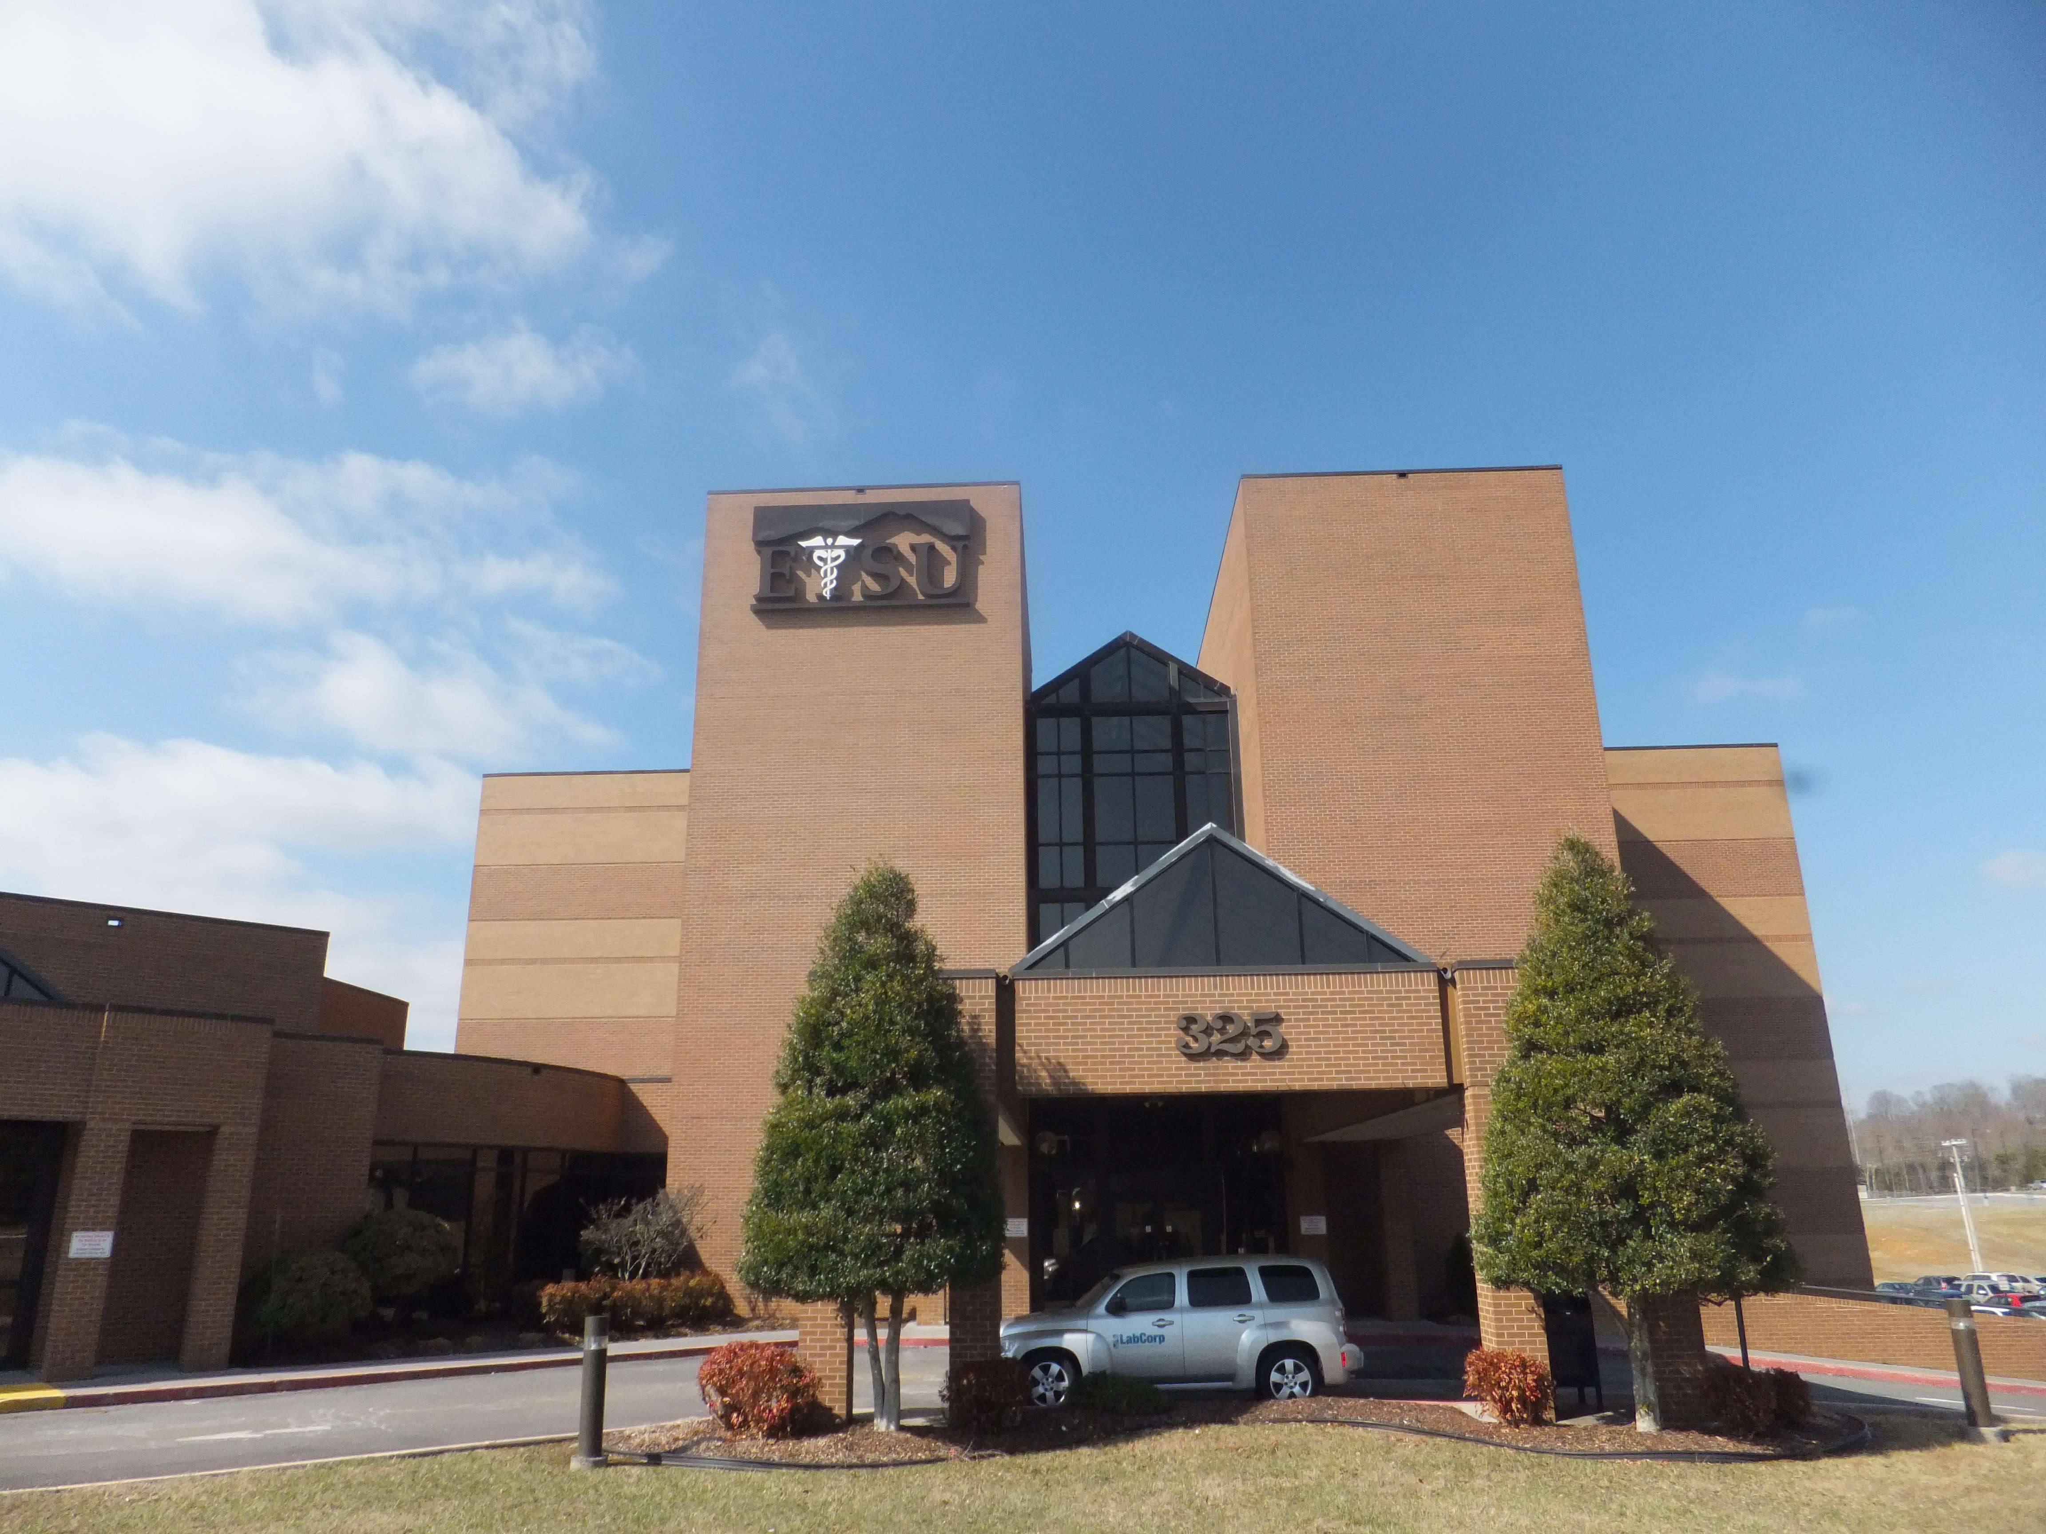
Methods: Participants
Recruitment
4 and 5 year olds were screened at each visit
Referral to BHC for FCU was made by pediatrician or behavioral health consultant based on…
Elevated PSC 17 score and clinical judgment
Notes:
Predominately Medicaid (~70%); serve birth to 12 years of age
East Tennessee State University (ETSU) Pediatrics
10 Attending Faculty
15 Medical Residents
3 Clinical Psychology Graduate Students (externs)
Existing integrated care services include mental and behavioral health and social work services.
Implementation Research Meetings
2 meetings in the Fall (2014)
Experiencing low enrollment
Expanded to acute visits → resulted in higher number of recruits
Diligence on part of BHC

Slide 16
Results: Adoption and Reach
ADOPTION – Electronic Health Record
PSC 17
Visits Attended | 143
PSC -17 noted in chart | 92
Adoption rate of PSC-17 | 64.3%
FCU
Score > 15 | 8
FCU Referral | 9
Adoption Rate of FCU Referral | > 100%
REACH – Electronic Health Record
FCU
Patients referred to the FCU | 9
Patients attending the FCU | 6
Reach of the FCU | 66.6%
Notes:
Family Check-Up Data March 31st
N=143
Well-child=97
Acute=46
Reach of the FCU: What percent of total referred patients to the FCU attend the FCU?
6 out of 9 patients have attended at least 1 session of the FCU (66.6%)
Adoption of the FCU: What percentage of those who screen at risk (PSC-17 score of ≥15) receive their provider’s recommendation to attend the FCU?
7 out of 8 patients who scored ≥15 on the PSC-17 were referred to the FCU by their provider (87.5%)
9 patients total were referred to the FCU by their provider, 7 had scores ≥15 and 2 had scores <15.
Adoption of the PSC-17 Screener:
Out of 143 total 4 and 5 year olds seen January 19th-March 31st 92 received the PSC-17 and 51 did not (64.3% vs. 35.7%)
Out of the 97 well-child checks, 78 received the PSC-17 and 19 did not (80.4% vs. 19.6%)
Out of the 46 acute visits, 14 received the PSC-17 and 32 did not (30.4% vs. 69.6%)
Study results indicate that there is a high rate of adoption of the PSC-17 screener at the well-child checks at ETSU Pediatrics but also indicate a need to increase adoption rates at acute visits

Slide 17
Conclusions
Integrated delivery model is foundational
Limitations
Clinic operations and ingrained practice behavior can make change difficult
Limited conclusions can be made at this time; however…
Adoption
64.3% screener adoption; 100% FCU referral adoption
Reach
Higher than school – 66.6% versus 25%
Current and future directions…
Reach and Adoption
Collect further data; compare to previous year
Effectiveness
FCU baseline and follow up data
Implementation
Maintenance

