Slide 1





Tackling Lead Poisoning: Community Intervention of the Montevideo PEHSU
Dr. María José Moll, MD, MSc (Nutrition)
PEHSU
Toxicology Departament – School of Medicine
Clinical Hospital
Montevideo - Uruguay

Slide 2
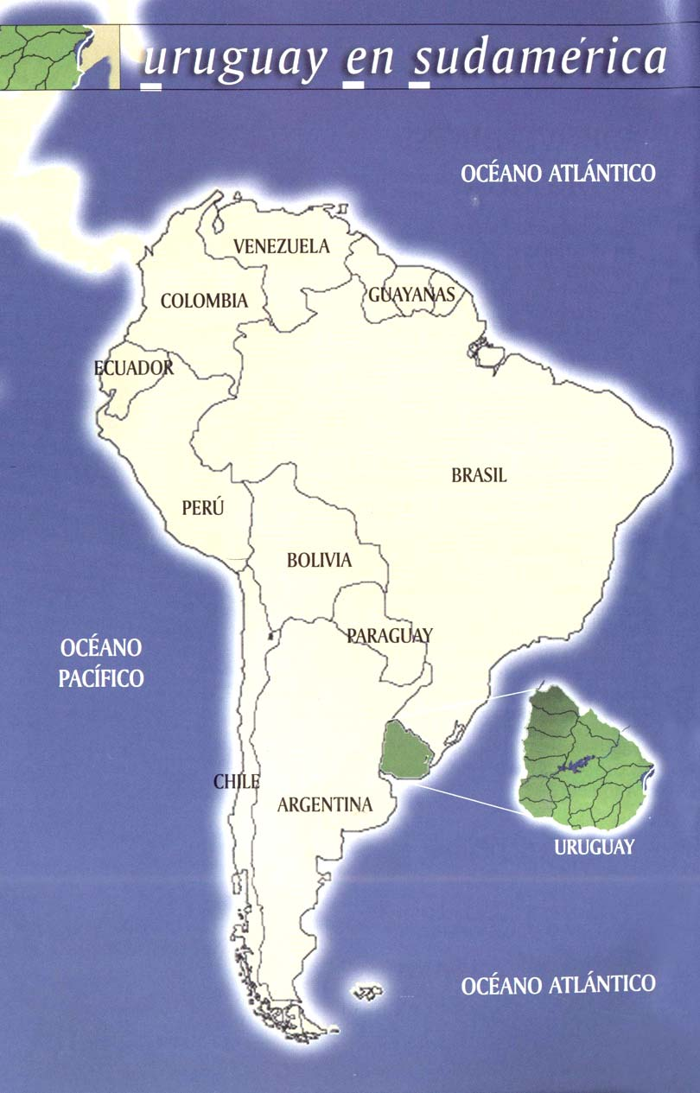
Uruguay
South America -110 sq. mi.
3.3 million inhabitants
Montevideo is the capital city with1.5 million inhab.
Main economic sectors are agriculture and tourism
80’s, 90’s many industries were closed or abandoned
Abandoned metal smelters and foundries create empty areas with high levels of metal contamination

Slide 3
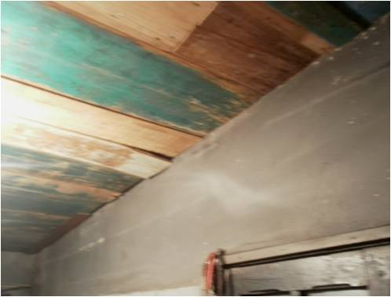
Why is it important to have lead present as an environmental determinant of health?
  Sources of contamination are not always visible
Chronic exposure with long-term sub-clinical manifestations
Persistent bone accumulation
Irreversibility of effects
Lead in blood means recent exposure
No safe threshold
Limited clinical benefit with chelation

Slide 4
Lead Background in Uruguay
Lead associated with smelting/foundries
“La Teja” Neighborhood
Environmental Research, 1997. Blood Lead in Uruguayan Children and Possible Sources of Exposure
A. Schützª, L. Barregård^{b}, G. Sällsten^{b}, J.Wilske^{c}, N. Manay^{d}, L. Pereira^{d}, Z.A. Cousillas
2001 Index case
Community mobilization
4,409 positive BLL results (children and adults)
  • 42% < 10 µg/dl.
  • 38% 10 - 14 µg/dl.
  • 14% 15 - 19 µg/dl.
  • 6% 20 - 44 µg/dl.
  7 cases > 45 µg/dl.

Slide 5
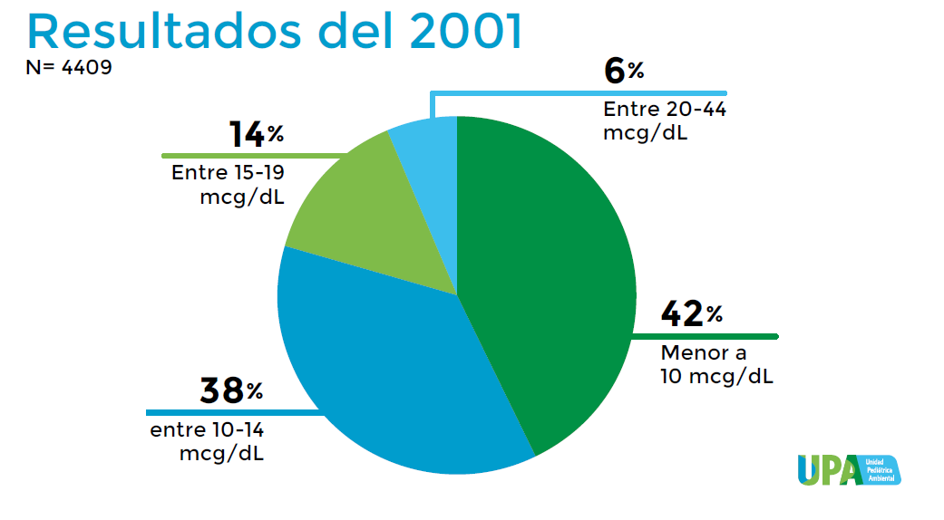
Lead Study in Uruguay in 2001
¿Qué se ha hecho?

Slide 6
The last 10 years
Legislation
  Unleaded gasoline
  Battery recycling law
  Unleaded paint law
Monitoring cases
Remediation and relocation
Lead exposure in children’s health programs

Slide 7
The National Children’s Health Program
Accident prevention at home (poisoning, falls, trauma, animal bites, other)
Environmental contaminant surveillance
Passive tobacco control
Environmental local and regional pollution (lead, agricultural toxic products)

Slide 8
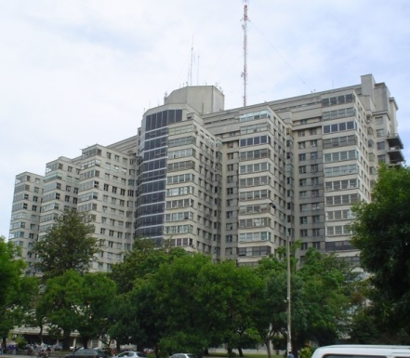
The Department of Toxicology of the University of Uruguay
Drug Control Unit
Toxicology and Occupational Environmental Unit
Toxicological Assessment and Information Center (CIAT)
1976
PEHSU
2010
Toxicology Clinic (CHPR)
2013
WHO-PAHO Collaborating Center – Environmental Human Toxicology

Slide 9

Environmental Risk Management
Primary Care Level actions
Speciality consultations
National Reference Center for the
Primary Health Care Network

Slide 10

Tools
  Environmental clinical history (WHO Green Page, Feedback report)
  Home visits (and surroundings)
    Reports
  Short questionnaire for environmental risks (Inner city)

Slide 11
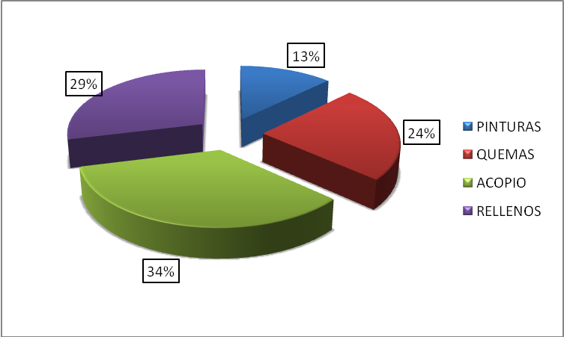
Sources of Lead Poisoning Cases
2010-2014
Paints
Burn
Collection
Land fills

Slide 12
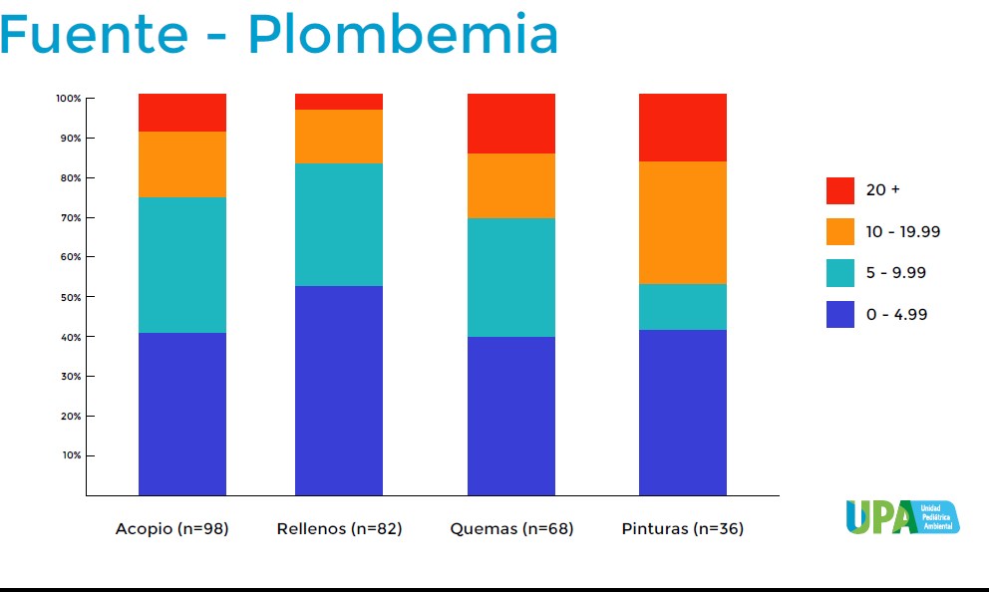
Sources of Lead Poisoning Cases
2010-2014
Collections
Landfills
Burns
Paints

Slide 13
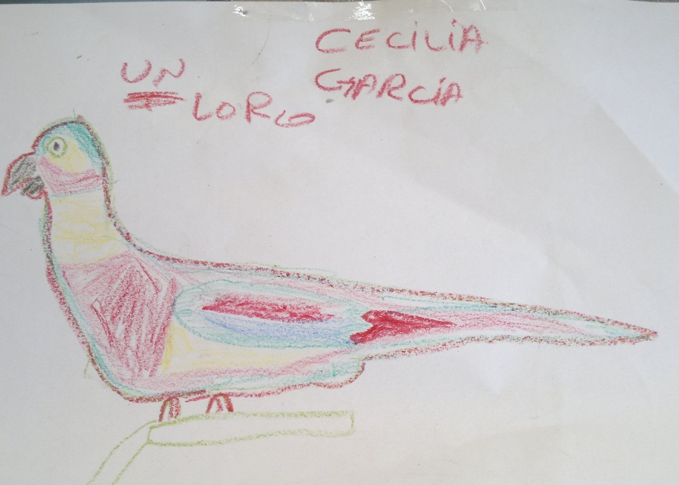
Ministry of Health Norm of 2009:
Intervention Level 5 µg/dl
Summary
52% values of BLL > 20 µg/dl in children less than 3 years old

Slide 14
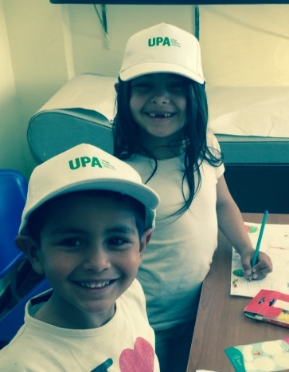
PEHSU Interventions
  Family Education about Lead Risk Exposure
  Preventative Advise:
  Frequent hand and toy washing
  Exposure source removal (children)
  Scrap and wire burning residue management
  Family Evaluation (BLL)
  Request of Background Environmental Studies
  Coordination of Environmental evaluation (soil lead removal)

Slide 15
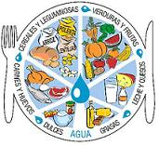
PEHSU Interventions (continued)
  Protocol follow-up (Ministry of
  Public Health)
    Pediatric Clinical Intervention
    Consultation with other specialists (neuro pediatrician, psychologists and others).
    Nutritional intervention
    Supplementation with Iron, Vit. C,
    Calcium, Zinc, and fat reduction.
Chelation only when necessary
(> 45 µg/dl)

Slide 16
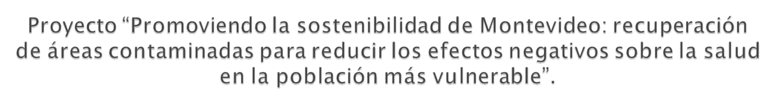

Social Interventions
Institutional intervention
  Non Governmental Organizations - Gurises Unidos
  Social Workers (3)
Family advised to relocate children from lead source

Slide 17
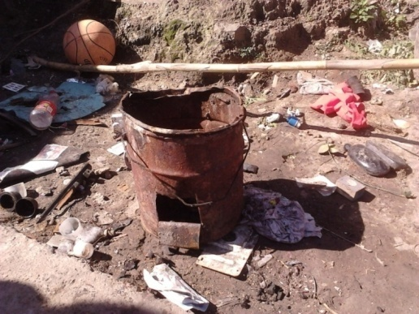
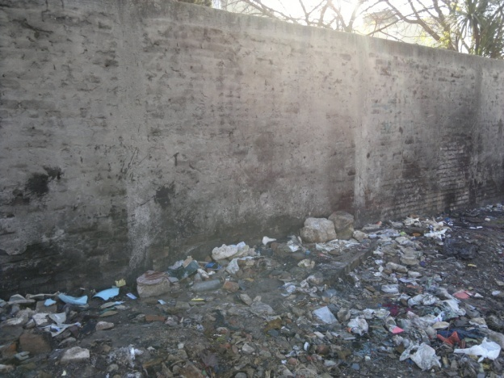
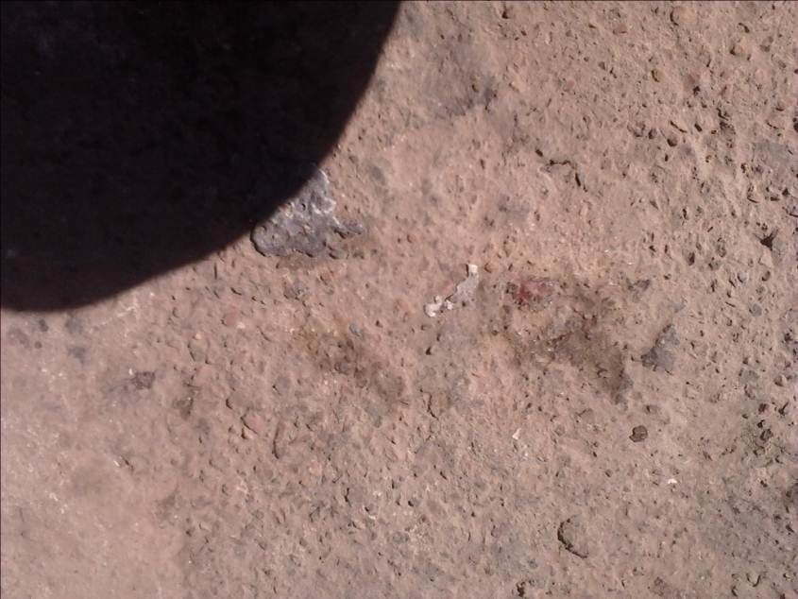
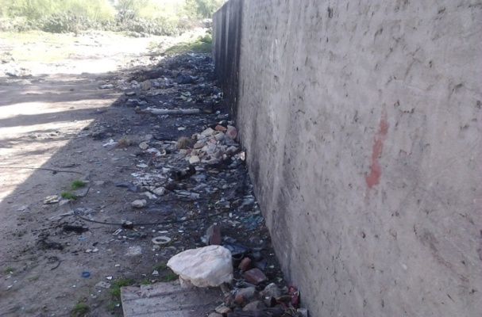
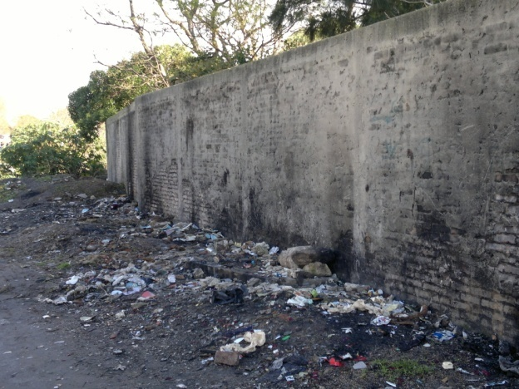
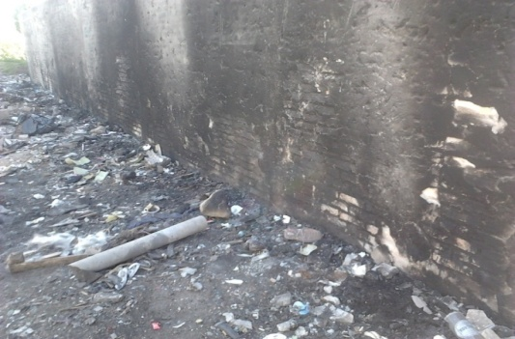
Site identification of lead collection
and metal smelting

Slide 18
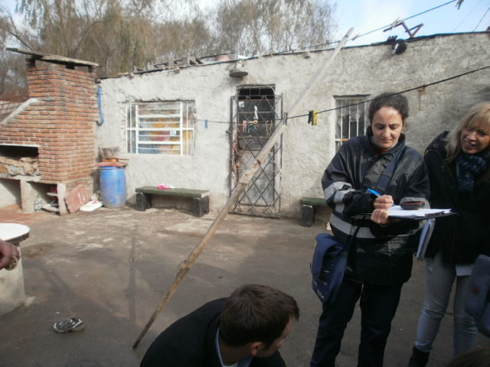
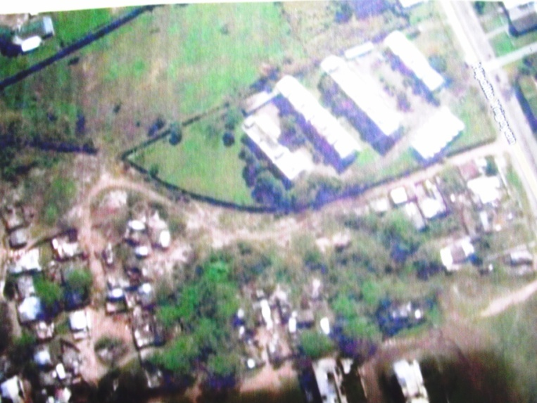
Example: 1st. Home Visit

Slide 19
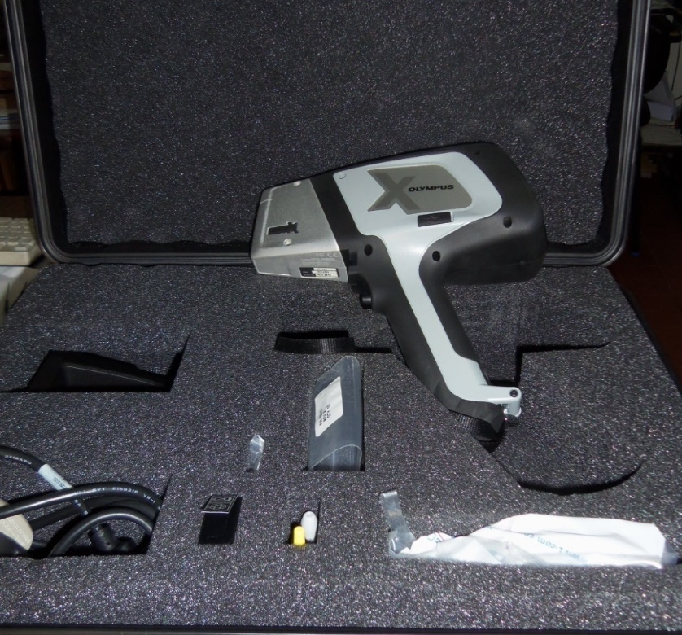
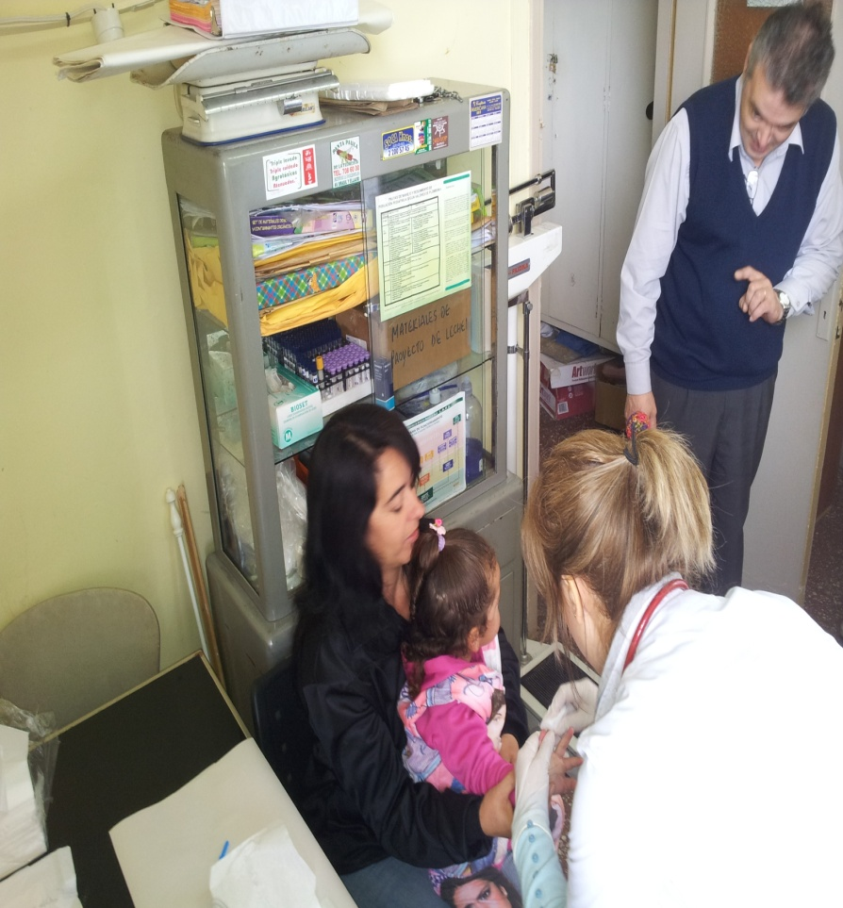
Assessment of soil and blood lead levels in exposed areas
FRx portable soil lead measuring equipment Olympus InnovX Delta
Lead Care II / BLL with finger prick

Slide 20
Family Management of BLL
PACIENT | BLL Follow up (µg %) 9/ 2011 1/ 2012 4/2012 7/2012
11a | 13,2 | 17,7 | 11,7 |  | 10,5
8a | 12,9 | 17,3 | 14,8 |  | 14,0
6a | 13,0 | 19,7 | 22,7 |  | 17,7
4a | 20,5 | 18,5 | 19,8 |  | 20,3
3a | 13,4 | 28,4 | 10,2 |  | 27,2
19m | 20,3 | 38,8 | 36,0 |  | 26,8
28a | 7,4 | 14,5 | 11,5 | 3,5
1m | Umbilical cord blood could not be obtained Maternal blood sample |  |  | 3,5
Plombemia, según Protocolo de manejo de seguimiento de población pediátrica contaminada con Plomo del Ministerio de Salud Pública
Ordenanza nº 123 del año 2009.

Slide 21
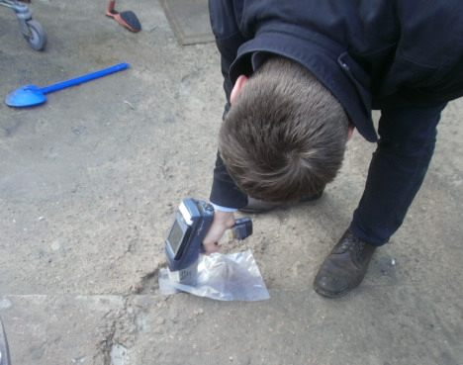
Family Interventions
New request for temorary housing
Attendance to kindergarten
Request for temprary housing
Cementing of patio and home lead removal
50
Stop exposures risk activities
40
30
20
BLL µg/dl
10
Lead in soil 3,200 mg/K
0
set/11
abr-12
set/12
ene-13
abr-13
may-13
1st. Home visit
Lead in soil 750mg/K
2nd. visit
Date
Notes:
Si movi las flechas por favor fijate que esten bien con las fechas
Saco verano por que estan los meses y te vas a acordar de comentarlo , asi la grafica esta menos pesada
En ves de medicion en suelo, mejor pongamos el valor ( el informe de Hugo esta en la UPA) no lo tengo electronico

Slide 22
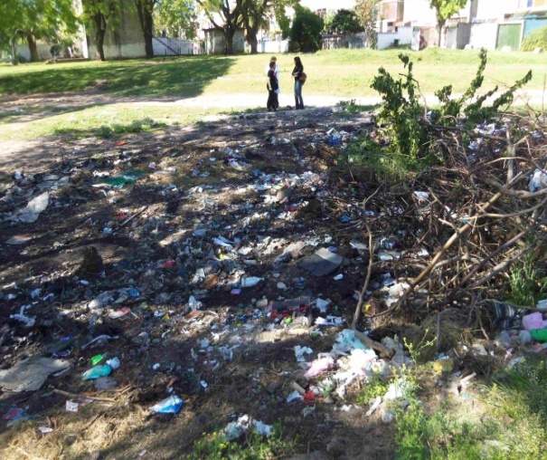
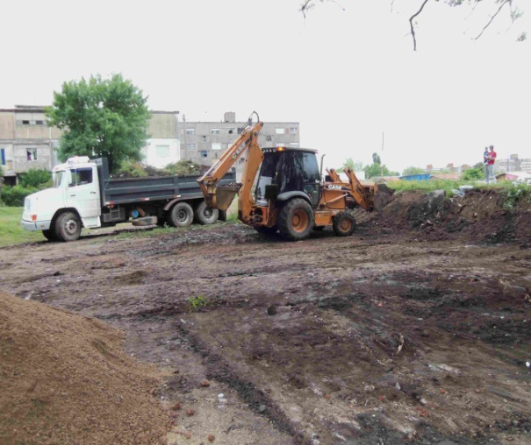
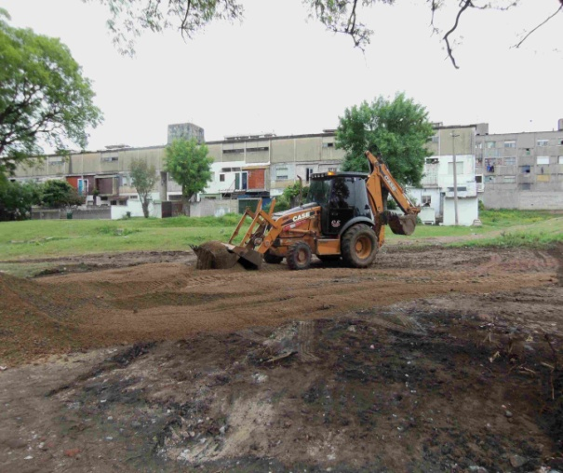
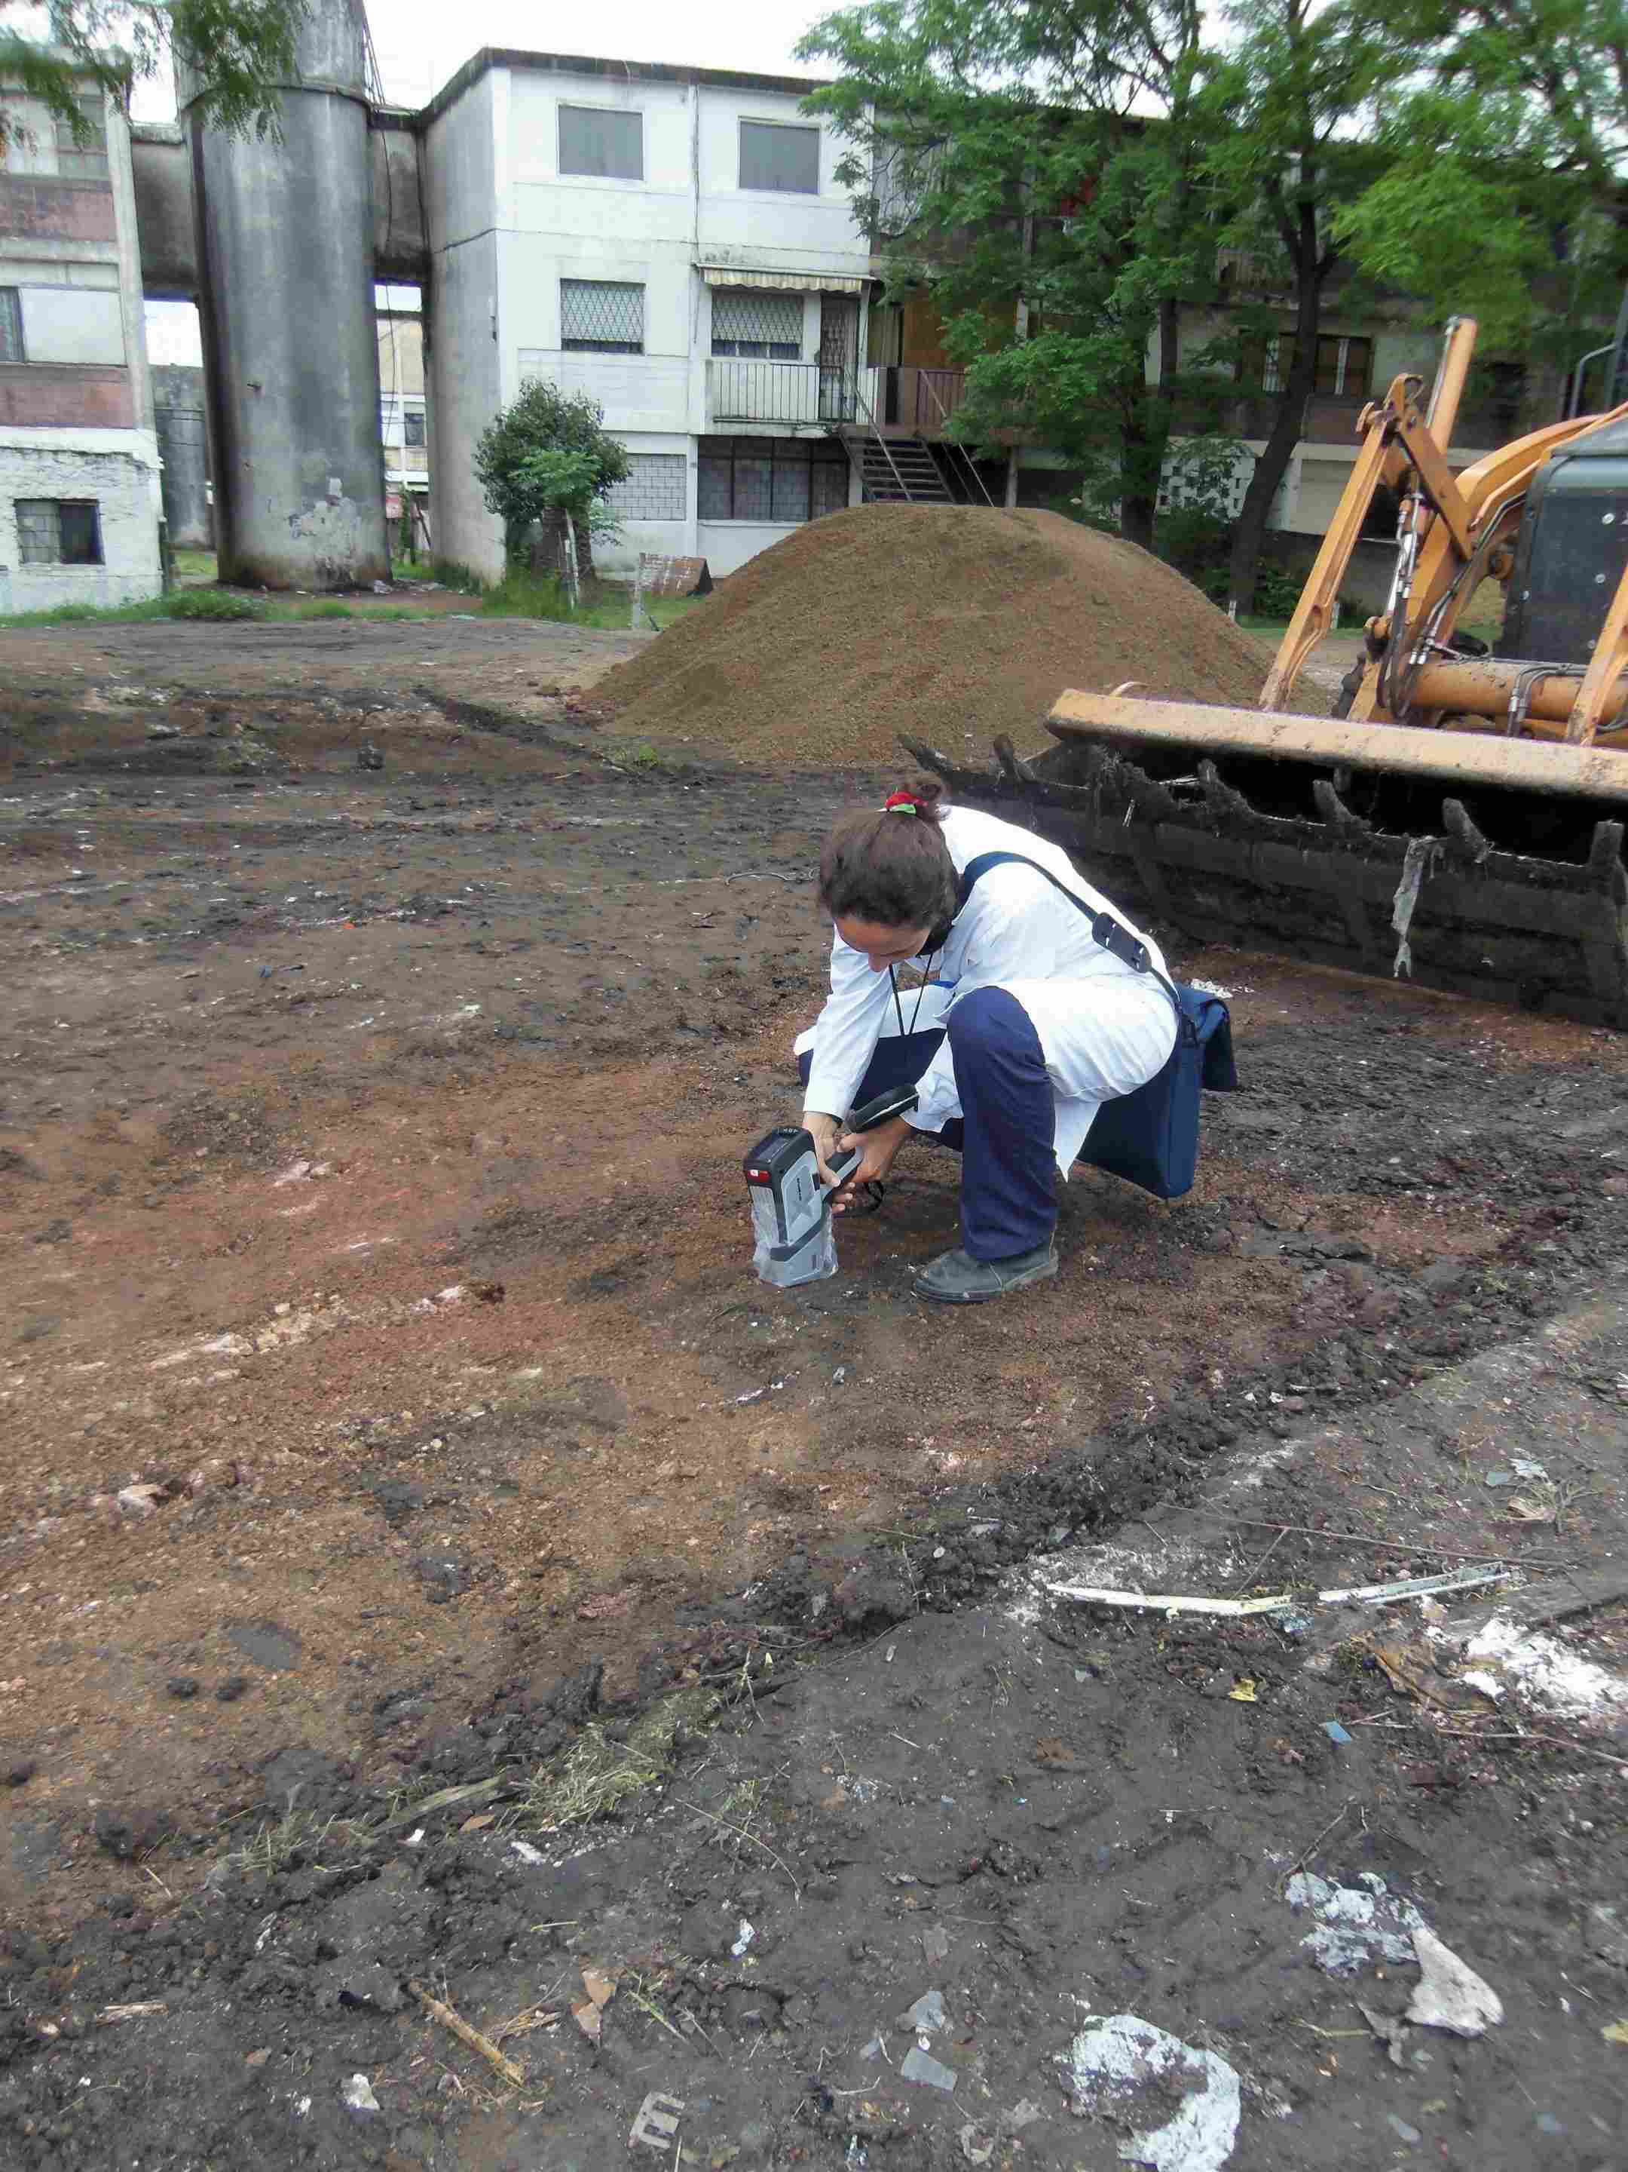
Clean up and remediation of hotspots associated with residue burning (wire and electronics)

Slide 23
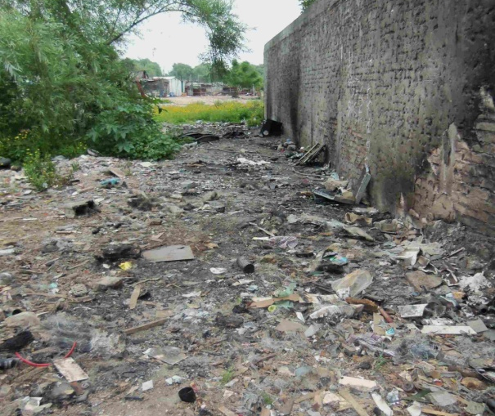
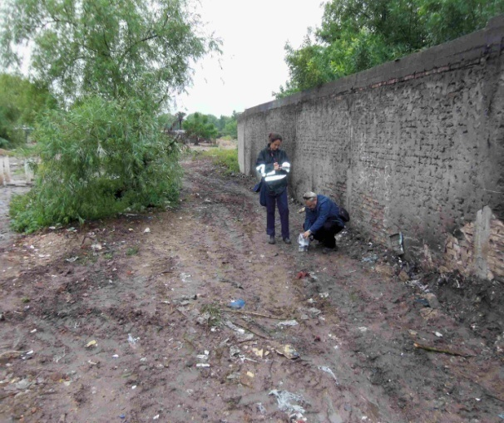
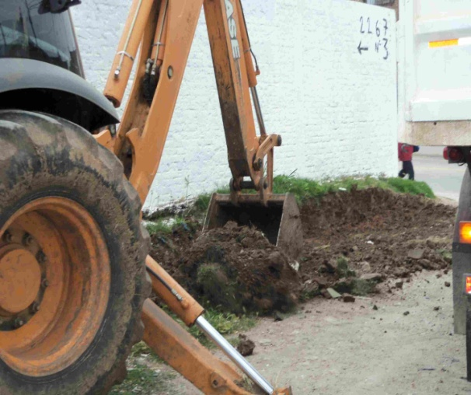
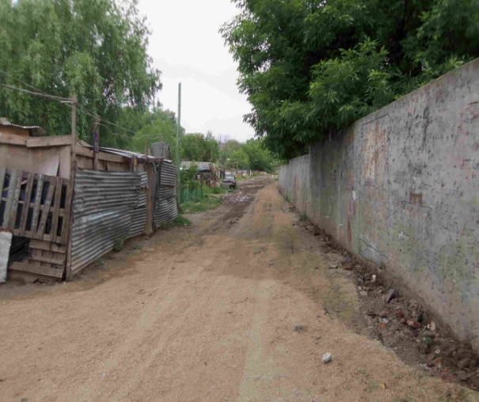
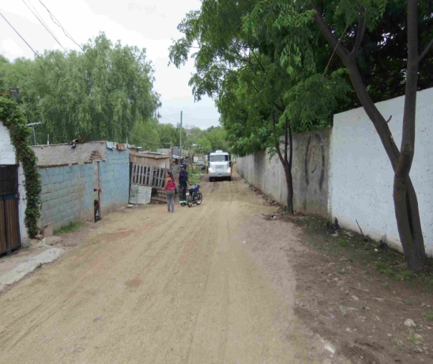
Before and After

Slide 24
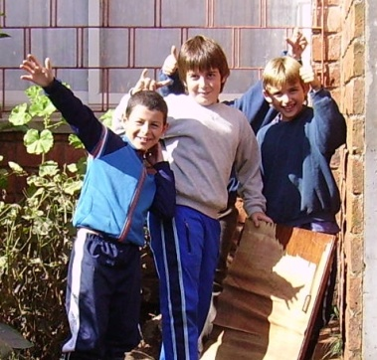
Key Points
Health Promotion
Inform and educate about
Sources of lead contamination and its controls
Hygienic and nutritional healthy habits
Communicating lead exposure risks and health effects to scientific community
Early primary care approach
Notes:
24

Slide 25
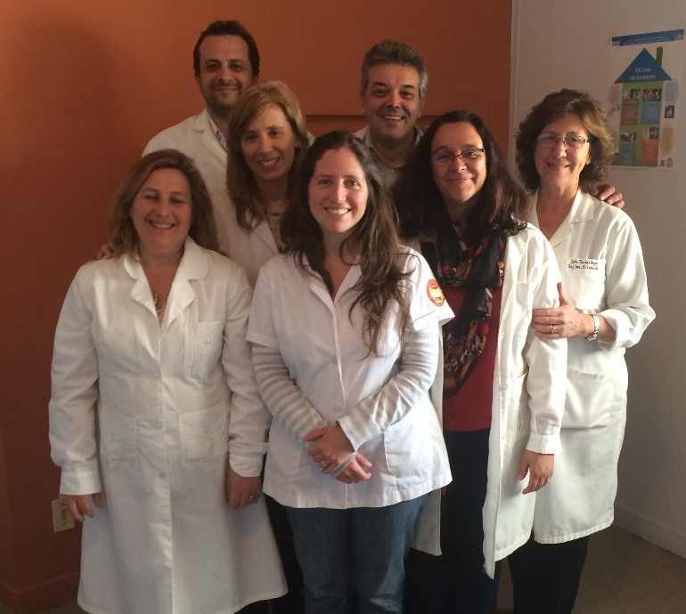
Thank you
Centro de Salud “Dr Enrique Claveaux “ Pampillo y Novas 3161 esq. Cufré .Sala 2
Tel. 598 2203 - 8679
SMS. 59899251641
Fax 598 2 24870300
Urgencias ( CIAT )- 1722
www.ciat.hc.edu.uy/upa

