Slide 1
Improving Environmental Exposure and Health Outreach to Children in Puerto Rico: A Geographic Information Systems Approach
9th Annual Break The Cycle Conference
Emory University
April 7th, 2014
Lauren Ritter, MPH Candidate
Columbia University Mailman
School of Public Health
Mentor: Damiris Perez Agu, MPA
Northeast PEHSU
Icahn School of Medicine at Mount Sinai

Slide 2
Northeast PEHSU Outreach
Provides information on environmental toxins and their effect on children
Helps with health-related decision making and recommendations for interventions
Trains health professionals
Conducts events that focus on recognizing, treating, and preventing environmental exposures to children
www.pehsu.net
Notes:
References: www.PEHSU.net

Slide 3
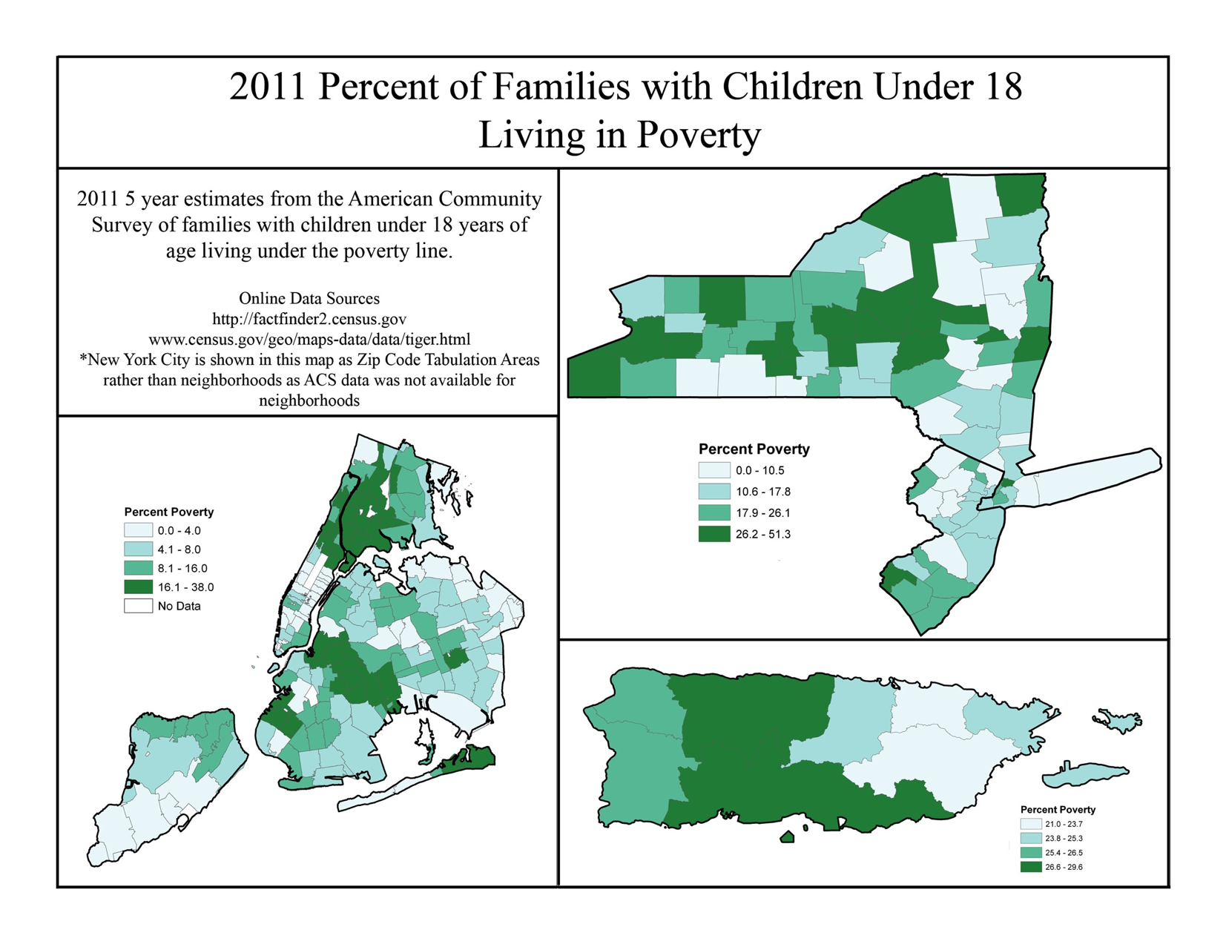
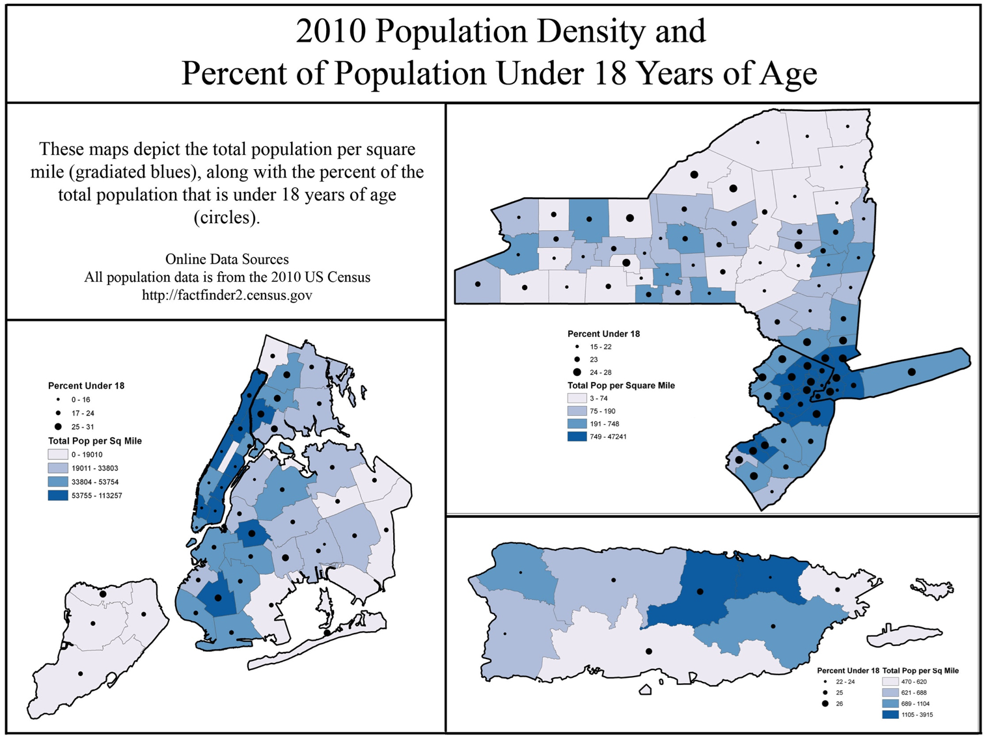
Northeast PEHSU: Demographics and Disparities
Notes:
Describe the captions for each image

Slide 4
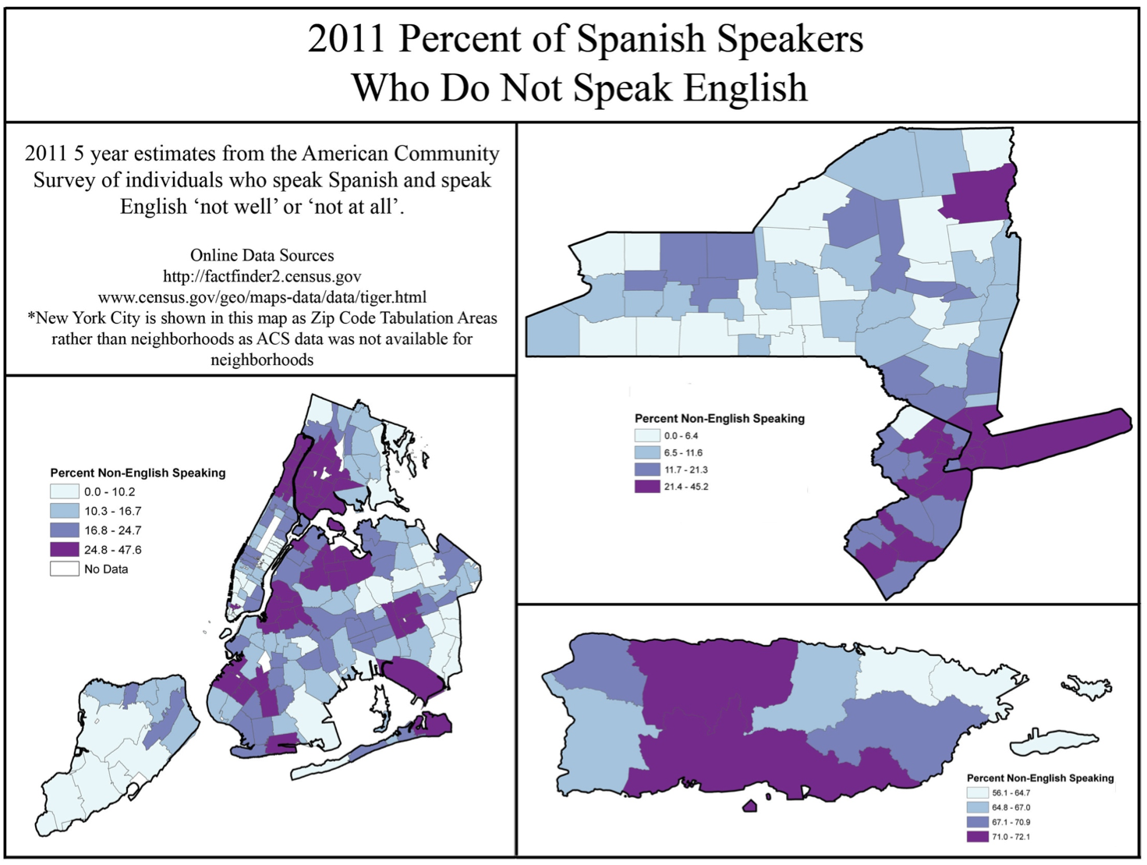

Slide 5
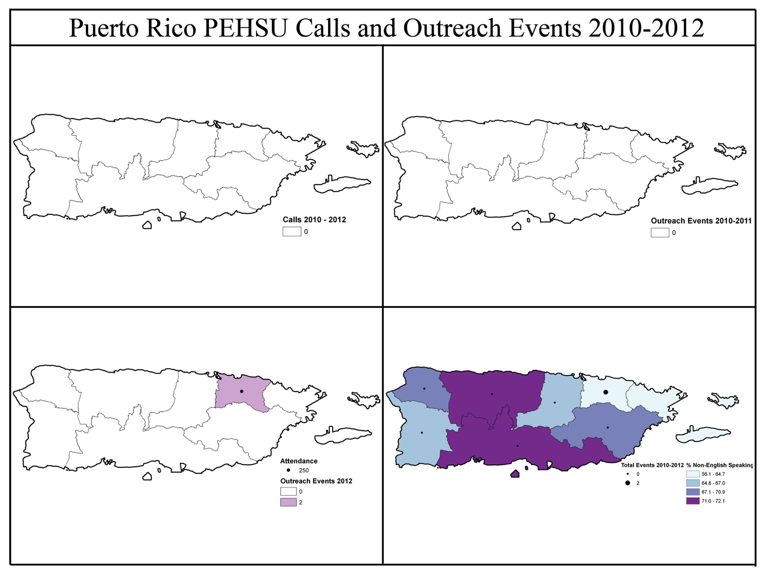
Why Puerto Rico?
Services are almost exclusively to persons with a high level of English proficiency
Outreach activities are critical to enhancing awareness of families, clinicians, and other health professionals
Figure 5. This map was created using PEHSU call databases and outreach events that included spatial data such as county and zip code. Only those calls with spatial data are represented. All outreach events are accounted for.
Notes:
Limited English proficiency contributes to multiple health disparities among both children and adults (Flores et al 2005; Wisnivesky et al. 2009)
References: Perez Agu, D., and Jankowska, M. (2012) “Region II Map Atlas.”

Slide 6
Methods
Surveys in English and Spanish were administered through an anonymous online platform (SurveyMonkey)
Distributed by email to 50 pediatric environmental health professionals throughout Puerto Rico
Goals of survey:
Determine environmental exposures of greatest concern and needed interventions
Collect opinions on current GIS usage and utility in health outreach initiatives
Using responses, PEHSU Region II Map Atlas, and ArcGIS 10.1, we mapped environmental exposures of concern in Puerto Rico, asthma prevalence, and current PEHSU outreach

Slide 7
Survey Results
What environmental exposures are of greatest concern?
Water contamination (25%)
Pesticides (18%)
Air pollution (18%)
Land waste (12.5%)
What interventions are needed to reduce exposures?
Parental and clinician education (53%)
Regulation and enforcement (20%)
Research to understand health risks (13%)
Figure 6. Depicts the categories of professions among survey participants working in the field of pediatric environmental health in Puerto Rico. Response rate was 30%.
Notes:
First graph and 2 questions on one slide

Slide 8
Survey Results
What are organizations currently using GIS for?
Mapping demographic data and spatial analysis (26.7%)
Risk assessment (20%)
Determining location of at-risk populations (13.3%)
Environmental investigations and management (13.3%)
How can GIS benefit professionals working in academia, clinical practice, and governmental organizations?
Spatial analysis, especially in identifying high levels of exposures and toxicants (26.7%)
Education of clinicians, policy makers, and community members on at-risk areas (20%)
Improve understanding of particular exposures under study (13.3%)
Improve the perception of environmental risk (13.3%)

Slide 9
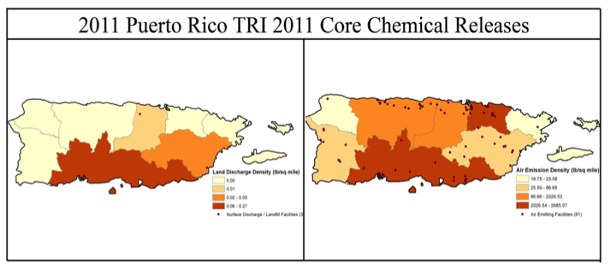
Puerto Rico Land Discharge and Air Emission Density
Figure 8. This map depicts data for 2011 Land Discharge Density and Air Emission Density using the EPA’s 2011 Core Chemical Release inventory, which includes almost 600 chemicals.

Slide 10
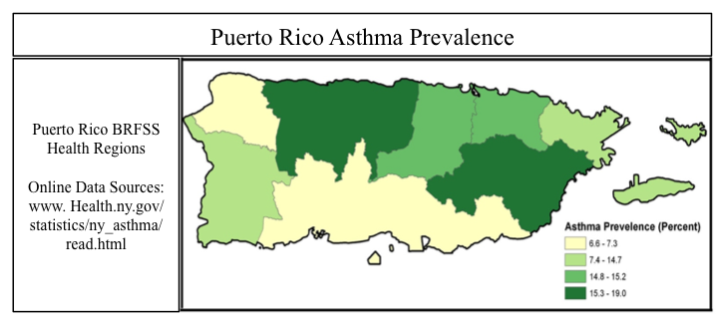
Puerto Rico Asthma Prevalence
Figure 9. Puerto Rico asthma data represented by prevalence of asthma in children under 18 in 2007 according to the Puerto Rico Behavioral Risk Factor Surveillance Survey.

Slide 11
Study Implications
Assist us in working with governmental and community organizations
Develop a protocol for reducing environmental exposures to children in Puerto Rico
Potential to impact PEHSU’s outreach strategies and policies

Slide 12
Breaking the Cycle
Acknowledgement of the need for outreach services and events to predominately non-English speaking communities may increase the currently limited services to these populations
Compound Risk Factors
Limited educational
services
Discrimination due to
minority status
Language barriers
Environmental Risk Factors
Environmental hazards
Location of Inhabitance
Dump sites
Environmental Characteristics
Water contamination
Pesticides
Air pollution
Land waste
Health Risk Factors
Toxicant Exposure
Notes:
Cycle of Environmental Health Disparities – adapted from Emory University

Slide 13
Where Do We Go From Here?
Where does GIS cost-effectively fit into PEHSU’s procedures and policies for outreach?
What other barriers, such as resources, are prohibiting current outreach services in Puerto Rico?
How can we use GIS as a tool to identify potential correlations between environmental toxicant distribution and disease prevalence?

