Slide 1
Factors That Trigger Asthma in African-American Children in Low-Income Communities in Fort Valley, GA
Jasmine Williams
Saul Mofya, DVM
Fort Valley State University
April 24, 2015

Slide 2
Background
Asthma is a leading chronic disease affecting children
6.8million children are affected in the United States
Occurs in 3 out of 5 children and steadily increasing
African-Americans have more severe symptoms
Health Disparities
Poverty, Lack of Education, Obesity, Poor Housing, and Environmental Factors

Slide 3
Research Question
What are the factors that trigger asthma in African-American children in low-income communities in Fort Valley, GA?

Slide 4
Research Objective
To determine what factors trigger asthma.
To break the cycle of health disparities
To come up with guidelines that will help medical and public health professionals.

Slide 5
Methods
Online Data Bases
GDPH North Central Health District Peach County 2013 Health Status Report
The city-data of Fort Valley, GA
NBC news lists worst, best cities for air quality
Face-to-Face Interview
Housing Authority Assistant Director

Slide 6
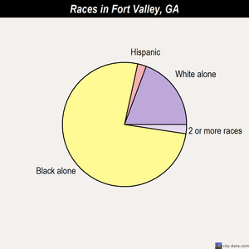
Race Demographics
Black alone - 7,963 (81.1%)

Slide 7
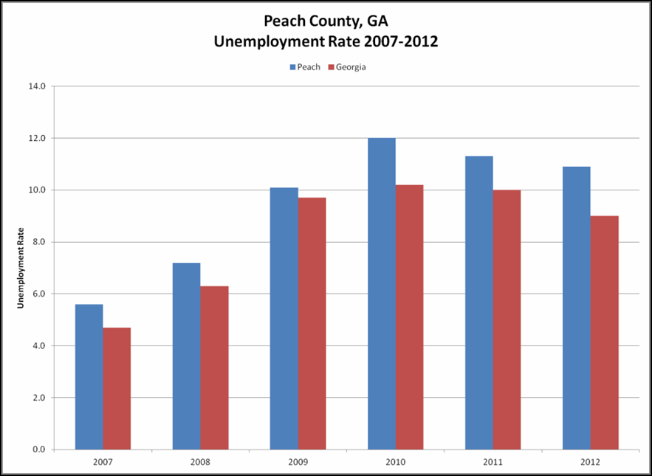
Poverty

Slide 8
Poor Housing
Mold
Cockroaches
Dust Mites
Smoking

Slide 9
Lack of Education
Peach County Education Information, 2010/2011 School Year
% Students Qualifying for Free/Reduced Lunch# | 72.2%
2011 Graduation Rate | 59.9%
% Illiterate* | 21.3%

Slide 10
Obesity
9% of the population are low-income.
50% of the restaurants are fast-food establishments.
There are 4 recreational facilities.
9% of the population lives within half a mile of a park.

Slide 11
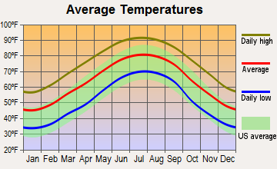
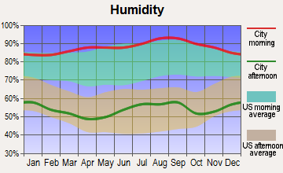
Environmental Factors

Slide 12
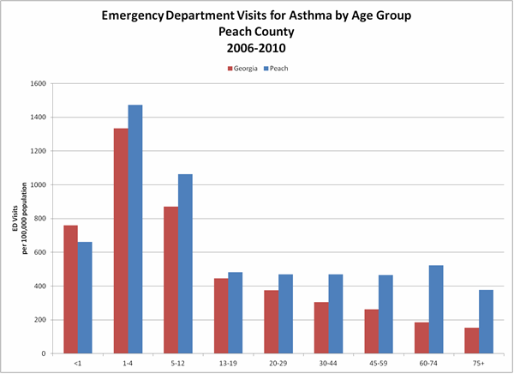
Rate of Asthma

Slide 13
Discussion
Poverty
Obesity
Lack of Education
Environmental Factors

Slide 14
Break the Cycle
Compound Risk Factors
Limited Healthcare Services
Limited Educational Services
Personal Characteristics
Limited Education
Limited Employment Options
Limited Income
Limited Health Literacy
Environmental Risk Factors
Limited Housing Options
Inadequate Infrastructure
Environmental Hazards
Cycle of Environmental Health Disparities
Environmental Characteristics
Homes in Disrepair
Limited Access to Healthcare
Limited Access to Healthy Food
Lack of Green/Recreational Space
Health Characteristics
Asthma &Allergies
Obesity
Health Risk Factors
Limited Health Care Facilities
Poor Nutrition
Inadequate Physical Activity
Toxicant Exposure

Slide 15
Future Outlook
Creating a dialogue/ workshop with community leaders
Creating a dialogue/ workshop with medical and care providers
Public awareness in schools, and communities
Families actively seek services and engage in programs

